Slide 1
X-Band RADAR Core
Anurag Nigam
Phone: 0091 9158580922
0091 9623299070
e-mail: nigam_anurag2011@nattelmicro.com
Design Intermediate Results

Slide 2
RADAR Core Block Diagram
10 dB Gain
25 dB Gain
>40 dBm (>9.5 W)
On/Off
16 dB Gain
On/Off
Psat 10 dBm
Insertion -1.5dB
Off-Chip
10 dB Gain
9 dB Gain
NF<3.4 dB

Slide 3
Coverage Check List
Three SPDT Switches
6- bit Attenuator with 0.5 dB Resolution
0-360° Phase Shifter with Phase Linearizer Digital Control
Three Gain Blocks
Low Noise Amplifier
Power Amplifier
Bias Circuit for Gain Stages with ON/OFF Control

Slide 4
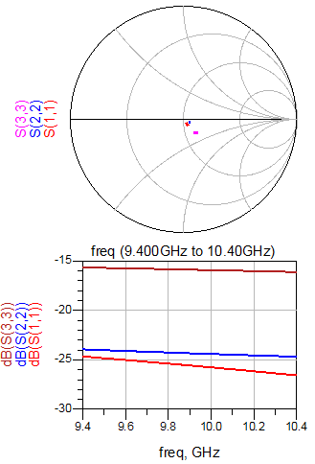
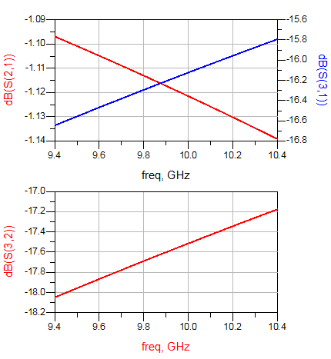
SPDT Switch
Return Losses on Ports
Insertion Loss ON Path
Insertion Loss OFF Path
ON-OFF Port Isolation

Slide 5
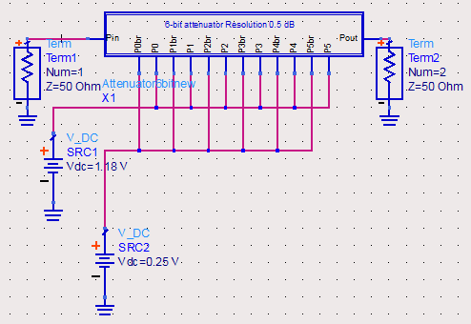
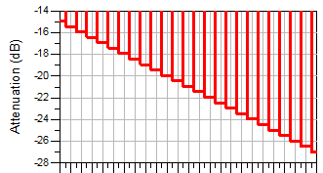
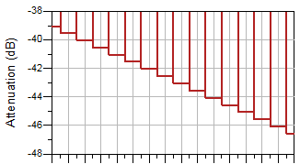
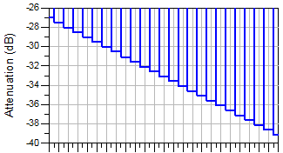
6-bit Attenuator
Binary Word 0 to 24
Binary Word 48 to 63
Binary Word 24 to 48

Slide 6
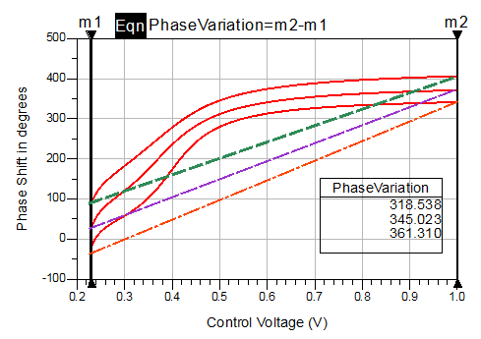
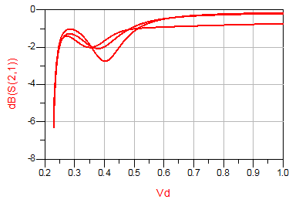
0-360° Phase Shifter
Gain Variation over
Control Voltage
Linearized Phase
Note that there will be three or more look-up tables for Attenuator and Phase Shifter for Linear Gain-Phase response of Phase Shifter and Attenuator. These will be derived in the design phase and will be available for DSP based Synthetic Aperture and Electronic Beam Steering

Slide 7
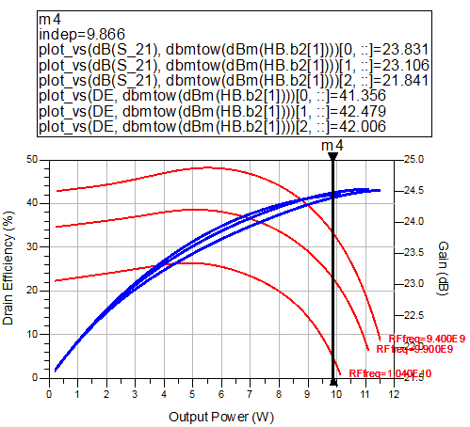
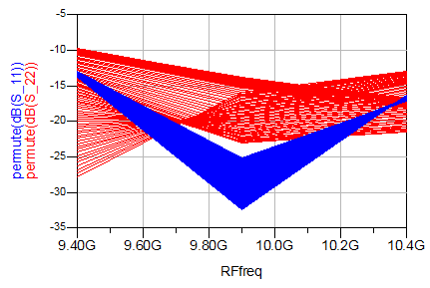
Power Amplifier
Output Power in Watt across band @ -1dB Gain Compression
PA is absolutely stable across all conditions of frequency and power
Drain Efficiency @ -1 dB Gain Compression
Output Return Loss
Gain
Input Return Loss
Drain Efficiency
Input & Output Return Losses across frequency
& across power

Slide 8
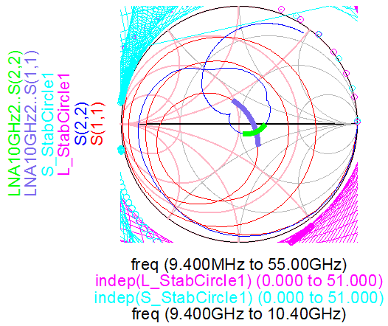
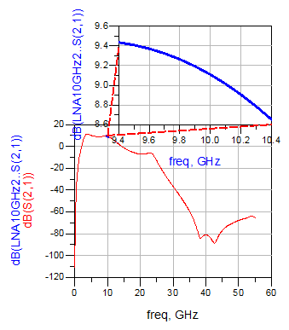
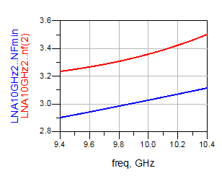
Low Noise Amplifier
We are just demonstrating single stage LNA. Two Stage LNA has 15 dB Gain
& 3.8 dB Noise Figure
In-band Match
Absolutely
Stable LNA
Noise Figure
In & Out
Band Gain

Slide 9
Design Scope
The status of the project is as follows
PNA Cells are designed and Laid Out, Power Dividers and Combiners are in progress
LNA is designed and in being Laid Out
Switches are designed
6-Bit Attenuator Design is Complete and is under Layout
Phase Shifter is designed and Digital Linearizer is under design
Look up tables for Attenuation & Phase Shift Correction are yet to be done
3 Gain Stages designs are in progress
Bias Circuit with ON-OFF Switch is yet to be designed
Power Limiter is yet to be designed- The problem is that this process does not have PIN Diodes
On-Chip Circulator with more than 18 dB Isolation is not possible
Thanks

