Slide 1
Overview of Wi-Fi Radio FEM
Anurag Nigam

Slide 2
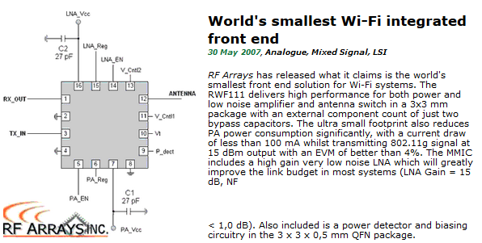
World’s Smallest

Slide 3
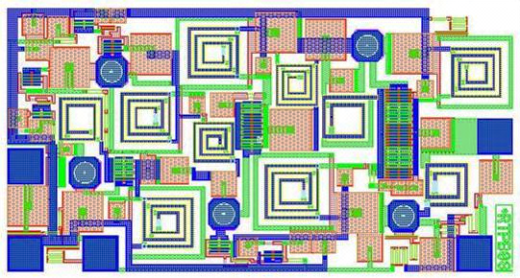
IEEE 802.11b/g PA

Slide 4
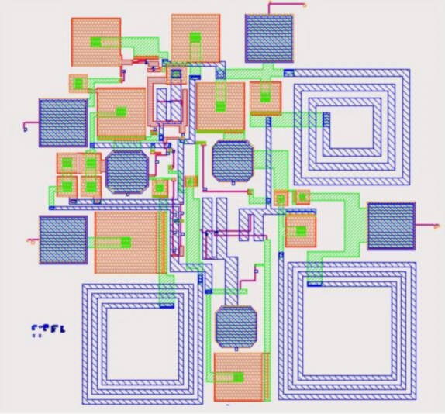
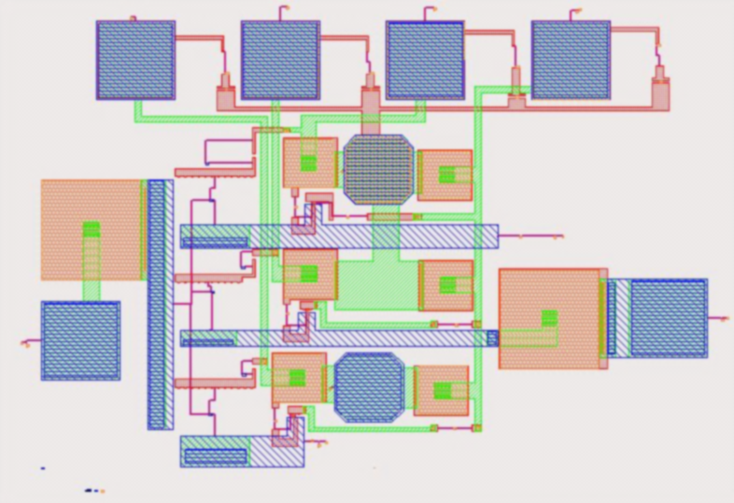
IEEE 802.11b/g LNA & SPDT

Slide 5
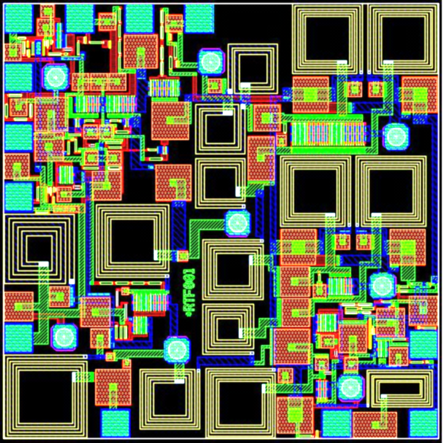
IEEE 802.11b/g RFE

Slide 6
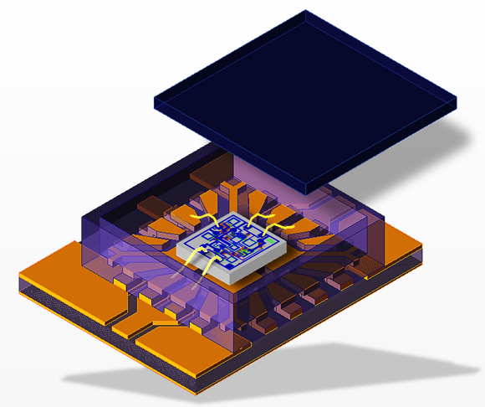
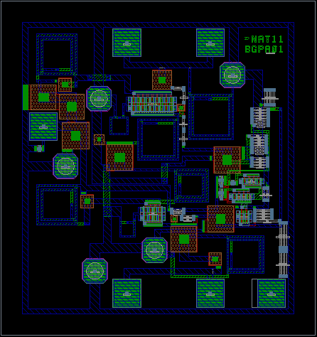
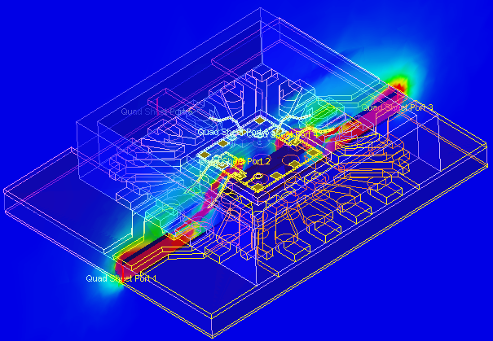
Wi-Fi PA Breakout in QFN Package
Wi-Fi PA with Package

Slide 7
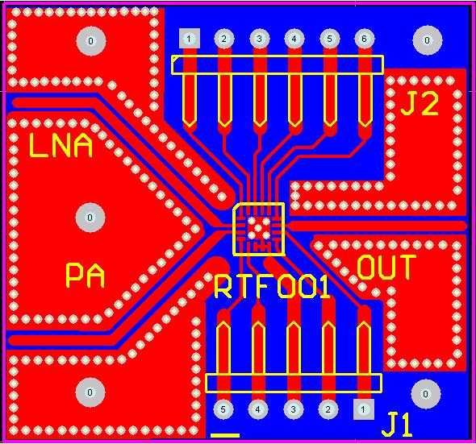
Evaluation Board for Testing

