Slide 1
Project Status Report
Presenter Name Anurag Nigam
Presentation Date October 12, 2012
Notes:
This template can be used as a starter file to give updates for project milestones.
Sections
Right-click on a slide to add sections. Sections can help to organize your slides or facilitate collaboration between multiple authors.
Notes
Use the Notes section for delivery notes or to provide additional details for the audience. View these notes in Presentation View during your presentation.
Keep in mind the font size (important for accessibility, visibility, videotaping, and online production)
Coordinated colors
Pay particular attention to the graphs, charts, and text boxes.
Consider that attendees will print in black and white or grayscale. Run a test print to make sure your colors work when printed in pure black and white and grayscale.
Graphics, tables, and graphs
Keep it simple: If possible, use consistent, non-distracting styles and colors.
Label all graphs and tables.

Slide 2
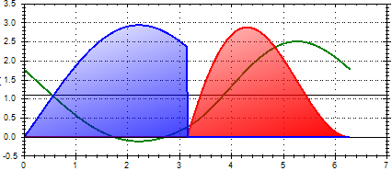
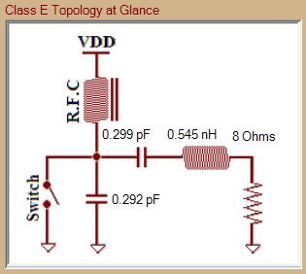
Class E Amplifier Design
Class E Amplifiers – Topology
Goal- Demonstrate a class E amplifier at Microwave frequencies
Class E Design Methodology & Design Algorithm

Slide 3
Current Status
We have designed Class E PA with following specifications
Frequency Band 2.3 to 2.6 GHz, Drain Eff. >95%, Pout 3.2 W to 1 W
Frequency Band 3.1 to 3.4 GHz, Drain Eff. 85% to 92%, Pout 6.8 W to 3.1 W
Frequency Band 9.6 to 10.2 GHz, Drain Eff. >80%, Pout 5.9 W to 3.3 W
Frequency Band 13.6 to 14.2 GHz, Drain Eff. >77%, Pout 7.1 W to 4.8 W
The project is at on hold for implementation due to non-availability of ATC High Frequency Capacitors.
Notes:
* If any of these issues caused a schedule delay or need to be discussed further, include details in next slide.

Slide 4
Issues and Resolutions
Capacitors and inductors for Load Network need to be have low parasitic values- ATC and Capacitors and distributed components can be used
Device mounting should be such that drain lead inductance and capacitance does not change
Notes:
Duplicate this slide as necessary if there is more than one issue.
This and related slides can be moved to the appendix or hidden if necessary.

Slide 5
Class E Operation
Ideal Class E Circuit Topology & Operation

Slide 6
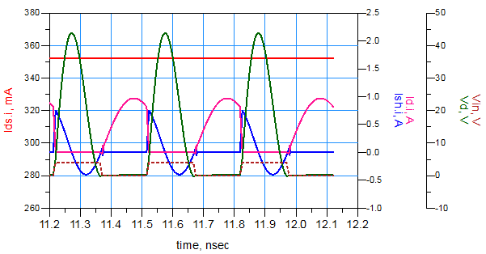
Class E Amplifier Circuit Topology
Vdd
Ids
Cs
Ls
Class E Waveforms simulated in ADS
@ 3.3 GHz
Switch
Csh
Ld
Off
On

Slide 7
Exact Class E Design at any load Q and any switch off duty cycle
Vdd
Vdd
$$A_{1}={ω_{1}}/{ω_{0}}$$
$$A_{2}={ω_{2}}/{ω_{0}}$$
Ids
Ids
Cs
Ls
Cs
Ls
Switch
Csh
Ld
Switch
Csh
Ld
$$ω_{0}$$
$$ω_{0}$$
$$Q={ω_{0}L}/R$$
$$ω_{1}=1/{\sqrt{LC_{S}}}$$
$$C_{equ}={C_{S}C_{Sh}}/{\left(C_{S}{+C}_{Sh}\right)}$$
$$Q_{1}={ω_{1}L}/{R=1/{ω_{1}C_{S}R}}$$
$$ω_{2}=1/{\sqrt{LC_{equ}}}$$
${Q_{1}}/{Q_{2}=}$ ${ω_{1}}/{ω_{2}=}$ ${A_{1}}/{A_{2}=\sqrt{\frac{C_{Sh}}{C_{Sh}+C_{S}}}}$
$$Q_{2}={ω_{2}L}/{R=1/{ω_{2}C_{equ}R}}$$
To solve KCL & KVL for two switch states based on smooth switch-on refer to
Ref:-
“Exact Analysis of Class E Tuned Power Amplifier at any Q and Switch Duty Cycle”, MARIAN K. KAZIMIERCZUK AND KRZYSZTOF PUCZKO, IEEE TRANSACTIONSO N CIRCUITSA ND SYSTEMSV,O L. CAS-34, NO. 2, FEBRUARY1 987

Slide 8
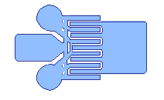
Device for a Switch
Absolute Maximum Ratings
Parameter | Value
Drain Voltage (DC) | 40 V
Gate Voltage Range | -50 to 0 V
Drain-Gate Voltage | 80 V
Drain Current | 1.25 A
Gate Current | 7 mA
Pin (CW) | 31 dBm
Channel Temp. | 200⁰ C
TriQuint TGF2023-01
GaN on SiC HEMT
Key Features
Frequency range DC to 18 GHz
38 dBm Nominal Psat @ 3GHz
66% Maximum PAE
18 dB Gain @ 3GHz
Bias: 28- 32 V, Idq=125 mA, Vg=-3.6V
Technology: 0.25 um Gate Length GaN on SiC
Chip Dim. 0.82 x 0.66 x 10 mm

Slide 9
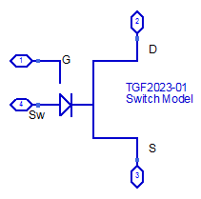
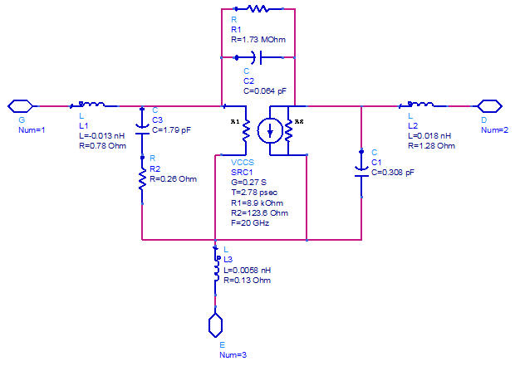
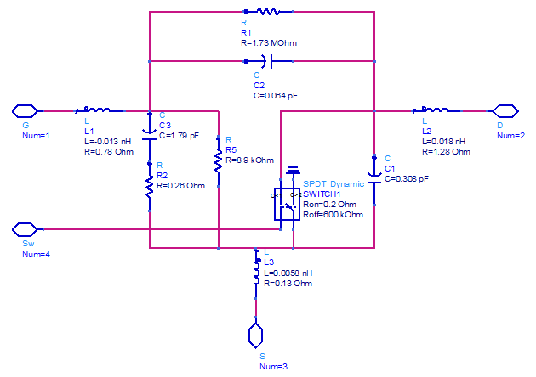
Small Signal & Switching Model
Symbol
Linear Model
Switch Model

Slide 10
NatTel Circuit Designer
RF Circuit Designer developed on .NET Framework

Slide 11
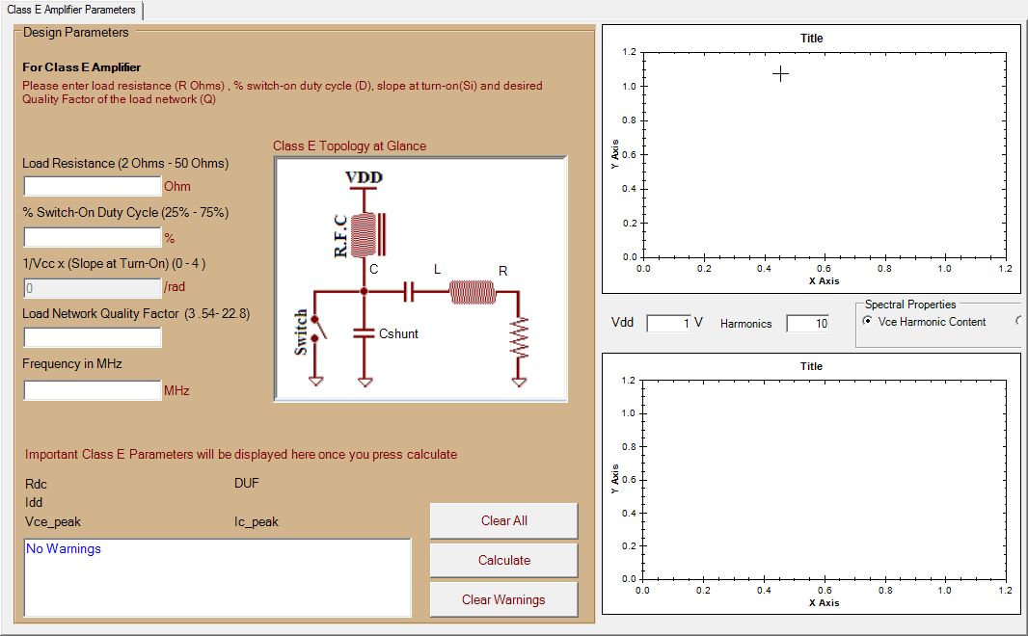
NatTel Circuit Designer
NatTel circuit designer is a software tool used automate circuit design of most of the RF circuits. One of the design module is used to compute Class E Amplifier Load at any Q and Switch Off Duty Cycle.
Computed Class E Load
Display for Class E Voltage & Current Waveforms
Supply
Voltage
Number of harmonics
Class E Design inputs
Display for Drain Voltage
& Power Spectrum
Class E Parameters
Design Warnings
Buttons to control design process

Slide 12
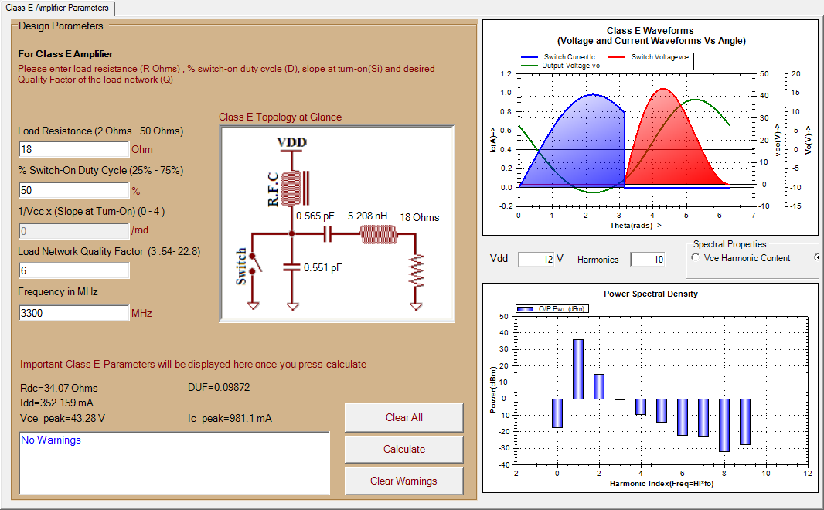
Class E Example @ 3.3 GHz using NatTel Circuit Designer

Slide 13
Class E Design
Ideal & Practical Class E Circuit Design

Slide 14
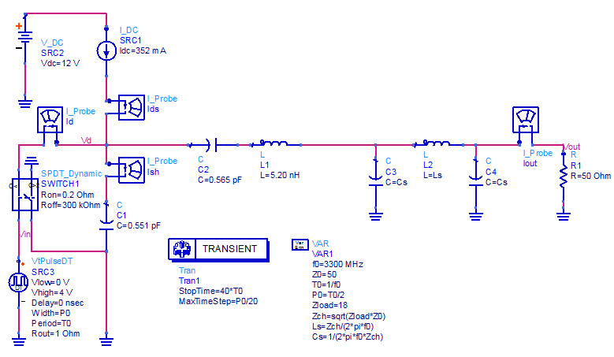
Ideal Class E Design @ 3.3 GHz & Transient Simulations
Transforming 18Ω to 50Ω

Slide 15
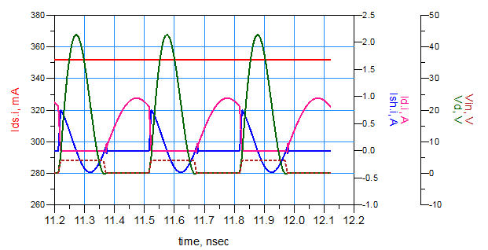
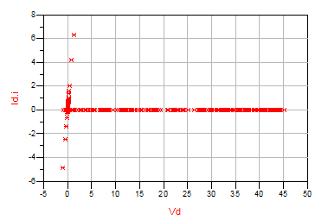
Ideal Class E Performance
Forward Active Region of Device

Slide 16
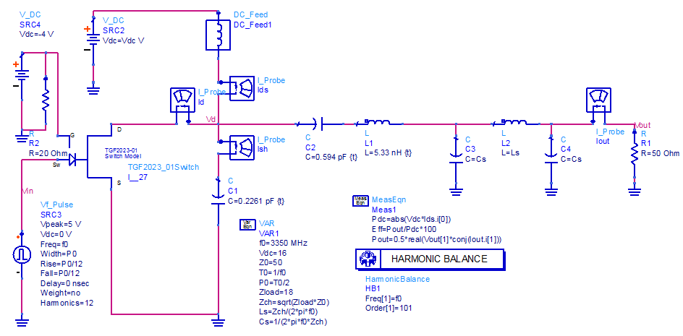
Class E Design @ 3.3 GHz using TGF2023-01
Computed values have been adjusted due to device parasitic.

Slide 17
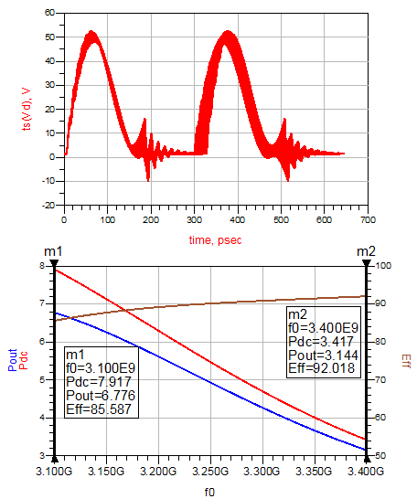
HB Response
The inaccuracies in HB are mainly due to switching transients in the device. If we choose large number of harmonic in HB we can capture these accurately. Transient and HB in ADS may result in awkward results due to limitations of component modeling. The condition under which the circuit gets over damped is Q1<0.5.

Slide 18
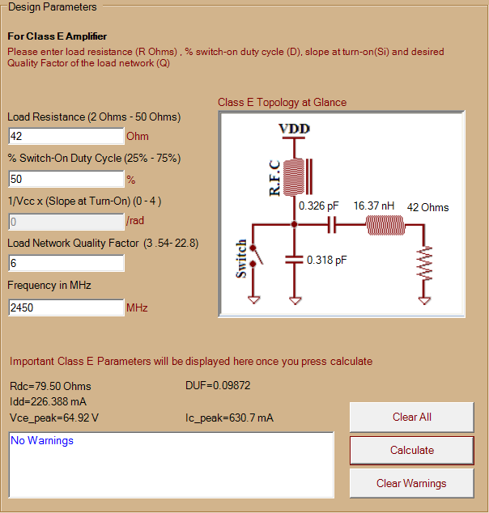
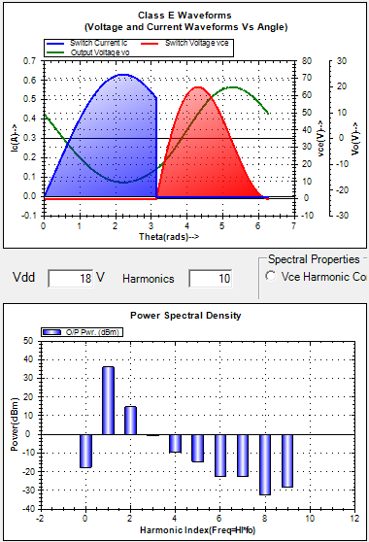
@ 2.45 GHz

Slide 19
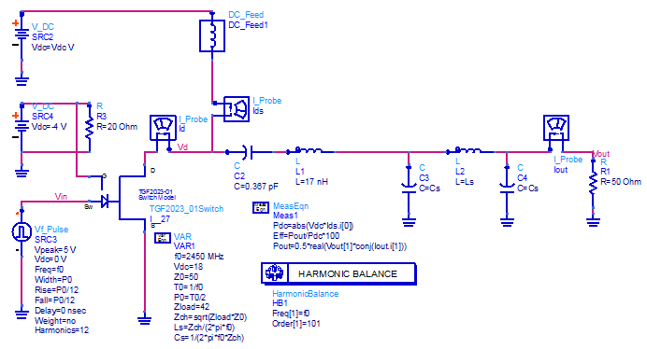
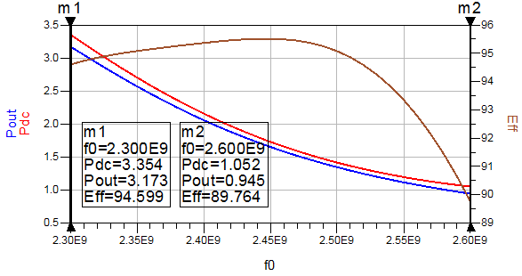
Class E Design @ 2.45 GHz using TGF2023-01

Slide 20
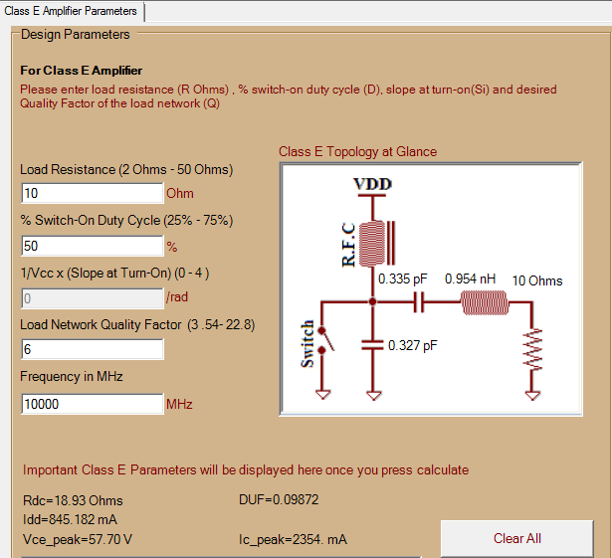
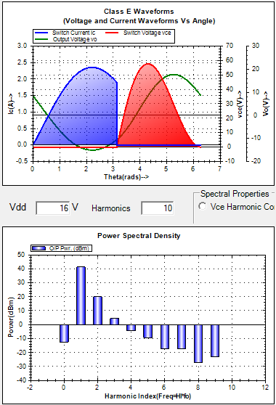
@ 10 GHz

Slide 21
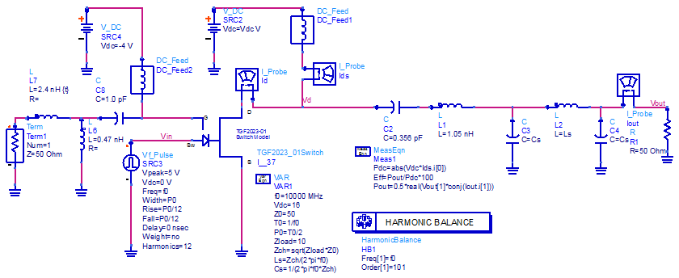
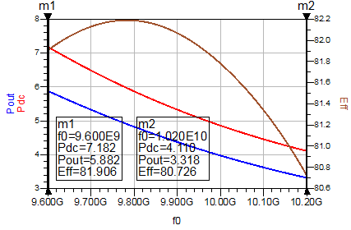
Class E Design @ 10 GHz using TGF2023-01

Slide 22
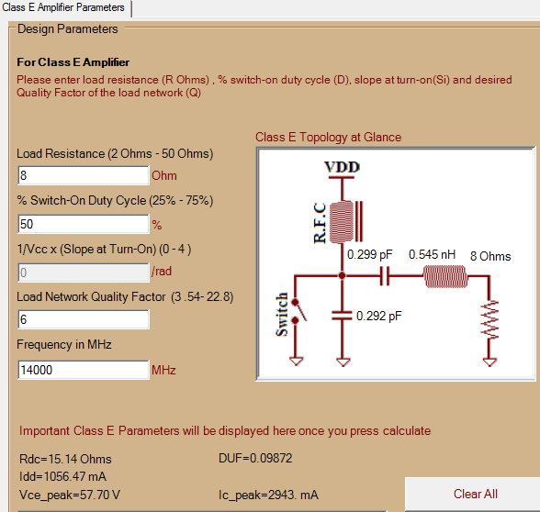
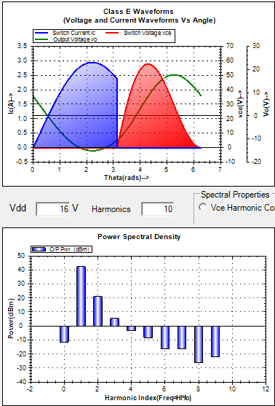
@ 14 GHz

Slide 23
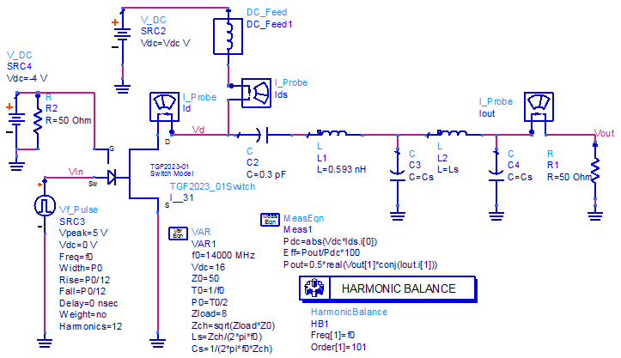
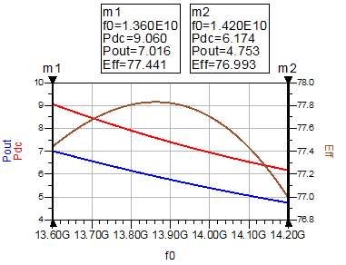
Class E Design @ 14 GHz using TGF2023-01

Slide 24
Looking Ahead
Bandwidth of Class E PA depends on decoupling at fundamental and second harmonic. We implement lumped & distributed decoupling for circuits.
ATC500 Series capacitors are suitable for our application
@ 14 GHz we implement distributed matching at fundamental & second harmonic using stubs
Input matching does not affect load match. We do broadband matching on the board.

Slide 25
Dependencies and Resources
Project
DuPont, ATC, Coilcraft
LTCC
Manufacturing
& FR4 Laminate
For Radar Core & DC-DC Converters
International University for Engineering
For Publications
Notes:
What are the dependencies that affect the timeline, cost, and output of this project?

Slide 26
Thanks
Anurag Nigam
NatTel Microsystems
Email: anurag_nigam@nattelmicro.com
Ph. No.: +91 9158580922
Notes:
Prepare slides for the appendix in the event that more details or supplemental slides are needed. The appendix is also useful if the presentation is distributed later.

