Slide 1
Class E Amplifier for Defense
Anurag Nigam

Slide 2
Compliance Matrix
 | Targeted | Simulated | Measured | Units
Frequency | 5 | 5 | 5 | GHz
Power Out | 28 | 28 | 27.5 | dBm
Gain | 10 | 10 | 9.5 | dB
Input Ret. Loss | <-10 | 10 | 7-9 | dB
Power Added Efficiency | 72 | 76 | 68.3 | %
Device | FLK057WG- Fujitsu MESFET
Laminate | RT Duroid 5880- Rogers 10 mil thick laminate
Figure 1: Targeted Specifications and Design Summary
Anurag Nigam Year 2000

Slide 3
Fujitsu Device
Features
High Output Power : P1db = 27.0 dBm ( Typ.)
High Gain : G1dB = 7.0 dB ( Typ. )
High PAE : η add = 32% ( Typ. )
Proven Reliability
Hermetic Metal/ Ceramic Package
Description
The FLK052WG is a power GaAs FET that is designed for general purpose applications the Ku-Band frequency range as it provides superior power, gain, and efficiency
Fujitsu’s stringent Quality Assurance Program assures the highest reliability and consistent performance.
Figure 2: GaAs MESFET Used for Designing Class E Power Amplifier
Anurag Nigam Year 2000

Slide 4
Design and Simulations Setup in ADS
Figure 3: Class Power Amplifier design and ADS Template for HB and S-Parameter Simulations
Anurag Nigam Year 2000

Slide 5
Design and Simulations Harmonic Balance Simulation Results
Figure 4: Harmonic Balance Simulation Results
Anurag Nigam Year 2000

Slide 6
Design and Simulations Layout
Figure 5: Layout and Assembly details of Single Stage Class E PA
Anurag Nigam Year 2000

Slide 7
Measurement Results
P input | 18 dBm
P output ( I Harm. ) P output ( II Harm. ) P output ( III Harm. ) | 27.5 dBm
 | -19.3 dBm
 | -30.3 dBm
Ids | 80 mA
P dc | 760 mW
Drain Efficiency | 73.99 %
Gain | 9.5 dB
P.A.E | 68.32 %
Figure 6: Measured results from the Power Amplifier
Anurag Nigam Year 2000

Slide 8
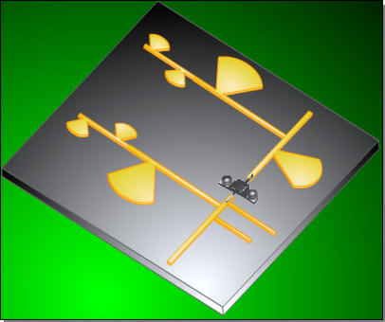
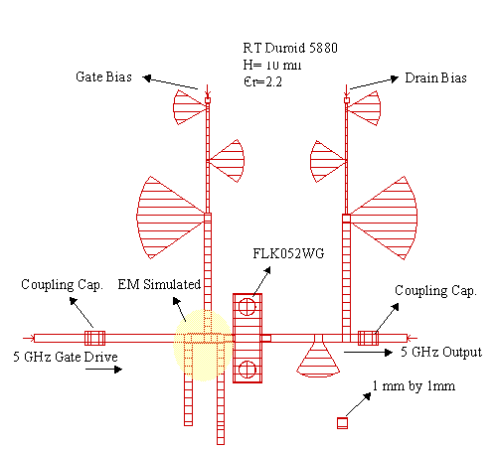
High Efficiency Class E Power Amplifier
Measurements
Frequency | 5 GHz
P input | 18 dBm
P output ( I Harm. ) P output ( II Harm. ) P output ( III Harm. ) | 27.5 dBm
 | -19.3 dBm
 | -30.3 dBm
Ids | 80 mA
P dc | 760 mW
Drain Efficiency | 73.99 %
Gain | 9.5 dB
P.A.E | 68.32 %

