Slide 1

W-24NAT
PA for WCDMA 3GPP Applications
Anurag Nigam
IBM Microelectronics, Boston, MA

Slide 2
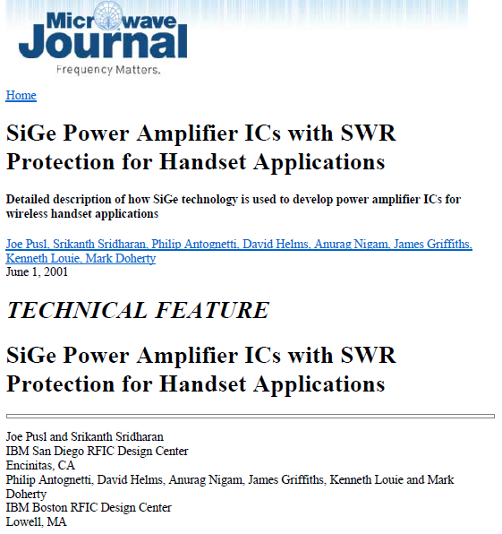
SiGe Amplifiers in IEEE MTT

Slide 3
Design Overview
3GPP WCDMA (Japanese Standard)

Slide 4
Design Goals
First Prototype IC in 3 months
  Strategy:
    Start with standard sized benchmarked devices
    Use available evaluation boards
    Integrate Two Stage PA on board and in QFN using bare die devices
    Reverse engineer the inter-stage match & implement on IC
Minimize Design Re-spins
  Strategy
    Do variations of IC
Minimize Design and Development Cost
  Strategy
    Minimize die size
    Parallel benchmarking, hybrid design & IC design

Slide 5
Design Challenges
Process Related Issues
  HBT Device
    Emitter Collapse depends on power cell layout and is not modelled
    There is no ballasting in power cell breakout
    Voltage bias in evaluation is not same as current bias in IC design
    Ruggedness enhancement in IC is not implementable easily in benchmarking
    Ruggedness under hot & cold can not be modelled in simulations
    Electro migration is difficult to model to predict MTTF
    Current Crowding under large signal is not modelled well in models thus compression is not well predicted
    Base Push Out under large signal not modelled well in devices
    Retrograde Triangular Germanium Profile not modelled well in Models
    Ft Vs. Ic not modelled well in models
    Bandgap discontinuity & tunneling in SHBT not modelled well in model
    Forward Current Gain roll off due to Collector Crowding under large signal not modelled in VBIC Model
    Device orientation changes its performance

Slide 6
Design Challenges
Process Related Issues
  Ground Related
    Absence of ground via in SiGe makes it difficult to model ground
    Chip ground using bond wires modelling can differ from implementation
    Substrate current can alter on-chip ground
    Shallow Trench and Deep Trench Mesh is difficult to model
  Interconnected Related
    Interconnect impedance is strongly affected by substrate currents
    Ground De-bounce along RF Path is likely
  MIM Related
    Substrate Tie in series capacitance in RF path is loss issue

Slide 7
Design Challenges
Process Related Issues
  Inductor Related
    Deep trench mesh under inductors are difficult to model
    DT mesh affects anti resonant frequency of inductors
    Current crowding at corners affects Q of the inductor
  Wafer Size Related
    12” Wafer could be grounded to 300 um substrate height- affects ground bond wire lengths
Assembly Related Issues
    For conductive substrate to be radiation hard, conductive epoxy is used for die attach. Conductive epoxy is bad thermal conductor affecting thermal performance
Simulation Related Issues
    No HP Ptolemy Bench for generating 3GPP WCDMA Modulated Signal

Slide 8
Action Item List
Create Specification Sheet
    Refer specifications of similar products from competitors
    Get customer inputs
    Create Compliance Matrices
Acquire information on process
    Device benchmarking
    Inductor and MIM Capacitor Modeling
Implement Two Stage Prototype
    Implement two stage on board and in QFN
    Extract Information about two stage design and evaluate performance
Implement Two PA IC design
    Implement Inter stage matching design on IC
    Simulate Small Signal and Large Signal performance of PA
    Optimize performance
    Include EM Simulated Passives in PA Simulations & Re-tune
    Include EM Simulated Board Components in PA Simulations & Re-tune
    Finalize PA Layout with variations and breakouts
1 week
2 weeks
2 weeks
3 weeks

Slide 9
Action Item List
Simulate Linearity of PA
    Simulate two tone performance of PA
    Generate I & Q signals from ESG for 3GPP WCDMA Modulation and create 3GPP WCDMA Source
    Perform ACPR Simulations
    Generate constant IM3 Circles in Load Pull Simulations & Re-tune PA
Design Evaluation Board for PA
    Design evaluation board for Two Stage PA Characterization
    Prepare Bill of Material and make sure availability of Off-Chip Passives
PA Assembly & Characterization
    Assemble PA on evaluation board with off-chip passives
    Get sweet spot performance of PA by tuning inter stage capacitors in capacitor banks & by tuning off-chip components
    Characterize various specifications- Small Signal Parameters, Large Signal Gain, Single Tone & Two Tone Performance, ACPR Measurements, ON-OFF Time, Receive Band Noise, Ruggedness under hot & cold, Mismatch Performance
Data Sheet
    Generate data sheet of PA prototype
3 weeks
2 weeks
3 weeks
First Prototype: 17 Weeks
1 week

Slide 10
Product Description
Two Stage PA with off-chip matching
Compliant with WCDMA 3 GPP (Japanese) Standards
Two Stage PA 50Ω Module on BT Substrate
Two Power Modes: High Power & Low Power
VCC
Bias Decoupling
Bias Decoupling
Input Match
Inter Stage
Power Stage
RF in
RF out
Driver Stage
Output Match
GND
VSWR Improvement
Off-Chip
On-Chip
Bandgap Bias
Bandgap Bias

Slide 11
Design Resources
Device Benchmark Test Setup & Assembly
  Test Stands & Equipment
    Maury/ATN Load Pull Stand
    Cascade Probe Station, On-Chip SLOT Cal Set with Parameters, VNA
    HP DC Parameter Analyzer
    Manual Power Test Bench- Manual Tuners, HP VSG, Mini Circuits Power Amplifier, Directional Couplers, Attenuators Pads, Power Sensors, HP Dual Channel Power Meter, Spectrum Analyzer
    3.5mm SMA SLOT Cal Set
    Bias Ts
  Assembly
    Wedge Wire Bonder
    Oven, Conductive Epoxy
    Device Carrier
    Evaluation Boards, 0402 SMD Inductors & Capacitors
    QFN, Gold Tabs, MIM Caps
    RF Sniffer

Slide 12
Design Resources
Simulation Tools & PDK
  Simulation Tools
    Cadence, Columbus RF
    ADS
  PDK
    IBM SiGe 5HP
Note on Simulation Tools
  Cadence
    Good for DC and Small Signal Simulations, Robust Convergence, Slow and Inappropriate for Large Signal Simulations, used for receive band noise simulations, yield analysis, corner analysis, layout & parasitic extraction
  ADS
    Good for EM simulation of passives & interconnects, Large Signal Simulations (HB & Envelope), use of root model speeds simulations, has convergence issues under large signal

Slide 13
Compliance Matrix (High Power Mode)
Parameter
Symbol
Min
Typ
Max
Units
Notes
Mes. / Sim.
Yes
Yes
24 / 25.5
+1.1 to -1.3
24 / 24
51 / 41
36.4 / 36.5
39 / Nil
53 / Nil
TBD
TBD / Abs. Stable
-40 / Nil
-10
TBD
TBD
TBD
Efficiency Control
Vaec1,2
0
V
(Unless noted otherwise, V_{CC} = 3.4Vdc, T=25C, F = 1950 MHz, 3GPPx: HPSK 3.84Mcps, dpcch+dpdch, ON/OFF input = logic ‘0’, Vaec1=Vaec2=high condition
Frequency range
--
1920
1950
1980
MHz
--
Gain
--
24
25
26
dB
--
Gain vs Temp/voltage
--
+/-1.5
dB
-40 to +85
Output Power
--
24
--
--
dBm
--
Quiescent current
Icq
120
mA
PAE
--
40
--
--
%
--
ACP1
--
--
--
-36
dBc
±5 MHz
ACP2
--
--
--
-46
dBc
±10 MHz
ACP3
-56
dBc
±15 MHz
Stability (2)
--
--
--
-60
dBc
Maximum spurs
Harmonics
--
--
--
-30
dBc
--
Input Return Loss
--
--
--
-10
DB
--
Noise Power
--
-142
dBm/Hz
Noise Figure
--
5
dB
Ruggedness VSWR (2)
--
10:1
--
--
--
No damage
1. ON/OFF input logic ‘0’ = 0Vdc-0.6Vdc; logic ‘1’ = 2Vdc-VCC
2. Out-of-band load VSWR <5:1, in-band load VSWR <3:1 With Pin = +3dBm, VCC = 5Vdc

Slide 14
Compliance Matrix (Low Power Mode)
 | Spec. | Mea. / Sim.
Gain Roll Off @ 13dBm Pout | 3dB | 0.6 dB
Gain Roll Off @ 3dBm Pout | 6dB | 1.1 dB
P.A.E @ 13dBm Pout | 10.4% | 10%
P.A.E @ 3dBm Pout | 1.75% | 1.85%
Parameter
Symbol
Min
Typ
Max
Units
Notes
Mea. / Sim.
Yes
Yes
23 / 23.5
1.1 to –1.3
yes
10
44 / Nil
56 / Nil
TBD
TBD
-45
TBD
TBD
Efficiency control
Vaec1,2
2.2
Vdc
Frequency range
--
1920
1950
1980.0
MHz
--
Gain
--
20
21
22
DB
--
Gain vs temp/voltage
--
+/-1.5
DB
-40 to +85
Output Power
--
13
--
dBm
--
PAE
--
10
--
--
%
--
ACP1
--
--
--
-36
dBc
±5 MHz
ACP2
--
--
--
-46
dBc
±10 MHz
ACP3
-56
dBc
±15 MHz
Stability
--
--
--
-60
dBc
Maximum spurs
Harmonics (2)
--
--
--
-30
dBc
--
Input VSWR
--
--
--
2:1
--
--
Ruggedness VSWR (3)
--
10:1
--
--
--
No damage
1. ON/OFF input logic ‘0’ = 0Vdc-0.6Vdc; logic ‘1’ = 2Vdc-VCC
2. Out-of-band load VSWR <5:1, in-band load VSWR <3:1 With Pin = +3dBm, VCC = 5Vdc

Slide 15
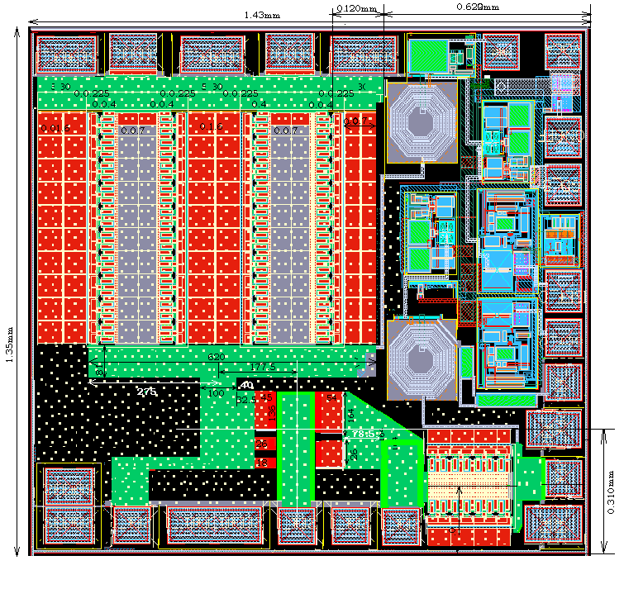
PA Layout
Bandgap Bias Circuits
Power Cell with Ballasting
Inter Stage
Driver Cell

Slide 16
Device Benchmarking & Modelling
IBM SiGe HBT

Slide 17
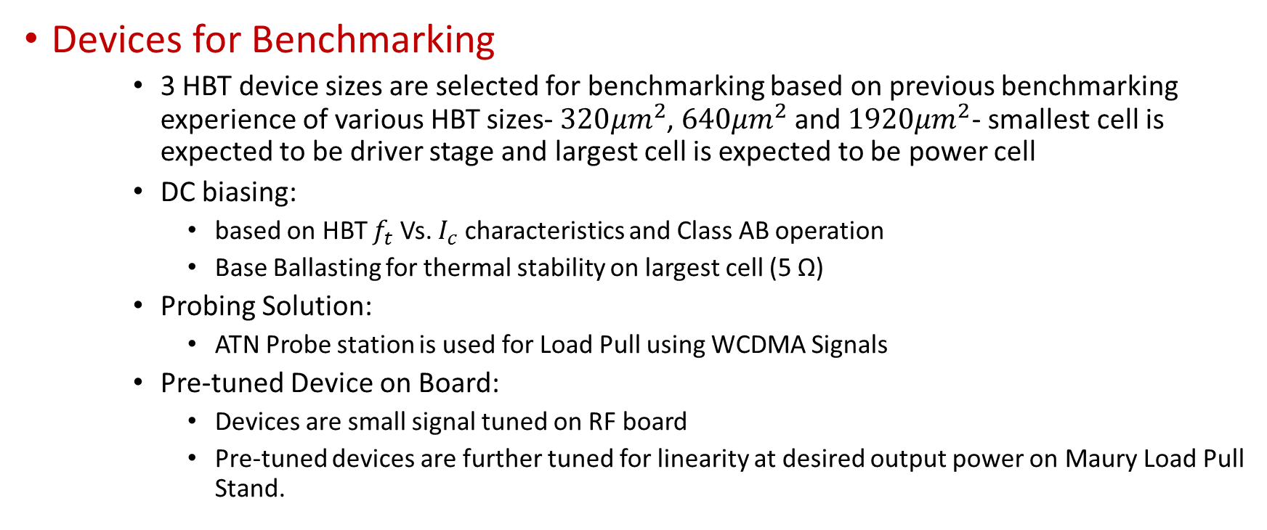
Benchmarking Strategy
Devices for Benchmarking
    3 HBT device sizes are selected for benchmarking based on previous benchmarking experience of various HBT sizes- $320{μm}^{2}$, $640{μm}^{2}$ and $1920{μm}^{2}$- smallest cell is expected to be driver stage and largest cell is expected to be power cell
    DC biasing:
      based on HBT $f_{t}$ Vs. $I_{c}$ characteristics and Class AB operation
      Base Ballasting for thermal stability on largest cell (5 Ω)
    Probing Solution:
      ATN Probe station is used for Load Pull using WCDMA Signals
    Pre-tuned Device on Board:
      Devices are small signal tuned on RF board
      Pre-tuned devices are further tuned for linearity at desired output power on Maury Load Pull Stand.

Slide 18
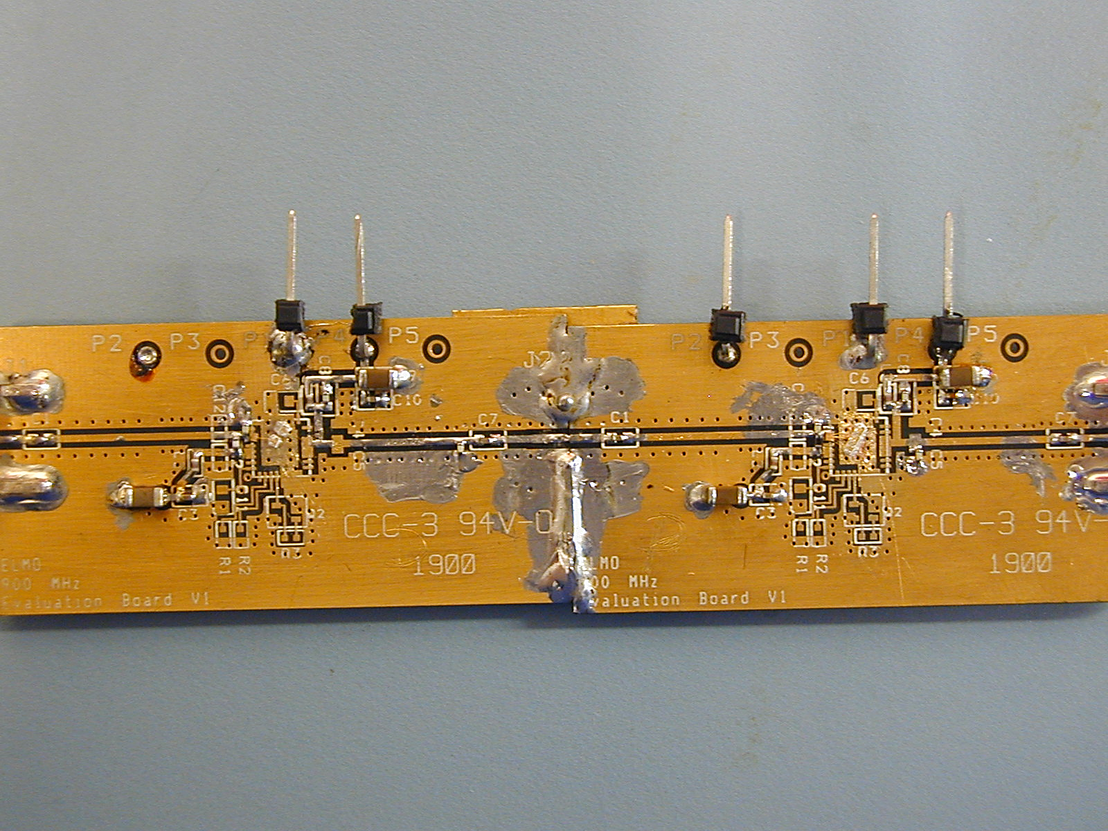








Benchmarking Boards
$$GND$$
$$V_{bb}$$
$$V_{cc}$$
Bias De-coupling
$$V_{bb}$$
$$V_{cc}$$
Input Coupling
Cap
Output Coupling
Cap
$$GND$$
Output Match
Input Match
$1920{μm}^{2}$HBT Power Cell
$320{μm}^{2}$HBT Power Cell

Slide 19

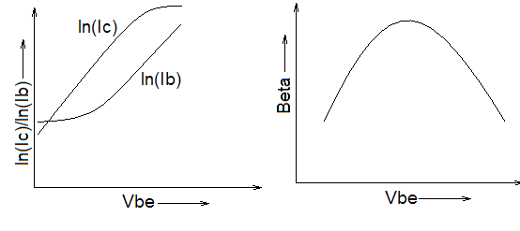

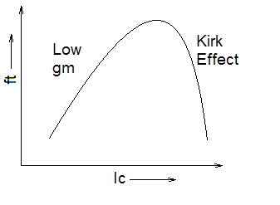


Choice of Quiescent Current
HBT Quiescent Current depends on
    $f_{t}$ Vs. $I_{c}$ characteristics
    Gummel Plot Characteristics
    Desired AM-AM, AM-PM Characteristics & Distortion
Gummel Plot
$f_{t}$ Vs. $I_{c}$ characteristics
Class B (Top) & Deep AB (Bottom) Performance across power

Slide 20
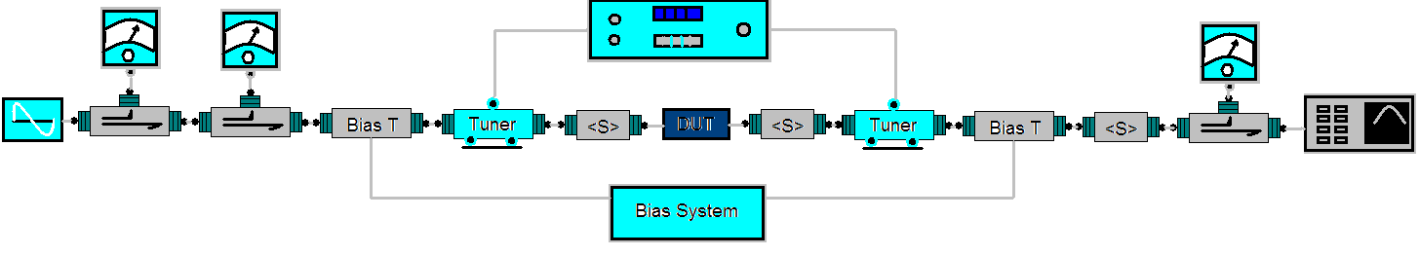
Maury Setup for tuning devices
Notes
  Signal Generator settings for WCDMA 3GPP- Most of the ESGs have standard settings. Else do the following –
    Mode Arb Waveform CDMA Formats W-CDMA(3GPP) Link=UP W-CDMA Select(DPCCH)= DPCCH +1DPDCH W-CDMA=ON
  Analyzer Settings- Setup the desired ACP Mode, Make sure the following-
    Center Frequency=1.95GHz
    Frequency Span=24.6848MHz
    RF attenuation – Not significant (Typically 10dB)
    Resolution Bandwidth- 30KHz
    Video Bandwidth- 300KHz
    Sweep Time- 2 Seconds
    Trace1: Detector RMS
No. of Adjacent Channels-2
ACP Channel Bandwidths-
  CH- 3.84MHz
  Adj.- 3.84MHz
  Alt.- 3.84MHz
Channel Spacing-
  Adj.- 5MHz
  Alt.- 10MHz

Slide 21
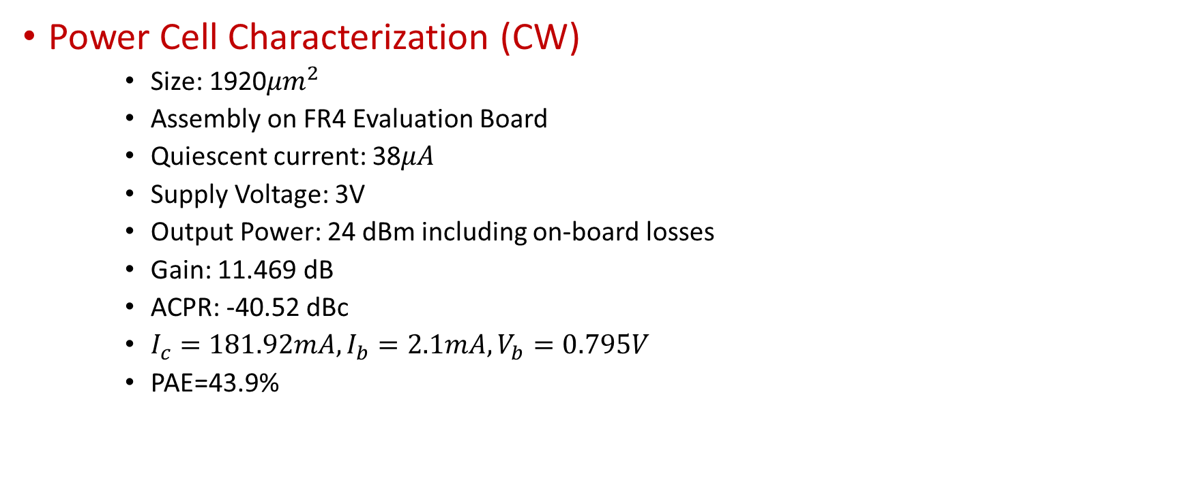
Benchmarked Performance (Power Stage)
Power Cell Characterization (CW)
    Size: 1920${μm}^{2}$
    Assembly on FR4 Evaluation Board
    Quiescent current: 38$μA$
    Supply Voltage: 3V
    Output Power: 24 dBm including on-board losses
    Gain: 11.469 dB
    ACPR: -40.52 dBc
    $I_{c}=181.92mA, I_{b}=2.1mA, V_{b}=0.795V$
    PAE=43.9%

Slide 22
Power Cell Linearity Performance
38.7%
-36.6dBc
24dBm
11.469dB

Slide 23

Benchmarked Performance (Driver Stage)
Driver Cell Characterization (CW)
    Size: 320${μm}^{2}$
    Assembly on FR4 Evaluation Board
    Quiescent current: 15$μA$
    Supply Voltage: 3V
    Output Power: 16 dBm including on-board losses
    Gain: 16 dB
    ACPR: -51 dBc
    $I_{c}=26.175mA, I_{b}=0.37mA, V_{b}=0.815V$
    PAE=50%

Slide 24
Driver Cell Linearity Performance
-40dBc
32.738%
17.6mA
12.42dB
12.58dBm

Slide 25
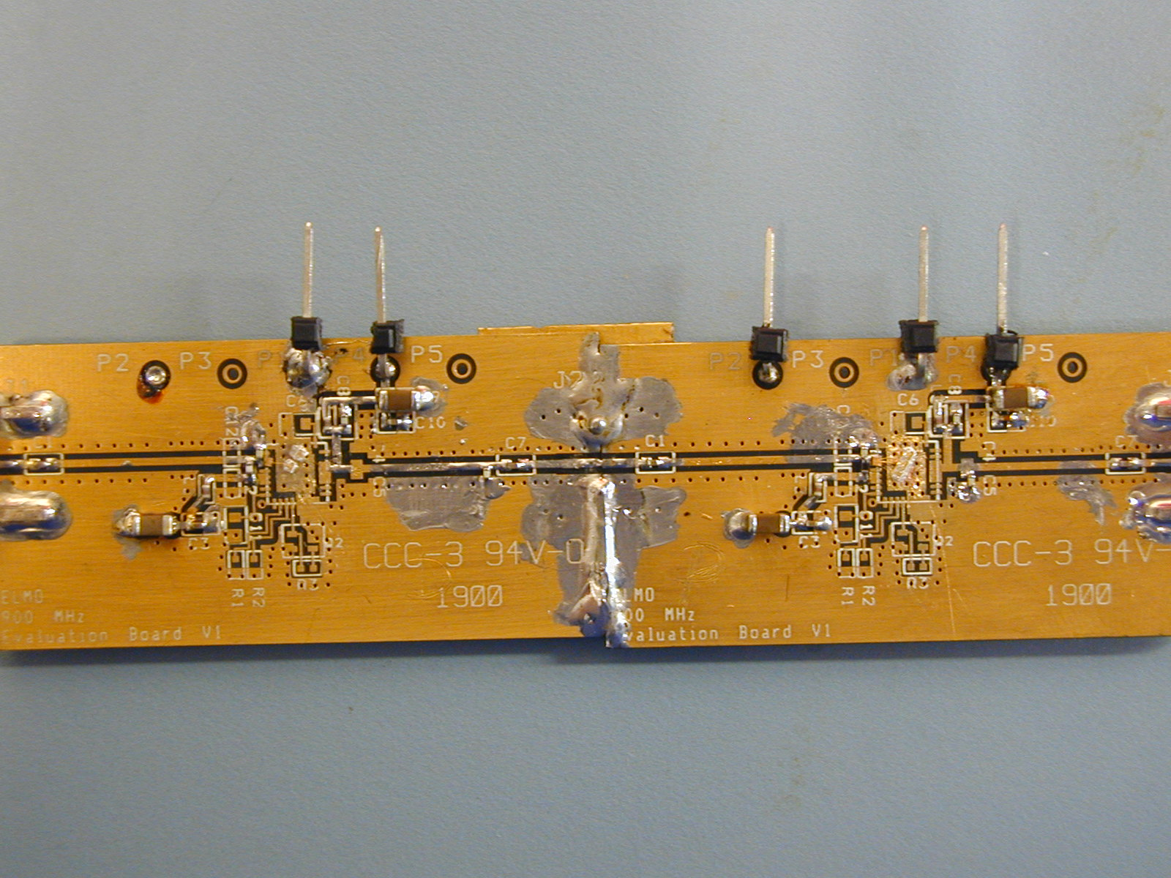
Two Stage PA (Ugly but it works)
Inter stage probed for impedance on Cascade Probe Station

Slide 26
Measurement Data from Hybrid PA

Slide 27
Modelling & Implementation
Implementing Two Stage PA on IC

Slide 28
Thermal Stability of HBT
Multiplicity of device or fingers does not serve as good HBT model
reason
Distributed Self heating leading to thermal instability
Forward Current Gain
Emitter Ballasting
Emitter
Collector
Emitter
Collector
Emitter
GaAs
High
Si, SiGe
HBT Cell
Temperature
Temperature
Base Ballasting
Base
Low
Ideal Response
Ids
Emitter
Collapse
Thermal Coupling between fingers depends on separation
HBT Cell
Vds

Slide 29





Emitter Crowding & Other Effects
Emitter Periphery is more important than Emitter Area
$$r_{b}^{′}$$
$$r_{b}$$
Forward Current Gain Roll-off due to base push out (Kirk) and high majority carrier density on collector side
$$r_{b}^{′}<r_{b}$$
$$β$$
Device layout affects compression characteristics
$$I_{C}$$
Base Current crowding along Emitter Periphery
These factors affect device compression characteristics

Slide 30
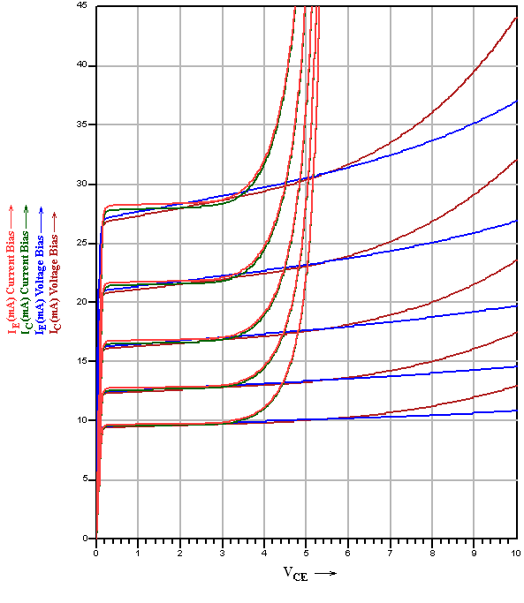


Current Vs Voltage Bias
Linearity Vs Breakdown
$1920{μm}^{2}$ HBT
Biasing with current results in higher output impedance and better linearity as compared to biasing with Voltage
Biasing with current results in lower breakdown voltage.
Best of both worlds !!!
$$I_{b}$$
HBT Power Cell
Current Bias
Voltage Bias
VSWR Protection Device

Slide 31
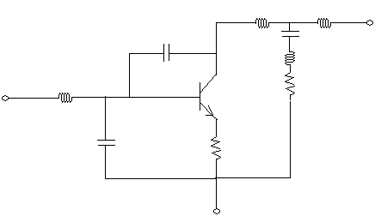
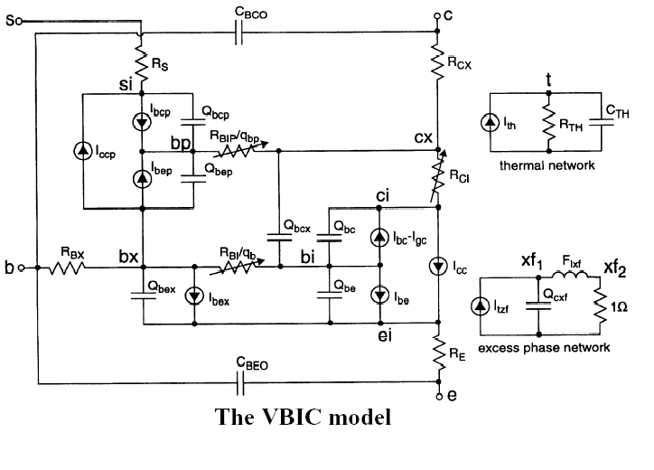
HBT Device Modelling
Approaches to device modelling
Approach1
Refine the model with device multiplicity and using lumped parasitic
VBIC Model of single emitter HBT with
Self Heat : On
Impact Ionization : On

Slide 32
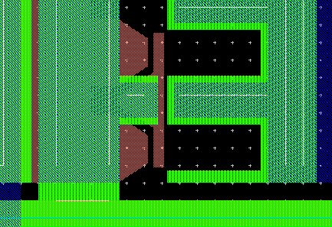
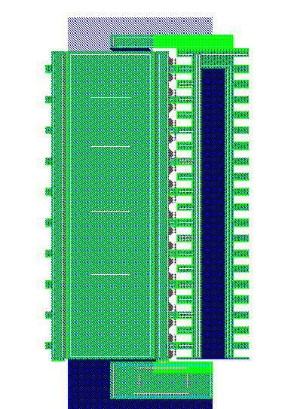

HBT Device Modelling
Approaches to device modelling
Approach2
EM Simulate the Layout Parasitic
$20{μm}^{2}$ Cell

Slide 33
Modelling Conclusion
Approach1 & 2
S-Parameters from Models and Measurements yielded accuracy within 2% from DC to 12 GHz.
EM Simulated Models were more accurate but circuit simulation required more time and had convergence issues.
With Self Heating and Impact Ionization on, models accurately predicted Input- Output Matching Impedances, across power gain, efficiency and output power.
Conclusion
Model accuracy degrades with cell size
Approach 1 provides model scaling in large steps
Approach 2 provides model scaling in small steps
Approach 1 provides models with easier convergence and smaller simulation time
Approach 2 provides models that are more accurate but need more simulation time and difficult simulation convergence

Slide 34



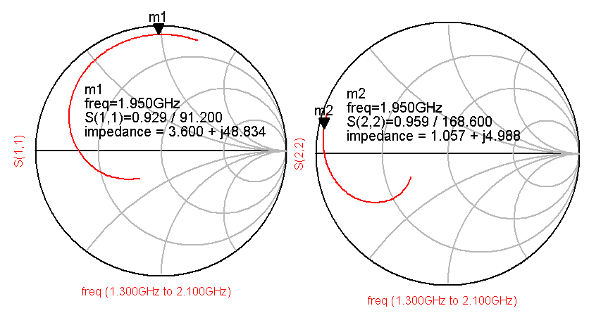

Inter stage Measurements
Inter stage is bonded to Bond wire-to-SMA Chip Transitions and probed for impedance
$$Z_{out}$$
$$Z_{L}$$
$$Z_{S}$$
$$Z_{in}$$

Slide 35
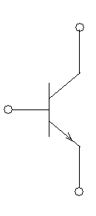
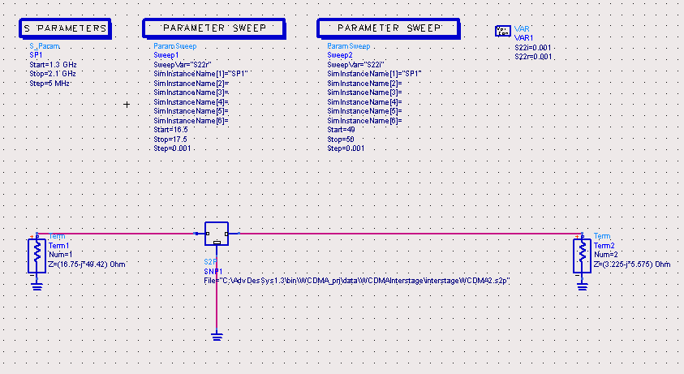
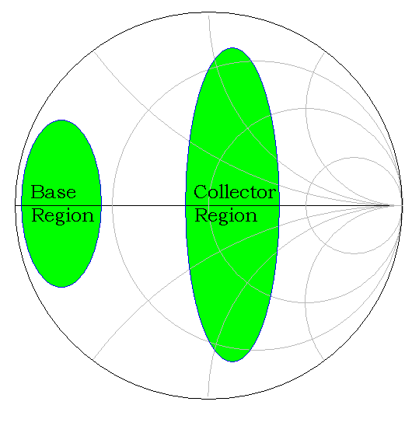
Inter stage Measurement Theory
Inter stage impedances measured are not complex conjugates due to measurement in a 50Ω System while inter stage is a non 50Ω system. The only known we have S-parameters measured from inter stage in 50Ω system.
Inter stage is a band pass network with unique set of complex terminal impedances (4 unknowns). The best way to determine 4 unknowns is using complex terminations and optimizer to arrive at center of smith chart i.e. minimum insertion loss.

Slide 36
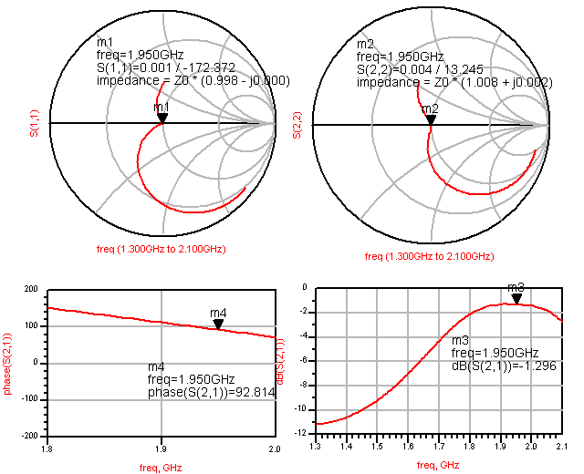
Determining Inter stage Impedances
Simultaneous matched to port impedance
Simultaneous matched to port impedance
Optimum Insertion Loss of -1.296 dB

Slide 37



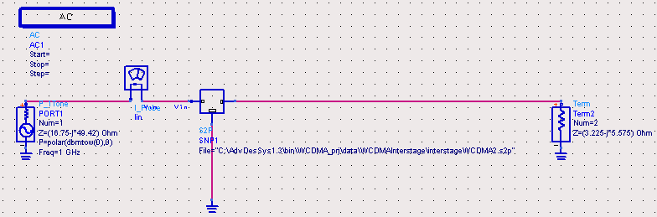


Load Impedance to Driver Stage
$Z_{L}$=
$Z_{out}$=16.75-j49.42
S-parameters from inter stage measurements
$$Z_{out}$$
$$Z_{L}$$

Slide 38
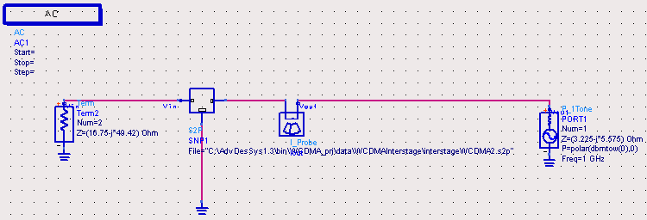




Source Impedance of Power Stage
$Z_{S}$=
$Z_{in}$=3.225-j5.575
S-parameters from inter stage measurements
$$Z_{S}$$
$$Z_{in}$$

Slide 39
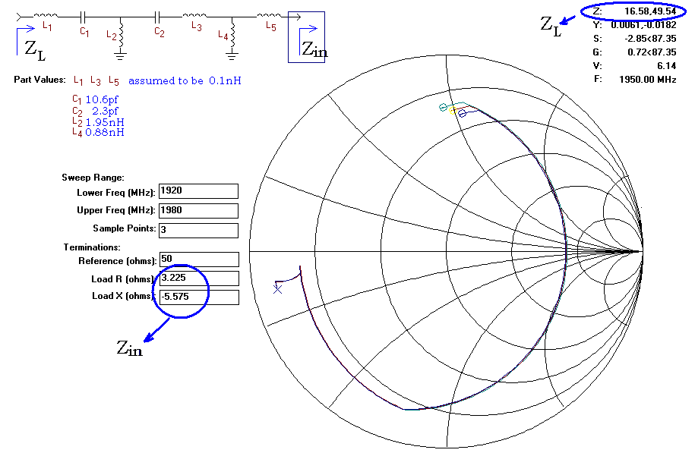
Inter stage Design
L1, L3 and L5 are trace inductances. L1 and L4 are shunt inductances implemented using Bond wires

Slide 40
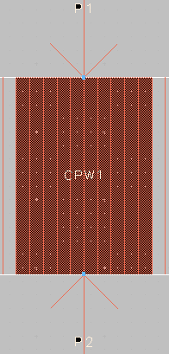
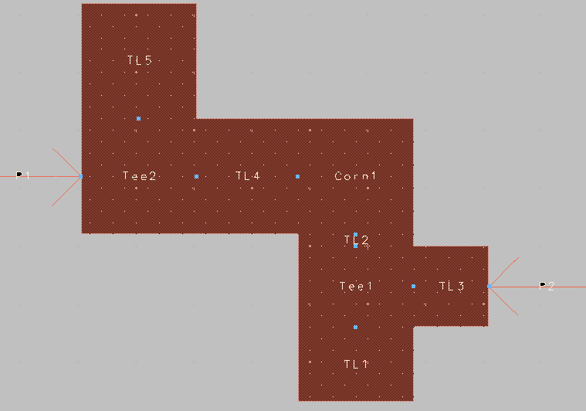
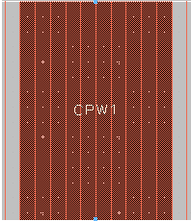
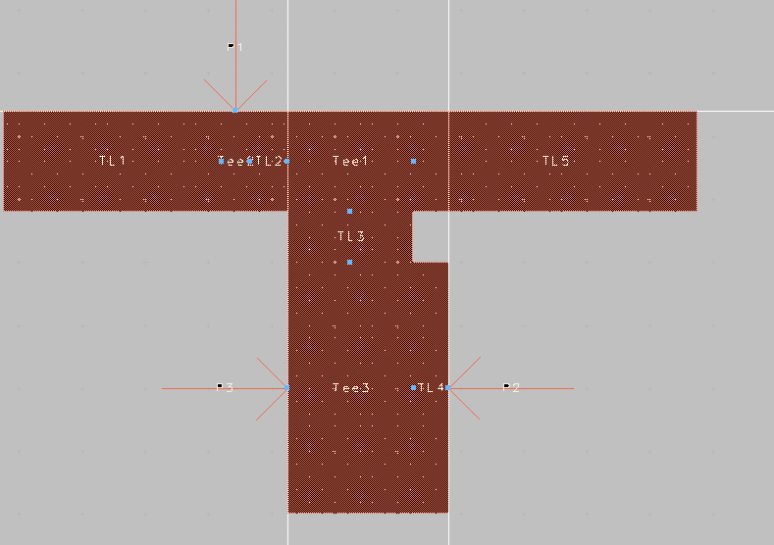
Inter stage Layout & EM Simulations
EM Simulated Sections Of Inter-stage
Inter-stage Cap.
Coupling Cap.
Little Tuning ability
Coupling Cap.

Slide 41
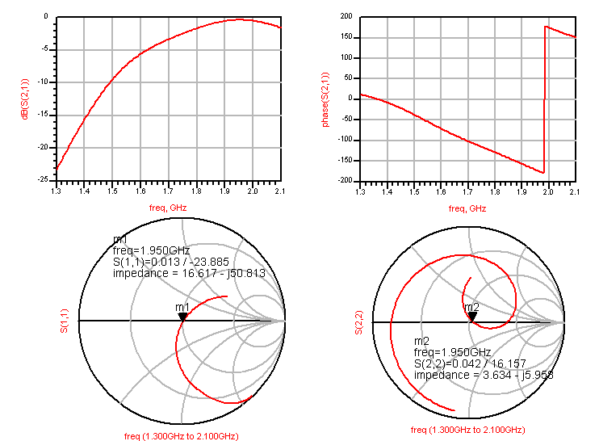
EM Simulated Response of Inter stage

Slide 42
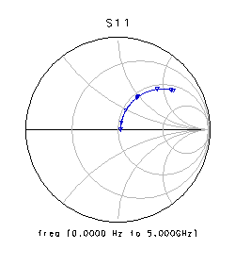
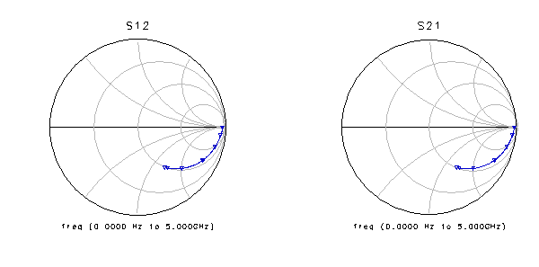
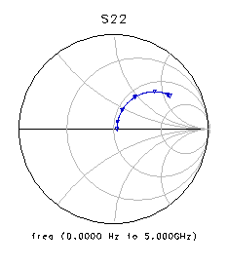
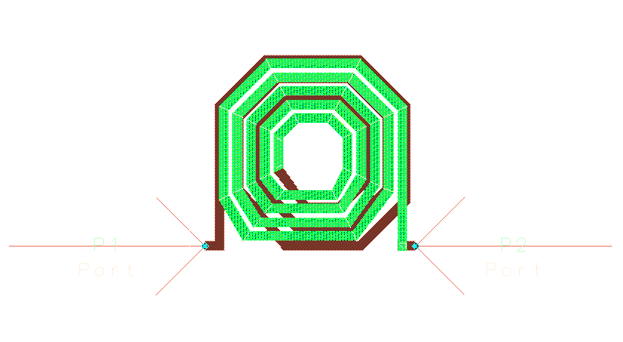
On-Chip Bias Decoupling Inductor
Power Stage Base Bias Decoupling Inductor has to part of Inter-stage Modelling

Slide 43
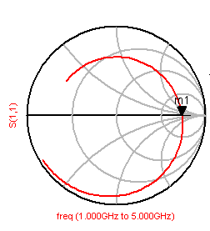
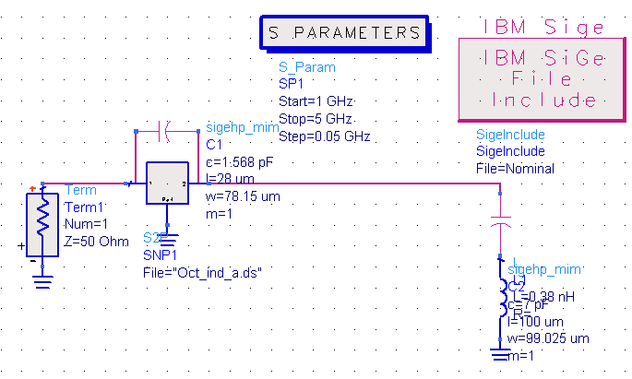
Response of On-Chip Bias Decoupling
340 Ohms
20mil bond wire

Slide 44
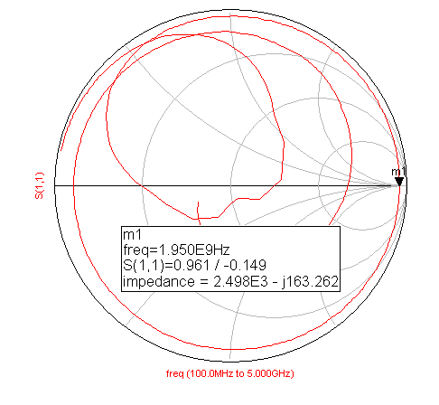
Measured On-board Bias Decoupling
Driver Stage Collector Bias Decoupling has to part of Inter-stage Modelling

Slide 45
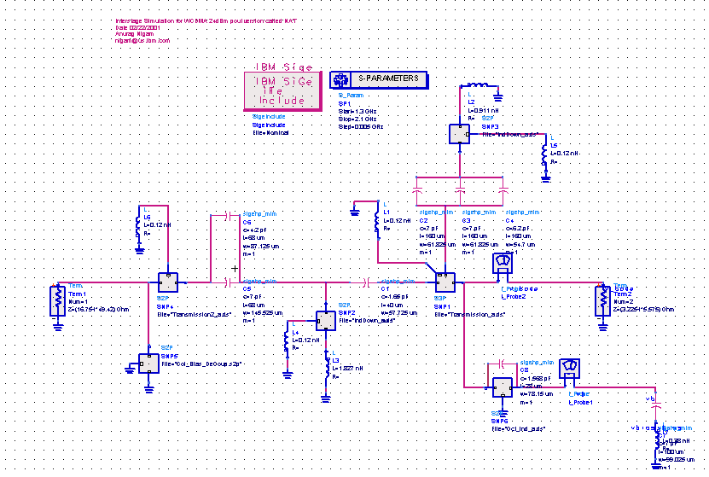
EM Co-simulated Inter stage
Anti-resonant on Board
Anti-resonant on Chip

Slide 46
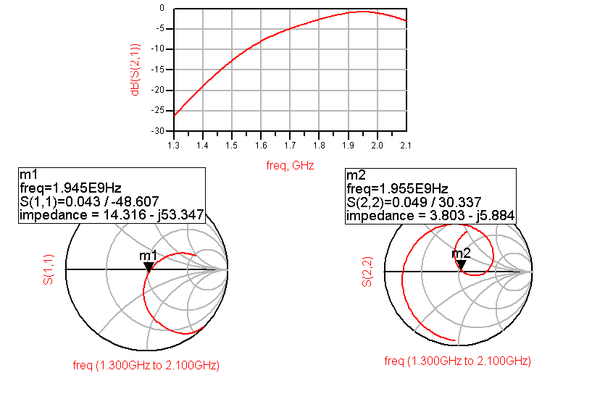
Simulated Response of Complete Inter stage

Slide 47
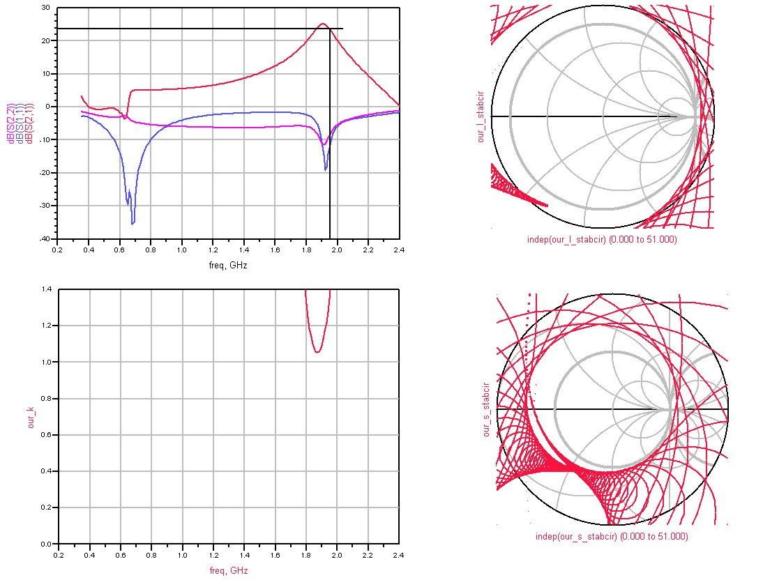
Simulated Small Signal Response of Amplifier

Slide 48
Across Supply Voltage Large Signal Response
45%@2.9V@ 24 dBm
41%@3.2V @ 24 dBm
Less Than 0.7dB
36.5%@3.4 @24 dBm
PAE
Gain
Pout

Slide 49
Temperature Compensated Bias Circuit Design
-40 to +85° C Temperature Variation

Slide 50
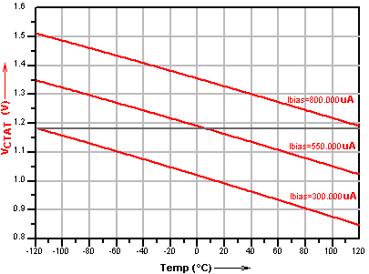
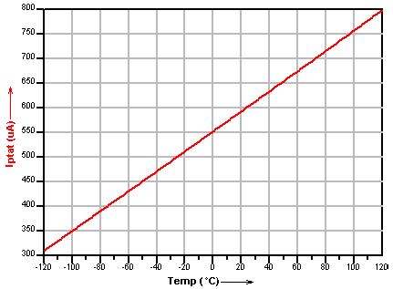
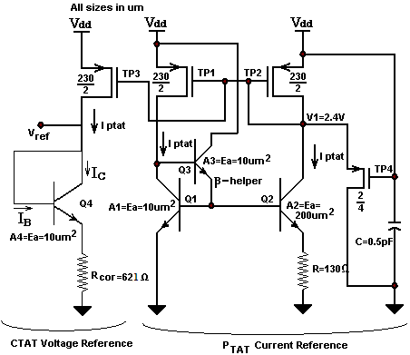
Principle of Operation
PTAT Current
CTAT Voltage

Slide 51
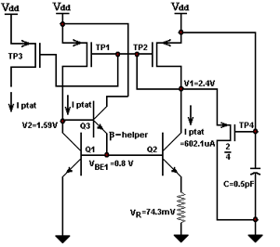

Simplified Design of PTAT
Process Parameters
Design at $T_{nom}=25°C=298.16 K$
Temperature Dependent HBT Parameters
Generic Constants
Assumptions

Slide 52


Simplified Design of CTAT & Band Gap
At $T_{nom}=−120°C=153.16 K$
At $T_{nom}=−120°C=393.16 K$

Slide 53
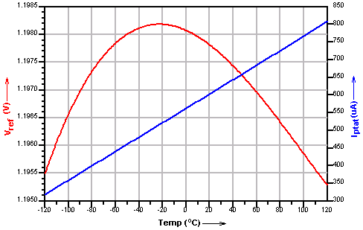
Across Temperature Performance
There are additional OP-Amp Based Circuits included in the design for incorporation a temperature sense device and Output Current Control. (Not shown due to IBM Patent Restrictions)
Various Cadence Simulations are also not included in this presentation

Slide 54
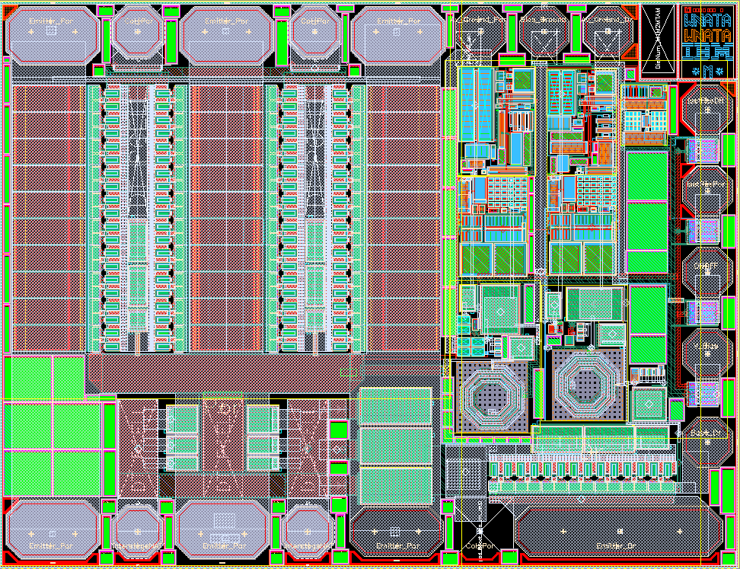
IC Layout

Slide 55
PA Measurements
Bare Die assembled on evaluation board

Slide 56
Two Stage PA Performance in HP Mode
38% P.A.E
Losses of connector and output line after load match approx. 0.27dB not de-embeded.

Slide 57
Two Stage PA Performance in LP Mode
Only 1.1 dB fall in gain@ 3dBm out
Only 0.6 dB fall in gain@ 13dBm out
Nokia Spec. 6dB fall
Nokia Spec. 3dB fall
As in HP Mode
8.91% P.A.E (Nokia Spec. 10.4%)
Our fix- Bias down the part (9.91% PAE,-39dBc)
1.31% P.A.E (Nokia Spec. 1.75%)
Our fix- Bias down the part (1.85% PAE,-39dBc)
Line and connector losses (around 0.27dB) are not de-embeded

Slide 58
MOSFET Predistorter
Enhances PAE by 5%

Slide 59
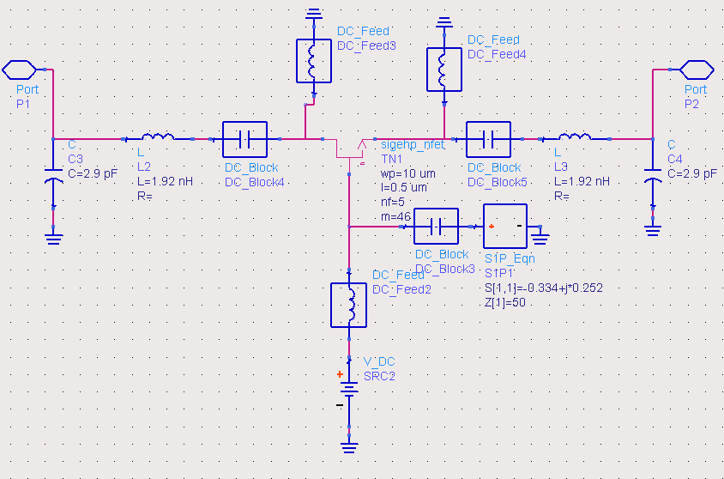
Predistorter Topology
Impedance to control |S21| and Arg(S21)
Simultaneous Conj. Matching
To control |S21|

Slide 60
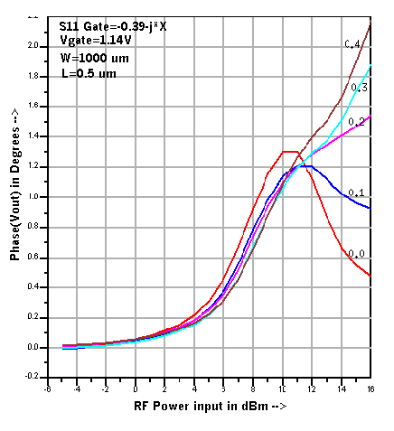
Phase Expansion across Power

Slide 61
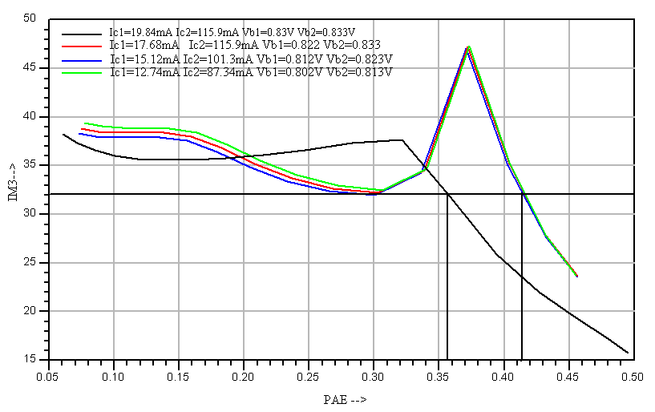
Linearity of PA with Predistorter(IM3 Vs PAE)

Slide 62
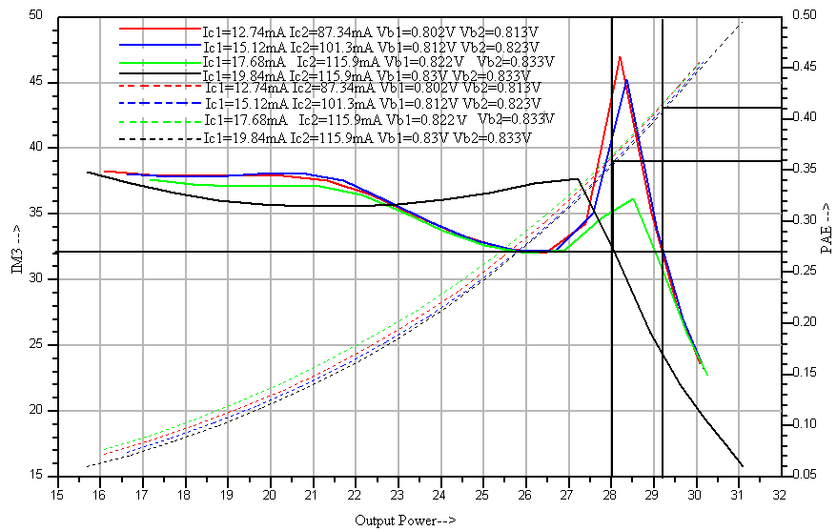
Linearity of PA with Predistorter across Power

Slide 63
Concluding Remarks
Other Parameters were tested besides those presented here
Bare Die was integrated into a BT Module
Design was later revised & met 99.7% yield criteria
Design met the ruggedness criteria
Assisted in test fixture design for Teradyne Volume Tester
Thanks

