Slide 1
Communication System
@ 40 GHz
Anurag Nigam

Slide 2
System Overview
Remote Antenna Unit (RAU)
Consumer Premise Equipment(CPE)
BPF
Mixer
Baseband Amp
Optical Fiber
Remote Antenna
(40 GHz - 42 GHz)
(DC- 1.5 GHz)
Power Detector
& Limiter
LNA
Multistage Power Amplifier
Photo Detector
(40 GHz - 42 GHz)
Injection Amp
PLL1
BB Amp
Remote Antenna
Design Focus
Mixer
Variable Gain BB Amp
Optical Fiber
(37.5 GHz – 39.5 GHz)
(DC- 1.5 GHz)
Low Noise Amplifier
Driver & PA
BALUN
LASER Diode
(37.5 GHz – 39.5 GHz)
Injection Amp
PLL2

Slide 3
Compliance Matrix for CPE
Transmitter
Frequency Band | 37.5 GHz to 39.5 GHz
Maximum Input p-p Differential | 20 mV
Output Peak Power | 11 dBm
Receiver
Frequency Band | 40 GHz to 42 GHz
Minimum Input Power | -75 dBm
Minimum Output p-p Differential | 5 mV
Noise Figure | <9 dB

Slide 4
CPE Architecture
Top LEVEL View

Slide 5
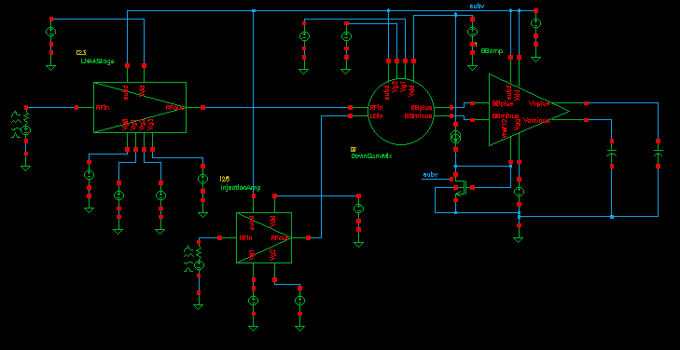
CPE Receiver
Low Noise Amplifier
Baseband Amplifier
RF in
Quadrature Mixer
RF out
LO in
Injection
Amplifier
CPE Direct Conversion Receiver Sub-Circuits

Slide 6
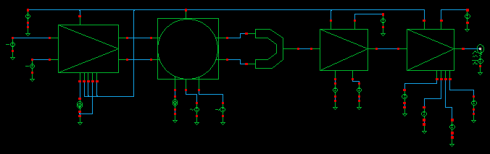
CPE Transmitter
PA
BALUN
BB Amp Var Gain
Driver Amp
Gilbert Mixer
CPE Direct Conversion Transmitter Sub-Circuits

Slide 7
LNA Design
Optimum Noise Figure & Gain

Slide 8
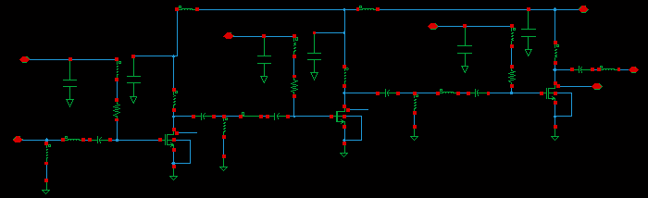
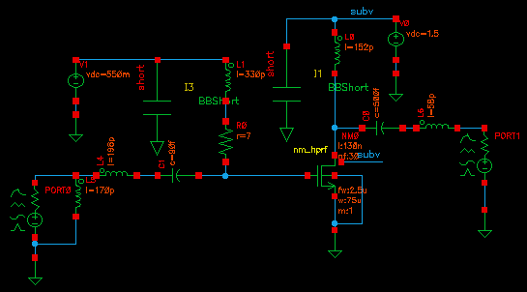
3-Stage LNA
Vdc = 1.5 V
Icq =13 mA
Nf =4.8 dB
Gain = 10.6 dB
Return Loss < -13 dB
Matching Topology

Slide 9
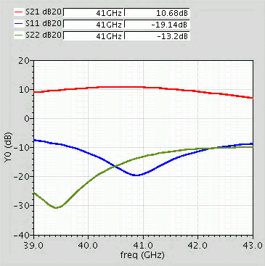
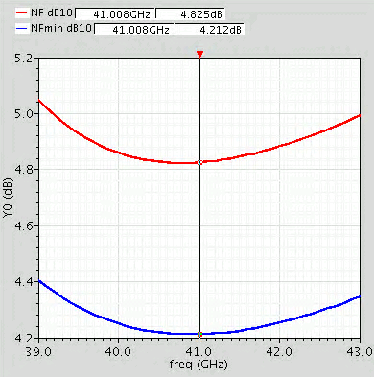
LNA Performance
LNA Gain & Return Loss
Noise Figure & Noise Figure Min

Slide 10
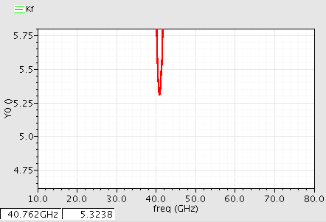
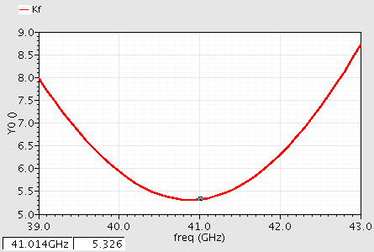
Small Signal LNA Stability
Out band Stability
In band Stability

Slide 11
Direct Conversion Quadrature Mixer
High RF – LO Isolation

Slide 12
Quadrature Mixer Topology
RF Short
O/P MNW
+
RF
I/P MNW
O/P MNW
_
LO
I/P MNW
RF Short

Slide 13
Mixer Operating Principle

Slide 14
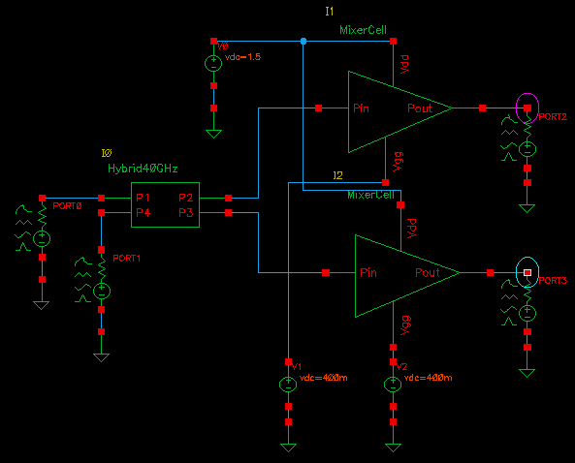
Mixer Integration

Slide 15
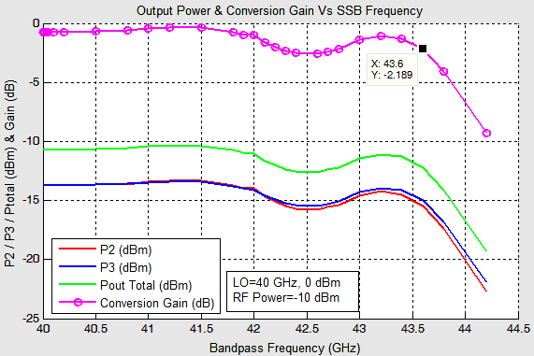
Pass band Performance
Note that Conversion Gain is almost flat for a bandwidth of 7.2GHz

Slide 16
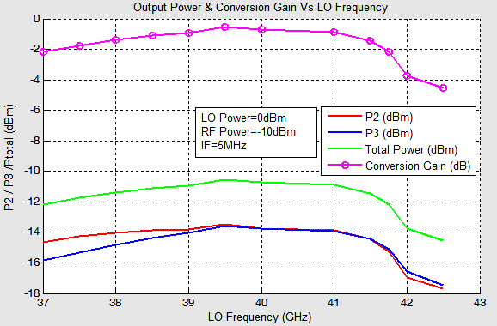
Across Frequency Band
Note that Mixer has sufficient conversion gain across transmit and receive band

Slide 17
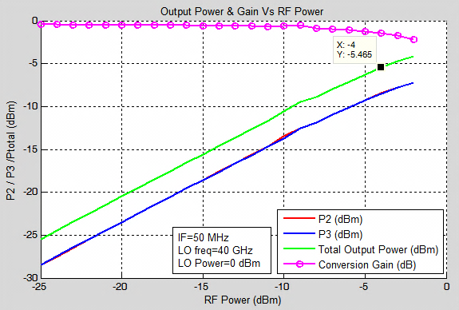
Mixer performance across power
Note -1 dB conversion gain compression

Slide 18
Injection Amplifier Design
RF-LO Isolation

Slide 19
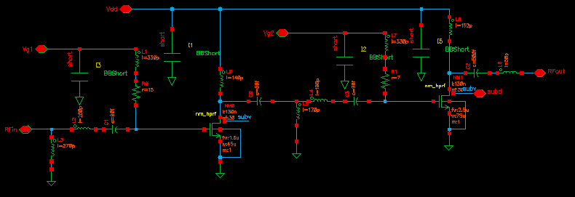
Injection Amplifier Circuit
Vdc = 1.5 V
Icq =6 mA
Gain = 10.6 dB

Slide 20
Base Band Amplifier & Matching
Maximizing Output Voltage Swing

Slide 21
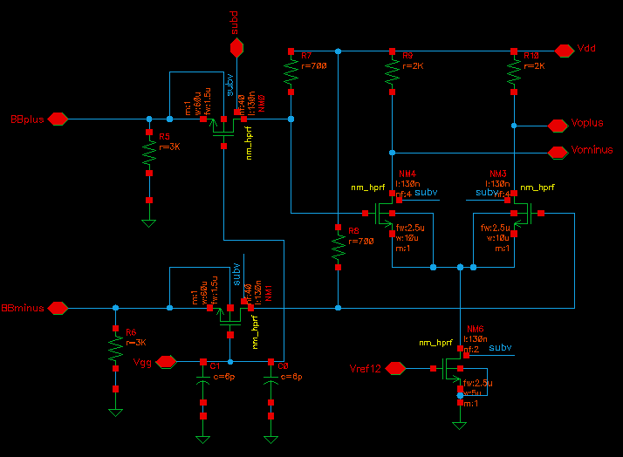
Base Band Amplifier Circuit

Slide 22
Receiver Integration
Receiver Performance

Slide 23
Complete Receiver Circuit
3 V
Low Noise Amplifier
1.5 V
3 V
Baseband Amplifier
RF in
Quadrature Mixer
RF out
LO in
Injection
Amplifier
1.5 V

Slide 24
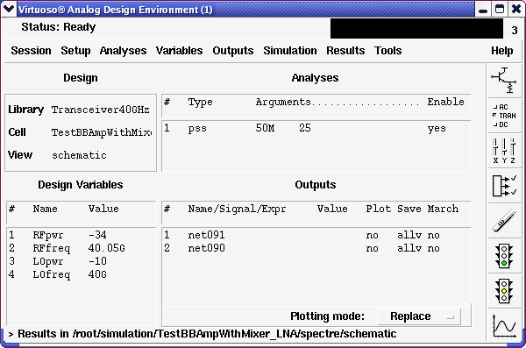
50 MHz Base band Performance

Slide 25
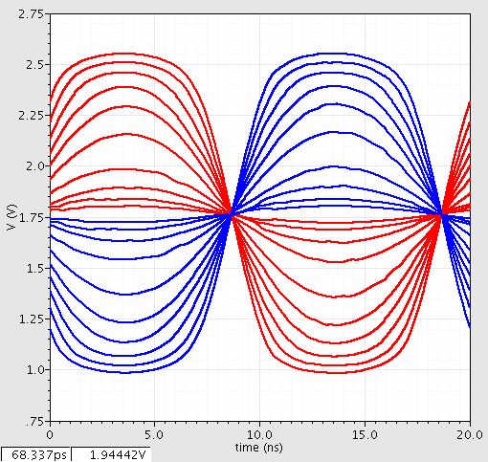
Receiver Dynamic Range @ 50 MHz Base band
-36 dBm
-40 dBm
-45 dBm
-55 dBm
-65 dBm
29 dB Dynamic Range
-60 dBm
-50 dBm
-42 dBm
-38 dBm
-34 dBm

Slide 26
1.5 GHz Base band Performance

Slide 27
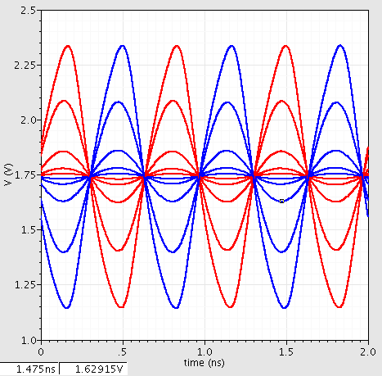
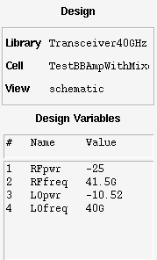
Receiver Dynamic Range @ 1.5 GHz Base band
Input Power
-25 dBm
40 dB Dynamic Range
Stimulus
-45 dBm
-65 dBm
-55 dBm
-35 dBm

Slide 28
Transmitter Design
PA
BALUN
BB Amp Var Gain
Driver Amp
Gilbert Mixer

Slide 29
Variable Gain Amplifier Design
4 bit Digital Gain Control

Slide 30
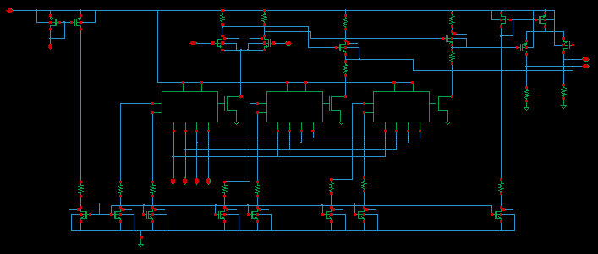
VGA Circuit Topology
Stage1
Level Shifter
Stage2
Current Steering Circuits
Current Sources

Slide 31
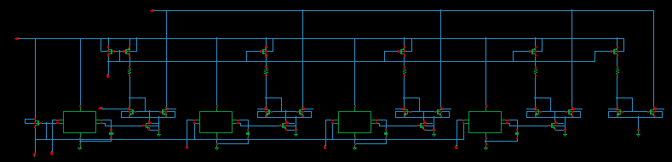
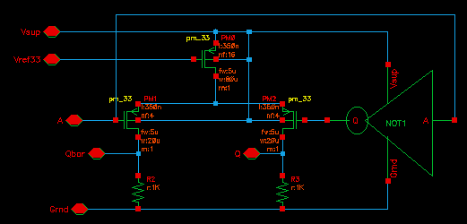
Switched Current Source

Slide 32
VGA Gain vs. Control Word

Slide 33
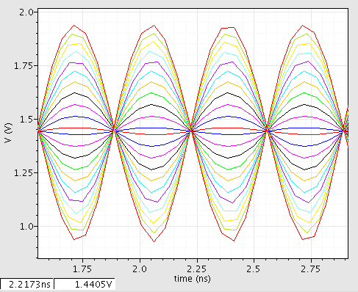
Input Output Voltage Ranges

Slide 34
Gilbert Cell Up-Conversion
High Linearity & Low Conversion Loss

Slide 35
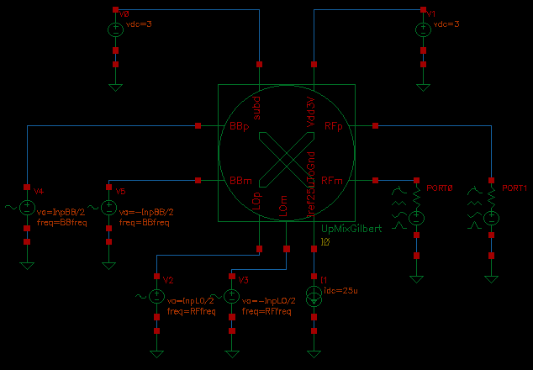
Gilbert Cell Up- Conversion
1.3 V DC
0.3 V p-p
BB DC – 1.5 GHz
100Ω Differential Output
0 V DC
0.2 V p-p
1.8 V DC
0.6 V p-p
LO 37.5 GHz – 39.5 GHz
Simulated @ Typical Inputs

Slide 36
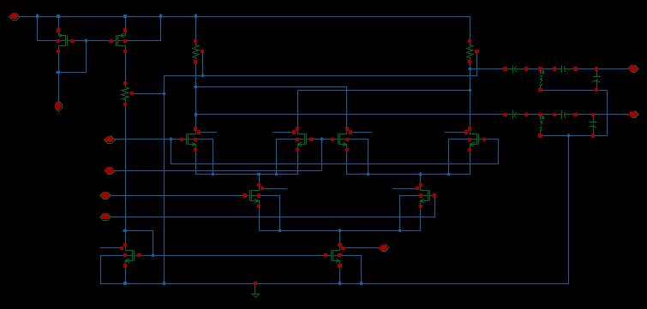
Gilbert Cell Circuit Topology
Output is matched to 100 Ω and Conversion Loss better than 2 dB

Slide 37
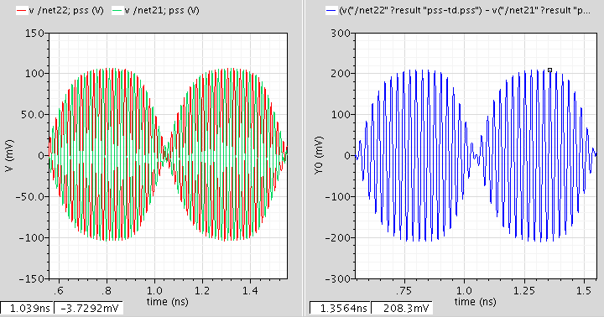
Gilbert Cell Performance

Slide 38
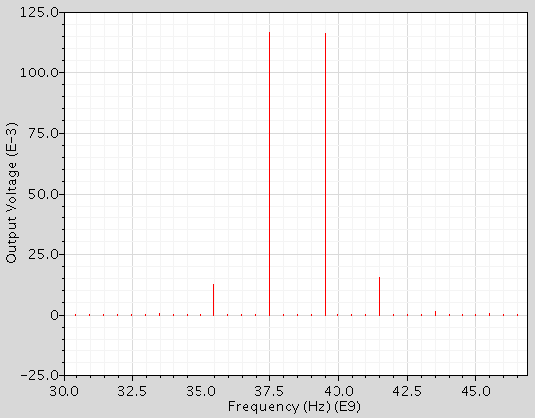
Gilbert Cell Output Spectrum

Slide 39
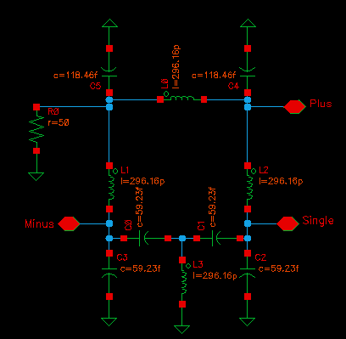
On Chip BALUN for Mixer Output

Slide 40
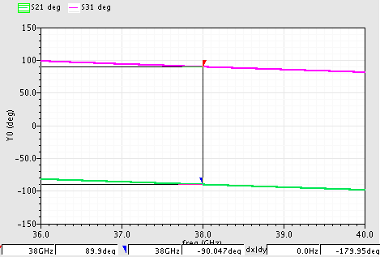
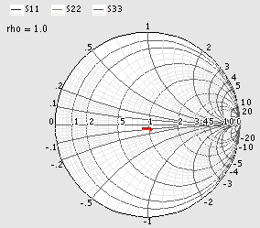
BALUN Performance
Return Loss- 36 to 40 GHz

Slide 41
Power Amplifier Design
Bottom Up Approach

Slide 42
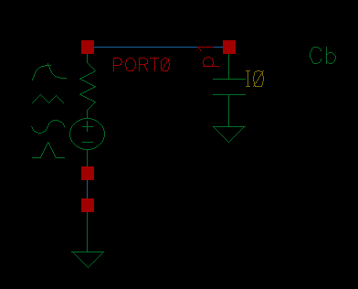
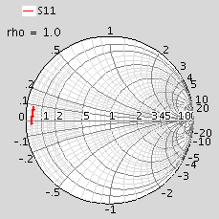
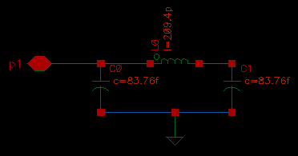
RF Bypass- critical for PA gain
RF Bypass at Supply Nodes isolates Load & Source Match of PA from Internal Impedance of DC Power Supplies
(37.5 GHz – 39.5 GHz)

Slide 43
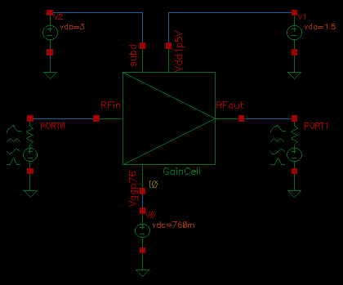
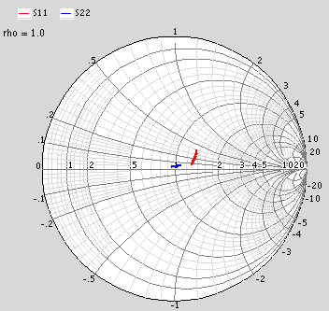
Gain Cell tuned for Small Signal
(37.5 GHz – 39.5 GHz)

Slide 44
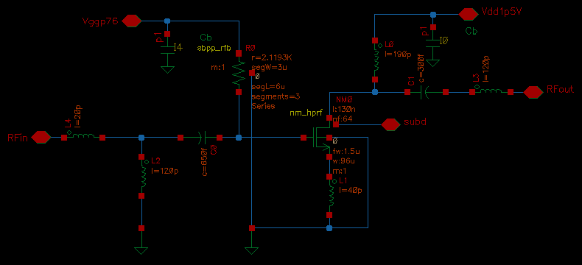
Gain Cell Sub-Circuit
Sub-Circuit is tuned for small signal performance

Slide 45
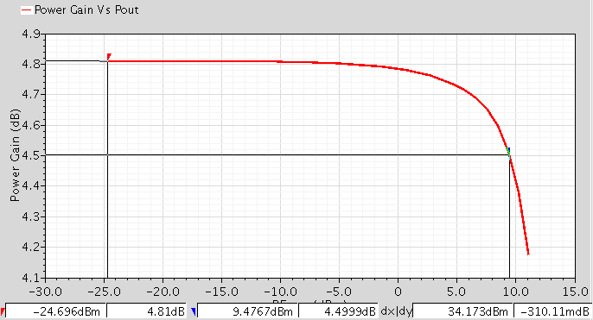
Gain Cell- Large Signal
Sub-Circuit is tuned for large signal performance

Slide 46
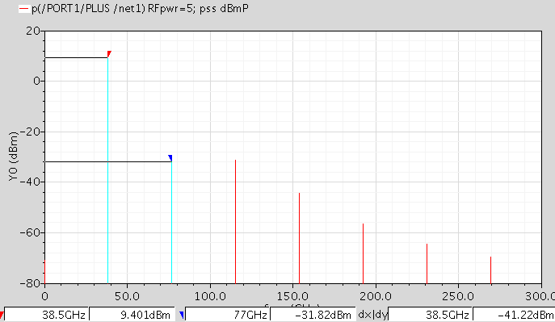
Output Spectrum @Compression

Slide 47
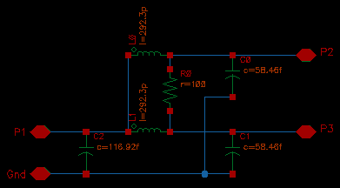
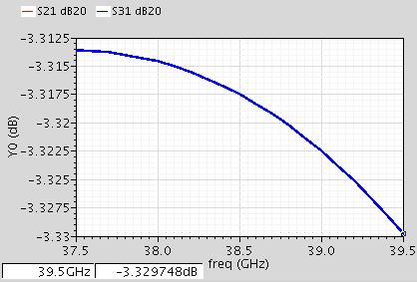
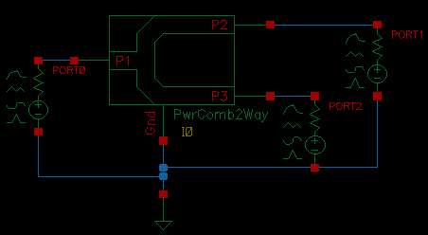
Balanced Power Amplifier
Most common method to boost output power is through power combining. We will use Two Way Wilkinson Power Combiner.

Slide 48
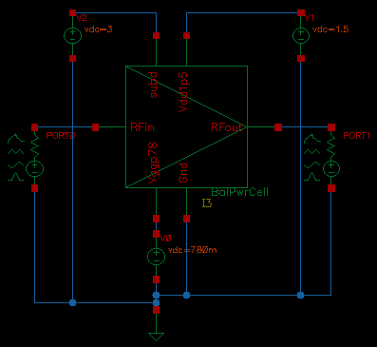
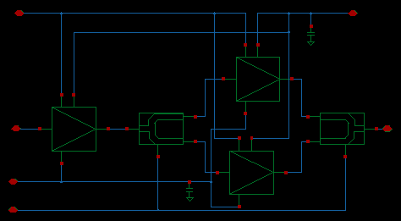
Power Amplifier Topology
Power Cell comprises of balanced cell and driver stage. Balanced cell has power divider at input and power combiner at output

Slide 49
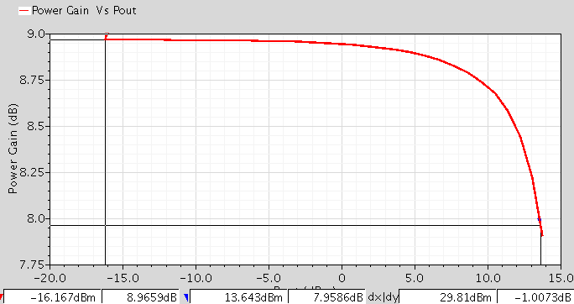
Large Signal Performance
Power Output at Gain Compression of 1 dB

Slide 50
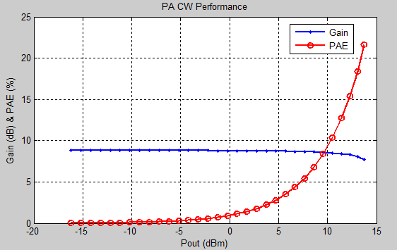
Power Added Efficiency
%PAE Vs. Output Power

Slide 51
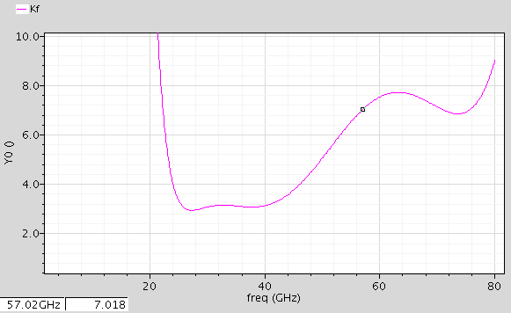
Balanced Cell Stability
Stability Factor >1 across frequency band

Slide 52
Driver Amplifier Design
Minimizing Size & DC Current

Slide 53
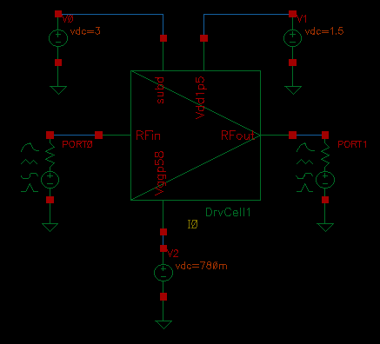
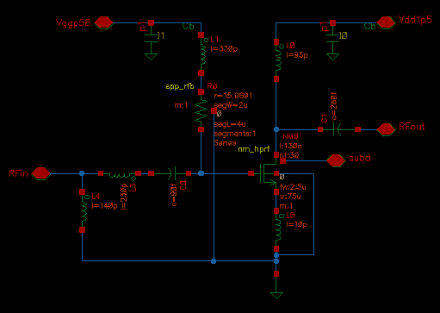
Driver Cell 1

Slide 54
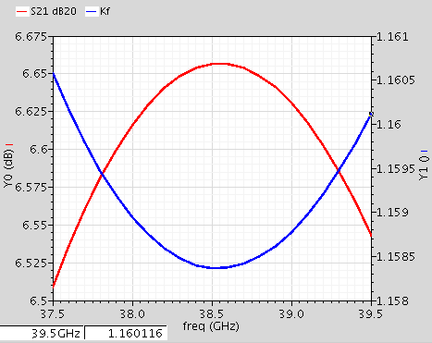
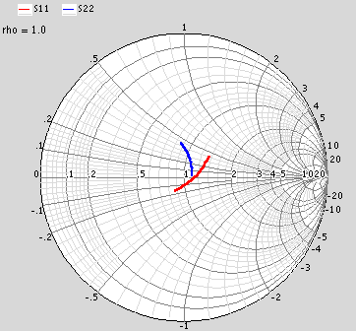
Driver Cell1- Small Signal
(37.5 GHz – 39.5 GHz)
Driver Cell1 is stable with appropriate return losses and descent gain

Slide 55
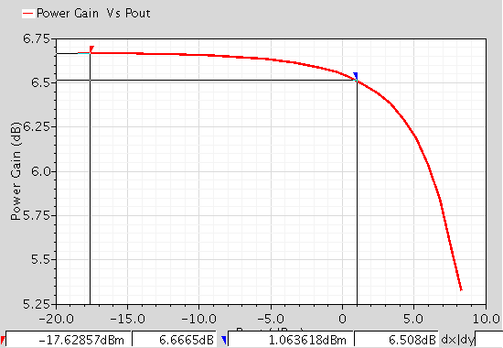
Driver Cell1- Power Capability
From Compression Characteristic of Power Stage and Driver Cell1 it is visible that we need another stage in between for better linearity. Driver Cell1 by itself is not able to drive Power Stage.
We will precede Driver Stage with Input stage of Power Stage to fix this issue.

Slide 56


Output Stage of Driver Amplifier

Slide 57


Input Stage of Driver Amplifier

Slide 58


Driver Input Stage- Performance
Next we cascade both stages of Driver Amplifier to determine over all performance

Slide 59

Driver Topology
Input and Output Stage of Driver are cascaded to design Driver Amplifier

Slide 60

PA with Driver
PA is driven by Driver Amplifier as shown in figure

Slide 61


Small Signal Gain of PA & Driver

Slide 62

Driver & PA- Large Signal
Power Gain compresses by 1 dB at the output power of 13 dBm

Slide 63
Transmitter Integration
Transmitter Performance

Slide 64
Integrated Transmitter
PA
BB Amp Var Gain
BALUN
Driver Amp
Gilbert Mixer

Slide 65

Peak Output Power Performance

Slide 66


Transmitter Linearity & Peak Output Power
-20.15 dB

Slide 67
Future Scope
Finalizing architecture
  FDD or TDD
Frequency planning
  Channel frequencies
  One antenna or two
Phase-locked Loop Design and Fabrication
Switch design
Circulator
IC + PCB/LTCC Integration
LTCC Filter design

