Slide 1
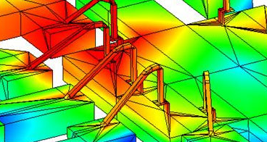
MMIC Design Flow
Anurag Nigam

Slide 2
Tutorial 2
Bias Decoupling or Matching
Bias Decoupling or Matching
2
Output Matching
Input Matching
Active Device
1
3
Day1

Slide 3
Six Caps of a MMIC Designer
MMIC stands for ‘Monolithic Microwave Integrated Circuit’. Due to high frequency, dimensions of lumped components are comparable to wavelength. This makes lumped components behave like distributed circuits. Substrate coupling, package & board parasitic dominate and affect the response of MMIC.
Layout & EM Simulations
Package Design & EM Simulations
Thermal Design & Modeling
Circuit Design
Sensitivity, Yield & DOE
Design Spins
& Documentation
RF Testing
Board Designs & Assembly

Slide 4
On Chip MMIC Circuits
Power Amplifier (PA)
Band Pass Filter (BPF)
Mixer
Power Combiner/ Divider
Low Noise Amplifier (LNA)
High Pass Filter (HPF)
Voltage Controlled Oscillator (VCO)
T/R Switch (SPDT)
Low Pass Filter (LPF)
Patch Antenna Array
Circulator
Band Stop Filter (BSF)
Hybrid
Patch Antenna
Power Limiter
Digital Attenuator
Digital Phase Shifter

Slide 5
Typical Gain Block
Bypass Cap
At DC, Bypass Capacitors are open. At RF, ideally, Bypass Capacitors are short . Role of this capacitor is to isolate Device Impedance from output impedance of DC Supply Voltage.
Bias Decoupling or Matching
Bias Decoupling or Matching
Coupling Cap
Output Matching
Role of Coupling Capacitor is to couple Device and Source/Load Impedance at RF and isolate DC from Load and Source Impedance. This capacitor can be small and part of high pass matching circuit.
Input Matching
Active Device
Device Impedance
With inductive load
Device Impedance
Bias Decoupling or Matching
Bias De-coupling circuit impedance appears in parallel to device impedances. Ideally they should be open circuit at frequency of interest so as to provide full Smith Chart Impedance Range. Th demerit is narrow band width of the circuit and stability issues at high frequency.
Instead of Bias Decoupling, an inductor can be used as part of matching. The merit of using low value inductor is low DC drop across it resulting is higher -1dB Gain Compression Point of Circuit and better stability at High Frequency. Demerit of using an Inductor is lower Impedance Range (Excursion to edge of Smith Chart is not possible, not suitable for large transistors with small impedances)
Input/output Matching
Matches Device Impedance to 50Ω. Lossless network is bilateral
Active Device
Active device provides RF Gain.

Slide 6
Typical Absorptive Type Switch
Bypass Cap
Coupling Cap
2
Roles of Coupling Capacitor & Bypass Capacitor are explained earlier.
1
Bias Decoupling
Resistance is used for decoupling as the gate does not draw any current. Bypass Capacitor and decoupling resistance present impedance to gate that decides phase of S21 across the pass transistors T1 and T3.
3
Pass Transistors
When On, Pass Transistors decide Insertion Loss of the switch. Insertion loss of switch in On path decides Power Capability of Transmit Chain and Noise Figure of Receive Chain.
When Off, Drain to Source Capacitance of Pass Transistors decides Off Path Isolation.
Operation in brief
For Port 1 to be connected to Port 2, T1 and T2 are On and T3 and T4 are Off.
Bypass Transistors
When On, Bypass Transistors terminate the off port in 50Ω.
When Off, Drain to Source Capacitance of Bypass Transistors decides on port impedance and hence the insertion loss of On Path.

Slide 7
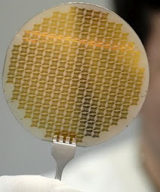
Gallium Arsenide (GaAs) Process
1 GHz
2 GHz
5 GHz
10 GHz
20 GHz
50 GHz
100 GHz
HP 07 Power MESFET (0.7um)
PPH 25 Power PHEMT (0.25um)
PPH 25x High Power PHEMT (0.25um)
Process we will explore through our designs
PPH 15 Power PHEMT (0.15um)
PH 25 Low Noise PHEMT (0.25um)
4” GaAs Wafer
PH 15 Very Low Noise PHEMT (0.15um)
HB20P R/O High Power /Oscillator InGaP HBT
HB20L Low Cost InGaP HBT
HB20S Very High Power
L-S Band InGaP HBT
BES 100 Schottky Diode Technology
Various UMS GaAs Processes

Slide 8
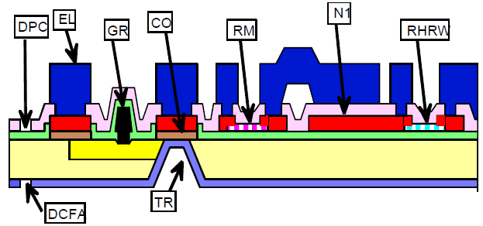
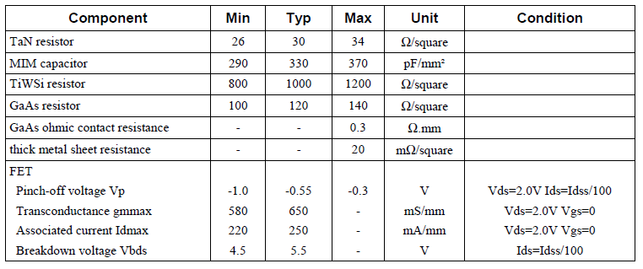
UMS PH 15 Process Summary

Slide 9
Layout Design Rules
Cell Names should not conflict
Only capital are acceptable in cell names
Maximum of 16 characters are acceptable in cell names
‘A’-’Z’, ‘0’-’9’ and ‘_’ are only acceptable characters in cell names
Maximum vertices acceptable in a polygon is 200
All polygons should have enclosed areas. Lines, poly-lines and curves are not acceptable
Hierarchical Layout is acceptable (No need to flatten p-cells)
At Wafer Level all dimensions should be multiples of 1um
Coincident patterns and cells including GR and PL Layers are not acceptable
Transistor Gate Widths should be along horizontal direction
Angles should be multiple of 45° or 90° except for patterns in EL Layers
Chip dimensions should be multiple of 10 um
Chip aspect ratio should be less than 3
Minimum distance between any pattern and dicing street is 20 um
Minimum distance between Substrate Via edge and dicing street is 55 um
Minimum dimensions of bond pad are 100 um x 100 um
Minimum distance between bond pads is 50 um
Text is written in CO Layer using DRC free UMS Alphabets
Dicing streets should be continuous across the wafer
6 mm x 6.1 mm < tile size< 14 mm x 14 mm
Substrate Via in straight lines are not acceptable
Tile y dimension should not be in range 7 to 7.45 mm, 9 to 9.58 mm, 12.6 to 13.4 mm
Area has to be reserved for PCM Cell
Minimum distance between bond pad and air bridge is 50 um
Minimum distance between MIM Capacitor and bond pad is 50 um

Slide 10
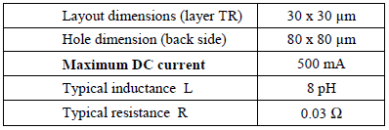
UMS PH 15 Process- Substrate Via
CO
EL
DPC
TR
30 x 30
EL
DPC
N1
CO
80 x 80
GaAs
TR
First Step in design at microwave frequency is to determine Substrate Via Inductance
First Effort to setup EM Simulation is ADS is to define Metal Stack
We have to inspect other components to have complete idea of Substrate Definition in ADS

Slide 11
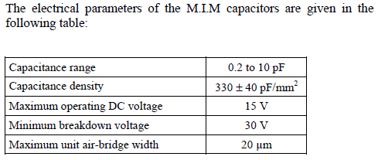
MIM Capacitor
DPC
air-bridge (PEL)
Dimensions of top electrode
Dimensions of bottom electrode
Dimensions of the bridge
EL
N1

Slide 12
Air Bridge
EL
PEL
Gold Plated Metal (EL)
Air
Silicon Nitride (MIM)
TiPtAu Metal (N1)
Silicon Nitride Passivation
With Boron Implant
GaAs
Gold Plated Metal (TR)

Slide 13
Approximate Substrate Definition in ADS
Boundary: Open, Er -Real: 1, Loss Tangent: 0
FreeSpace
PEL
Model: Thick (up), thickness: 3.3um, Real: 5.8e7S/m
Thickness: 2 um, Er -Real: 1, Loss Tangent: 0
EL_VAB
Bridge
EL
Model: Thick (up), thickness: 3.3um, Real: 5.8e7S/m
T: 0.19 um, Er -Real: 7.2, TanD: 0.0004
MIM_SiN
DPC
N1
Model: Thick (up), thickness: 0.5um, Real: 3.4e7S/m
T: 0.2 um, Er -Real: 7.2, TanD: 0.0004
Pass_SiN
DPC_VIA
CO
Model: Thick (up), thickness: 0.19um, Real: 0.125e7S/m
EL_DUMMY
GaAs
Thickness: 100 um, Er -Real: 12.8, Loss Tangent: 0.0003
Cond
Model: Thick (down), thickness: 2.69mil, Real: 4.1e7S/m
FreeSpace2
Boundary: Open, Er -Real: 1, Loss Tangent: 0
DPC_VIA, DPC
Model: 2D Distributed, Real: 3.4e7S/m
EL_VAB
Model: 3D Distributed, Real: 3.4e7S/m
EL_DUMMY
Model: 3D Distributed, Real: 4.1e7S/m

Slide 14
Microstrip Lines
L
EL
T
W
GaAs
Cond

Slide 15
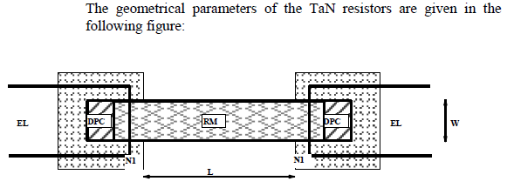
TaN Resistance

Slide 16
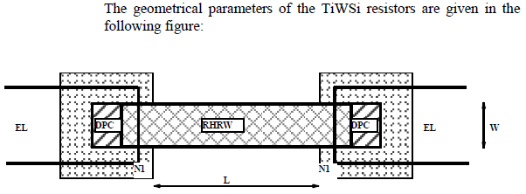
TiWSi Resistance

Slide 17
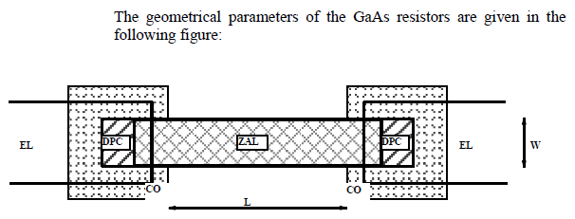
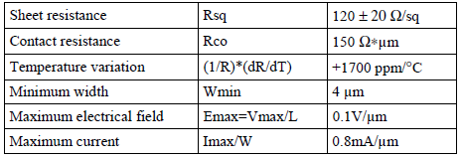
GaAs Resistance- SiN with Boron

Slide 18
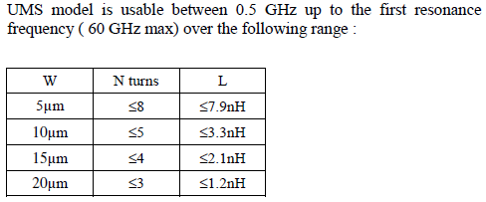
Inductors
air-bridges
EL
Fixed Spacing s=5um
N1
Variable Width
W=5, 10, 15, 20 um
Output node
Input node
Fixed 26 um x 26 um
Fixed inner radius n=20 um

Slide 19
Maximum Current Ratings
Layer | Component | Max. DC current | Max. RF Power | Imax1(Mean) | Imax2(RMS)
EL | Line, inductor, bridge | 7.5 mA/ um |  | 7.5 mA/ um | 47 mA/ um
GR/PL | FET gate | - |  | 3 mA/ um | 3mA/ um
RM | TaN resistor | 0.4 mA/ um | 5 uW/ um sqr. | 0.45 mA/ um | 1 mA/ um
RHRW | TiWSi resistor | 0.1 mA/ um | 10 uW/ um sqr. | 0.4 mA/ um | 0.2 mA/ um
N1 | Inductor, interconnection | 2 mA/ um |  | 2 mA/ um | 22 mA/ um
ZAL | GaAs resistor | 0.8 ma/ um | 77 uW/ um sqr. | 0.8 mA/ um | 0.8 mA/ um

Slide 20
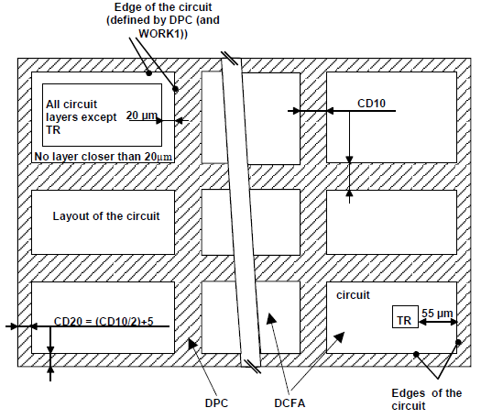
Dicing Street Rules

Slide 21
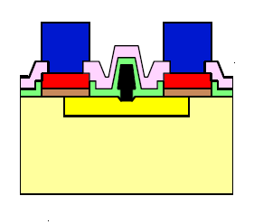
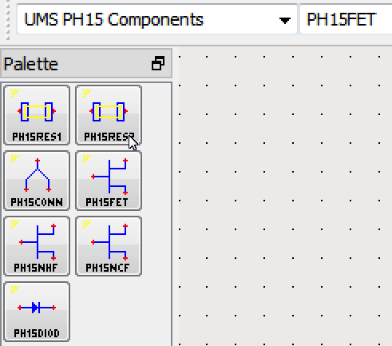
PHEMT Device Models
Gold Plated Metal (EL)
Silicon Nitride Dielectric
TiPtAu (N1 Metal)
Silicon Nitride Passivation
Ohmic metal (CO)
Linear Model for Low Noise Amplifier Design
InGaAs
GaAs
Non-Linear Cold Model for Switching Circuits
AlGaAs
T-shaped Al Gate
Non-Linear Hot Model for Power Circuits

Slide 22
Maximum DC Ratings

Slide 23
Layout Guidelines
Layer Name | GDSII Num. | Technological process step | Min. Grid
ZAL | 02 | Boron Isolation | 0.1 um
CO | 03 | Ohmic Contacts | 0.1 um
PL | 41 | Gate Bus | 0.005 um
GR1 | 14 | Gate (0.15 um) | 0.005 um
GR2 | 44 | Gate (other dimension) | 0.005 um
OUV | 38 | Nitride Opening on CO | 0.1 um
RHRW | 16 | TiWSi resistor | 0.1 um
RM | 06 | TaN resistor | 0.1 um
RMG | 17 | Al/ Au diffusion barrier layer | 0.1 um
N1 | 04 | MIM bottom electrode | 0.1 um
DPC | 05 | Nitride Opening | 0.1 um
PEL | 39 | Air-bridge Layer | 0.1 um
EL | 40 | Gold Plating Metal | 0.1 um
TR | 10 | Via-hole | 0.1 um
DCFA | 11 | Backside Dicing Street | 0.1 um
The recommended grid size for layout is 1 um. Sub-micron grid is acceptable in cells. Spacing, Width, Overlapping, Overhanging, and Enclosure rules for various layers should be read prior to attempting layout and layout based designs

