Slide 1
Low Noise Amplifiers
Anurag Nigam

Slide 2
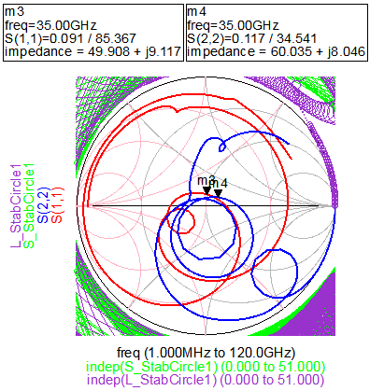
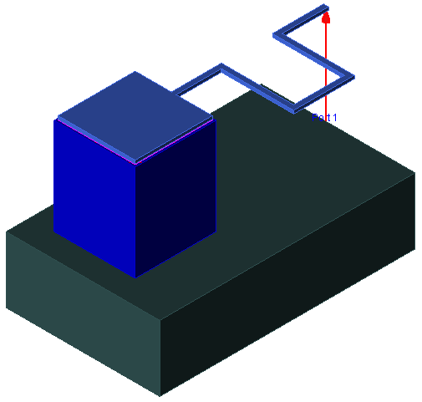
Tutorial 6
Day2

Slide 3
Lab Objectives
In this lab exercise we will
Electrical Specifications of Low Noise Amplifier
Receiver Specifications affected by LNA Characteristics
Sources of Noise in Active Devices & their nature
Design of LNA in Ka-Band
Construction of LNA
LNA Layout & EM Co-simulations
Linear & Non-Linear Characterization of LNA

Slide 4
Electrical Specifications of LNA
Gain
Ratio of Output Power to Input Power expressed as pure number or in dB.
Gain(dB)
Available Gain
In case Input and output mismatch losses are not considered while establishing gain
Power Gain
In case Input and output mismatch losses are considered in gain calculation
Transducer Gain
In case only Input mismatch losses are considered in gain calculation
Return Losses
Ratio of reflected power to incident power at any port of electrical network expressed in dB.
Two Port
Network
Return Losses(dB)

Slide 5
Electrical Specifications of LNA
Reverse Isolation
Ratio of power transmitted to input port to power incident at output port is called Reverse Isolation
Reverse Isolation(dB)
In case of Conjugate Match at Input and Output
Quiescent Current
Current drawn from the DC Supply into Drain or Collector without any RF input
Pin @ -1dB Gain
Compression
Input 1 dB Compression Point is Input power at which Power Gain of LNA drops 1 dB below Small Signal Gain
Third Harmonics
Non-Linear nature of LNA results in harmonics. Harmonics are at integer multiple of frequency of operation (Fundamental Frequency). Harmonics near to fundamental frequency have higher power level as compared to harmonics far away from fundamental frequency. Harmonics with thrice the fundamental frequency are called Third Harmonics.
Second Harmonics
Harmonics at twice the fundamental frequency are called Second Harmonics.
Fundamental
III Harmonic
Complex Signal
II Harmonic
Transfer Function
Or Unit Impulse
Response
Linear Gain
III Order Mixing
II Order Mixing

Slide 6
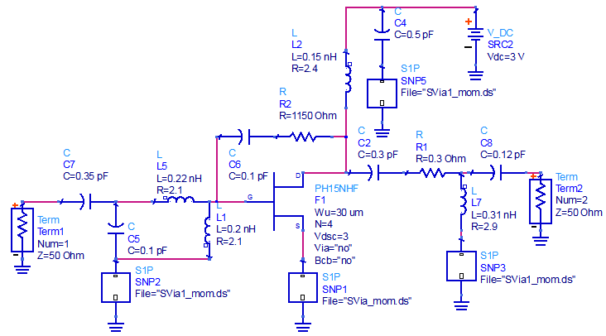
Single Stage LNA
List of Components
DC Biasing at Drain
L2= 0.15 nH, R<2.4Ω
C4=0.5pF
DC Biasing at Gate
L1= 0.2 nH, R<2.1Ω
Output Match
L7= 0.31 nH, R<2.9Ω
C2=0.3 pF, ESR<0.3Ω
C8=0.12 pF
Input Match
L5= 0.22 nH, R<2.1Ω
C1=0.1 pF
C7=0.35 pF
Feedback
R2= 1150Ω
C6=0.1 pF

Slide 7
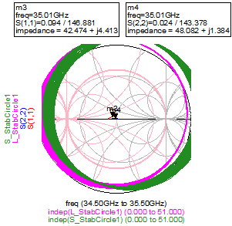
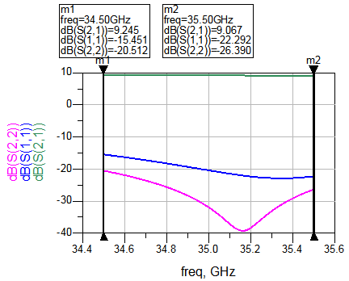
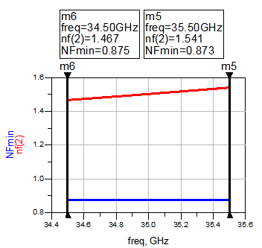
In-band LNA Performance

Slide 8
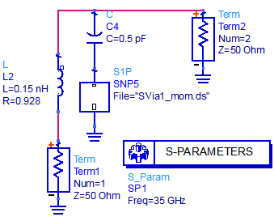
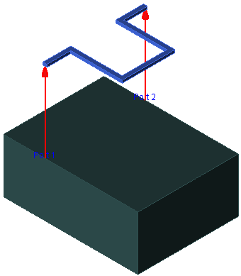
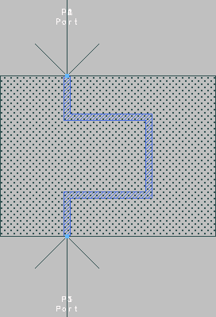
DC Biasing at Drain
Must be a good RF Short or LNA will de-tune due to internal impedance of DC Supply
Inductor Dimensions
cond
EL
30µm
67µm
5µm
EM Simulation Results
Eqn
y=stoy(S)
65µm
Eqn
Lem =imag (1/-y(1,2))/(2*pi*freq)
Eqn
Rem=real(1/-y(1,2))
freq
Lem
Rem
35.00 GHz
150.0 p
928.1 m

Slide 9
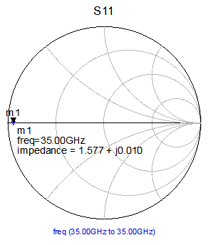
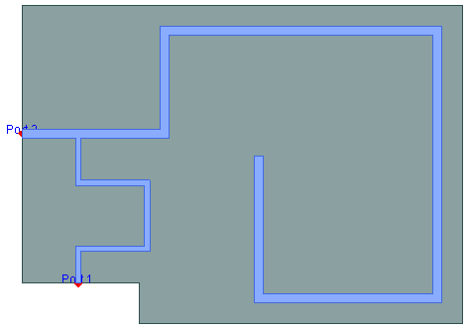
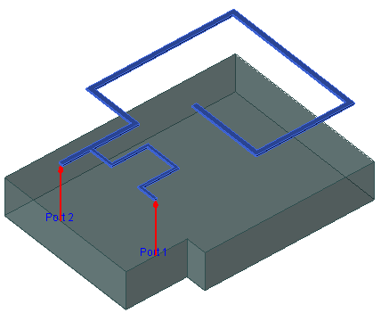
DC Biasing at Drain
260µm
96.8µm
75µm
265µm
100Ω
138.2µm
176.5µm

Slide 10
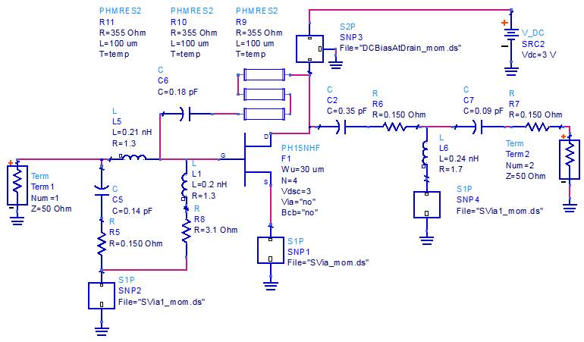
LNA with DC Biasing Circuit
EM Simulated Biasing Circuit
Tantalum Resistance
ESR
ESR
ESR
Design Strategy
Minimize Component Spread in the design. Observe that besides output coupling capacitor all other capacitors in Input / Output Match and Feedback have nearly same value. We choose this value to be 0.123 pF

Slide 11
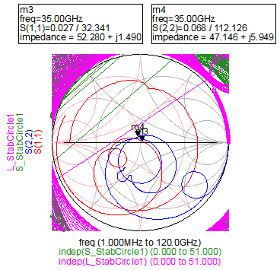
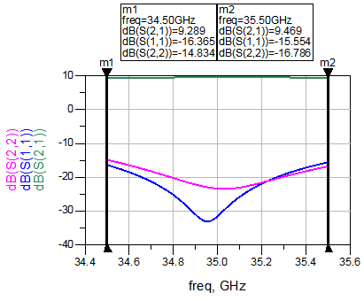
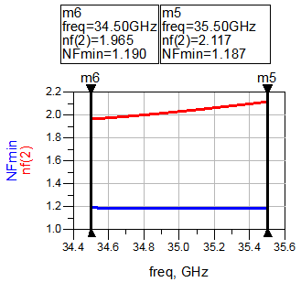
LNA Performance
Stability and Matching
In-band Performance
Noise Figure

Slide 12
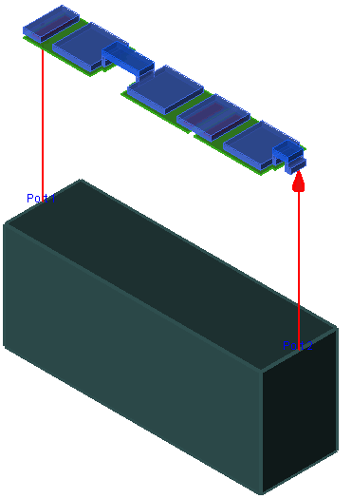
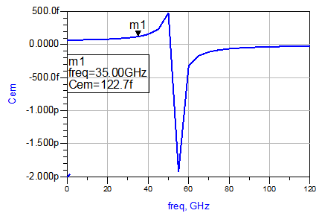
MIM Capacitor
MIM1
MIM2
MIM3
0.2p F PPHCAP2
0.2p F PPHCAP2
0.2p F PPHCAP2

Slide 13
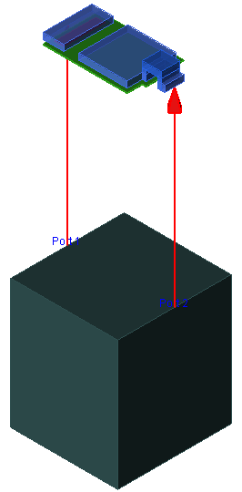
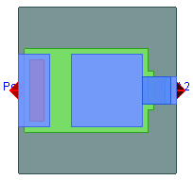
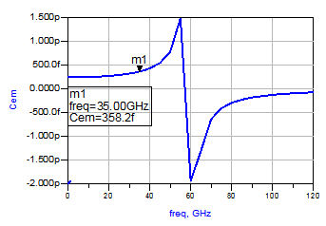
Output Coupling Capacitor
0.22p F PPHCAP2

Slide 14
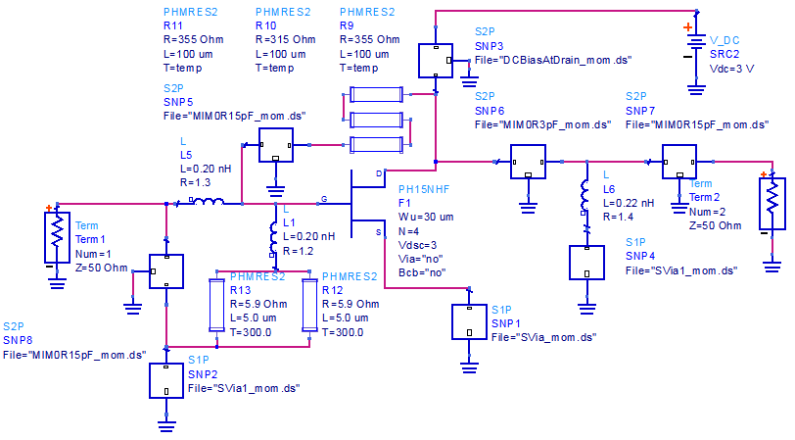
LNA with EM Sim. MIM
Design Strategy
Notice that LNA has been slightly re-tuned after replacing all the MIM Caps with EM Simulated Components

Slide 15
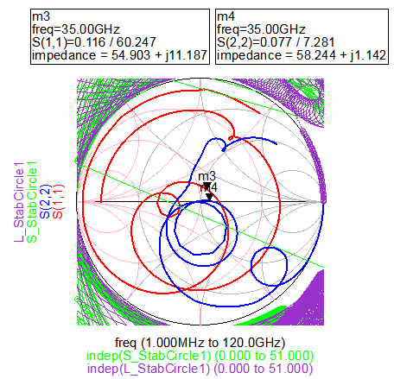
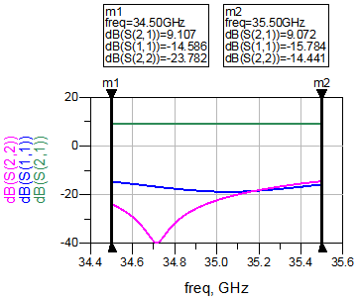
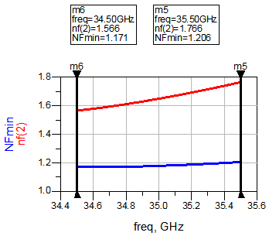
LNA Performance
In-band and out-band Stability
Input / Output Matching
Noise Figure

Slide 16
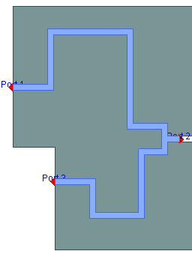
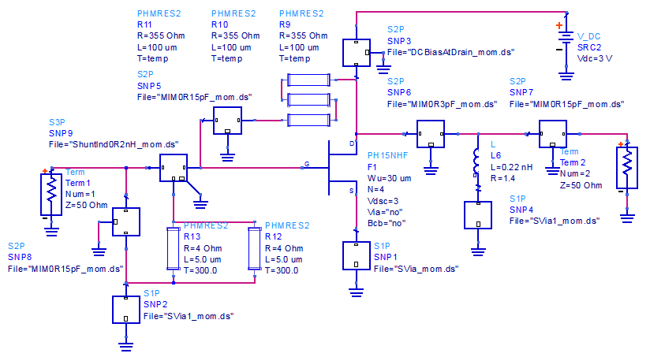
LNA with EM Sim. Input Match

Slide 17
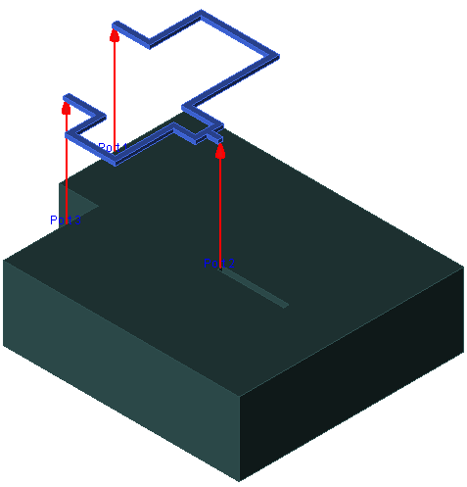
Section of Input Match
73 µm
30 µm
48 µm
81.5 µm
30 µm
11 µm
29 µm
11 µm
54.5 µm
10 µm
30 µm
20 µm
47 µm
Trace Width= 5µm

Slide 18
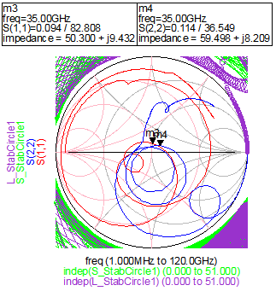
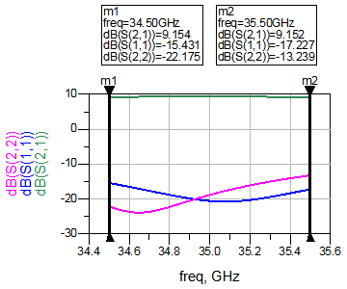
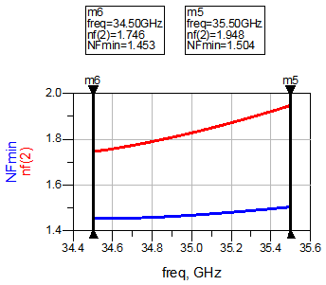
LNA Performance
In-band and out-band Stability
Input / Output Matching
Noise Figure

Slide 19
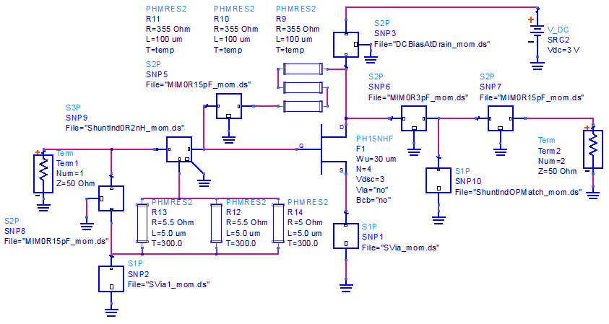
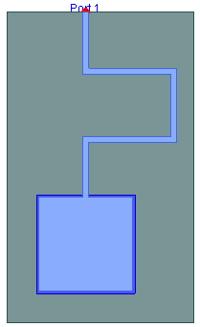
LNA with EM Sim. Output Match
As you can see in the design we have replaced all passive components except resistances by EM Simulated Sections. Through some mindful layout their interactions can be minimized

Slide 20
Section of Output Match
48 µm
75 µm
63 µm
45 µm
Trace Width= 5µm

Slide 21
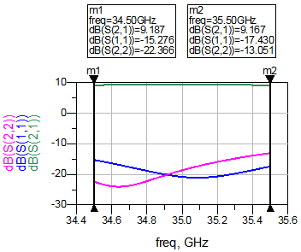
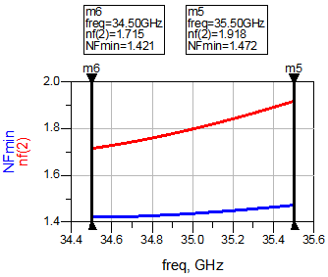
LNA Performance
In-band and out-band Stability
Input / Output Matching
Noise Figure

Slide 22
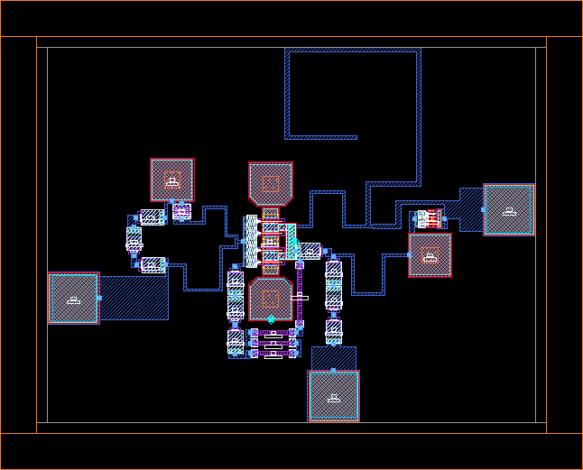
Complete LNA Layout
940 µm
ESD
VDC
Pin
720 µm
Pout
Work1
Work3

