Slide 1
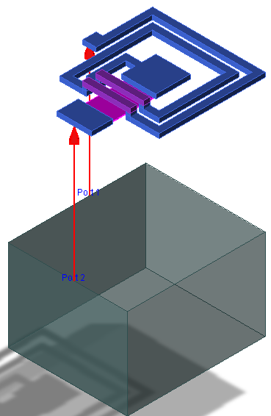
GaAs Process & Devices
Anurag Nigam

Slide 2
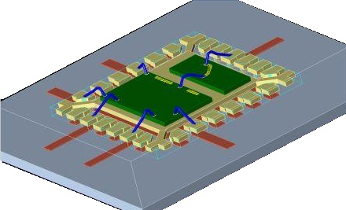
Tutorial 5
EL
PEL
N1
DPC
Day1

Slide 3
Lab Objectives
In this lab exercise we will
Study various DRC Rules that must be followed while drawing shapes in different technology layers in UMS Process
Realize an Inductor Layout, View it in 3-D and Perform EM Simulations
Fit a pi- Model for the inductor from its EM –Simulated S- Parameters and compare it with Circuit Model in pdk
Realize a MIM Capacitor Layout, View it in 3-D and Perform EM Simulations
Compare Capacitance & ESR of MIM Capacitor obtained through EM Simulations with that from Circuit Model in pdk
Small Signal tune a PHEMT Device using passive components with near realistic losses
Establish LNA Stability, Realize Input Output Match with acceptable return losses and noise figure of LNA

Slide 4
DRC Rules
Besides the constraints we have discussed in previous presentation related to geometry and naming convention, we have certain Layout Rules that must be followed while drawing structure in various technological layer. There are some guidelines related to non-technological layers as well. Most of the structures we will draw will be in EL, N1, DPC and PEL Layers for interconnects and custom layout of Inductors and Capacitors. In this section we will be drawing custom Capacitors and Inductors.
Structures for EM Simulations will be slightly different from the layout structures. It is ok to make these changes for EM Simulations but you will have to replace these structures with DC Rules Compliant Structure for Tape Out.
Width (1)
Same Layer Spacing (2)
Notch(2)
Different Layer Spacing (3)
Different Layer Intersection (4)
Different Layer Overlap (5)
Overhangs 3 sides (6)
Overhangs 2 sides (7)
Enclosure (8,9)
Overlapping not allowed
DRC Rules are numbered with convention – Layer Name followed by one of the layout rules above with the numbering shown

Slide 5
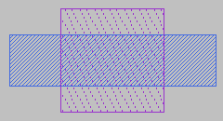
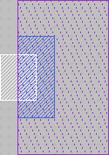
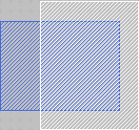
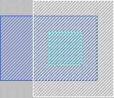
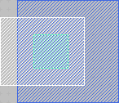
Important EL Layer Rules
EL
Rule: EL1B
EL on PEL Width
20>=W>=5
PEL
Rule: EL10
W>=5
Rule: EL20a
S>=8
Rule: EL20b
EL in Inductors
S=5
DPC
Rule: EL58
EL Overlaps N1
Ov>=2
Rule: EL58B
EL on N1 Overlaps PEL
Ov>=4
Rule: EL68
EL Overhangs N1
Oh>=2
Rule: EL78B
PEL Overhangs EL on N1
Oh>=4
N1
Rule: EL78
N1 Overhangs EL
Oh>=2
Rule: EL89
EL Encloses DPC
En>=2

Slide 6
Important PEL, N1 & DPC Layer Rules
EL
No Inclusions are allowed, Only Rectangle shapes, No edge angle other than multiple of 45º
PEL
DPC shape cannot be drawn outside N1
Rule: PEL10
W>=8
Rule: PEL20
S>=10
DPC
Rule: DPC18
DPC Width on N1
W>=4
Rule: DPC98
N1 Encloses DPC
En>=2
Rule: N110
W>=4
Rule: N120
S>=4
N1

Slide 7
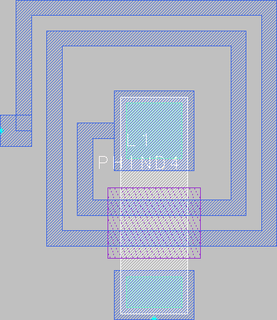
Construction of Inductor
Inductor on EL
S=5 µm
W=5 µm
20 µm
26 µm
2 µm
Air Bridge
4 µm
PEL
N1
Inner loop dimensions, pad size and underpass width, EL Metal to Metal Spacing and EL Metal Width are fixed Options and PDK Sizes Inductor to meet the Inductance requirement. We are just validating the dimensions.

Slide 8
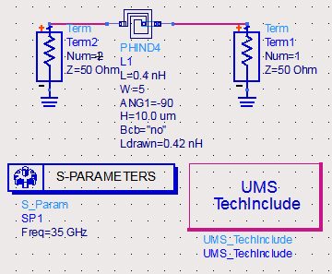
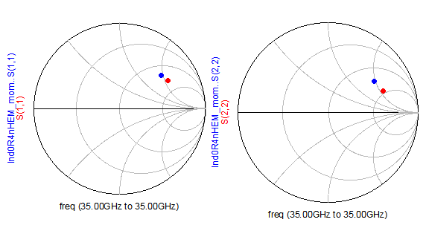
EM Simulation Vs Model for Inductor
EM Sim.
EM Sim.
pdk mod.
pdk mod.
EM Sim.
pdk mod.

Slide 9
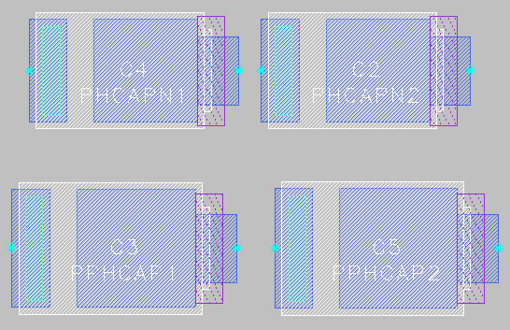
MIM Capacitors in UMS Process
Cap Value & Width Input
Cap Value & Aspect Ratio Input
Lower Precision
PHCAPNx
Higher Spread across Process in same wafer and wafer to wafer
PPHCAPx
Lower Spread across Process in same wafer and wafer to wafer
Higher Precision

Slide 10
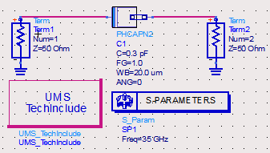
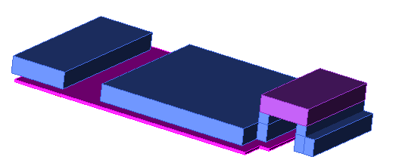
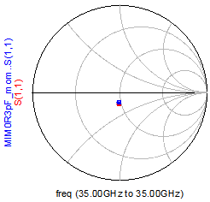
MIM Capacitor Construction
0.3 pF MIM Capacitor PHCAPN2 in UMS Process
EM Simulation Results shown below do not agree with the model
Eqn
y1=stoy(S)
Eqn
y2=stoy(MIM0R3pF_mom..S)
Eqn
C=imag(-y1(1,2))/(2*pi*freq)
Eqn
C1=imag(-y2(1,2))/(2*pi*freq)
Eqn
R=real(1/-y1(1,2))
Eqn
R1=real(1/-y2(1,2))
freq
C
ESR
pdk mod.
35.00 GHz
732.4 f
512.9 m
freq
C1
ESR1
EM Sim.
35.00 GHz
691.4 f
165.4 m

Slide 11
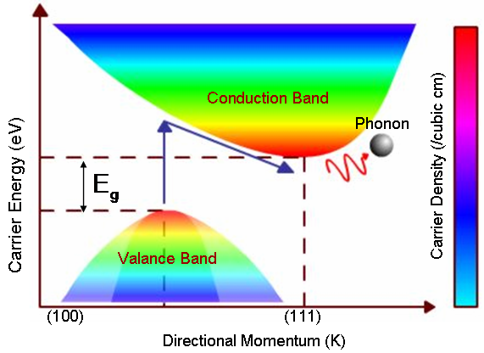
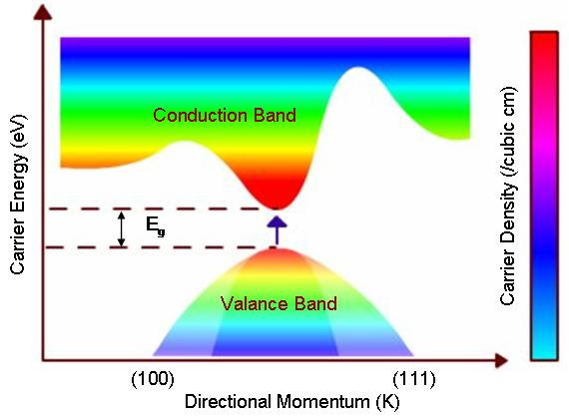
Direct Vs. Indirect Bandgap
Energy Band Vs Wave Number for Indirect Bandgap Semiconductor Material
Energy Band Vs Wave Number for Direct Bandgap Semiconductor Material
Examples: Si, SiGe, Ge
Examples: GaAs, InGaAs, AlGaAs, InP

Slide 12
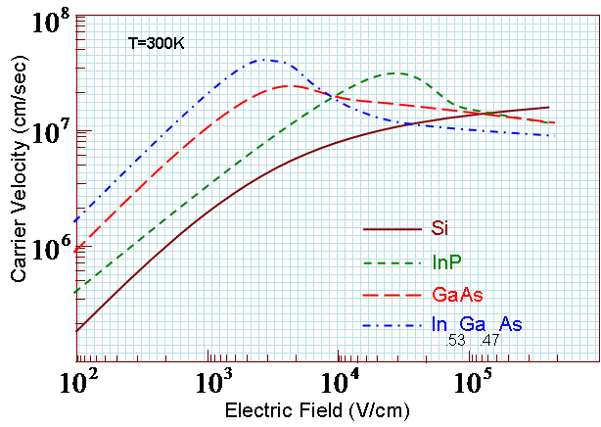
Velocity Overshoot
Velocity Overshoot due to Reduced Carrier-Carrier Interaction in High Energy less occupied state

Slide 13
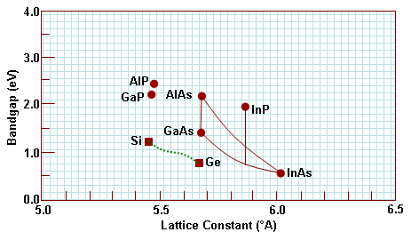
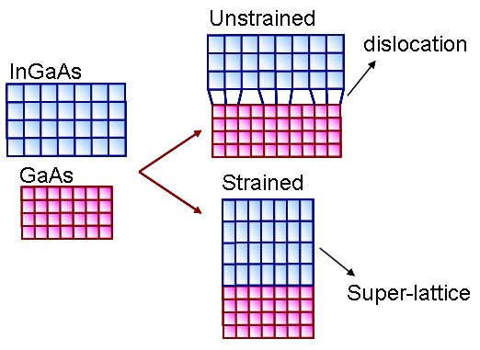
Pseudomorphic Quantum Well

Slide 14
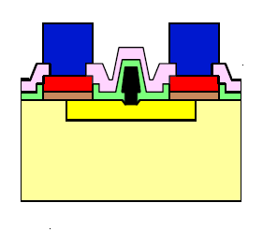
Quantum Well at Hetero-junction in PHEMT
Bandgap discontinuity will be removed through grading
Quantum Well
P-Type
N-Type
P-Type
N-Type
Critically Biased Hetero-junction
Unbiased Hetero-junction
AlGaAs
Ohmic Metal (CO)
InGaAs
GaAs
T-shaped Al Gate

Slide 15
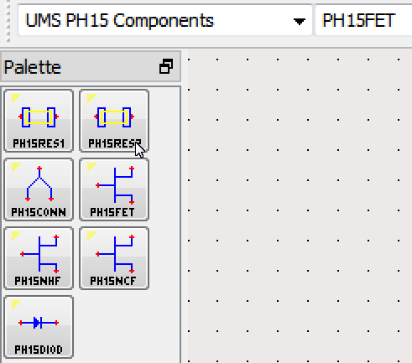
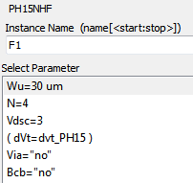
PHEMT Models in UMS PDK
Figure shows the purpose for which 3 PHEMT Models have been created
We will use PH15NHF Model for LNA and PA Designs. Noise Sources are built into this model for LNA Design and Simulations.
Linear Model for Low Noise Amplifier Design
Non-Linear Cold Model for Switching Circuits
Model without Source Via Inductance
Non-Linear Hot Model for Power Circuits
PHEMT devices can have negative as well as positive gate bias. We have to bias the device using negative gate voltage to keep low quiescent current. In case the circuits have only positive supply voltage, generation of negative voltage requires DC-DC converters with rectifiers and filters. Gate bias also needs to be free from noise.
To do away with these problems, we will use 0V gate bias and to keep quiescent currents low we will size the device. The drawback is that small devices have slightly higher noise figure

Slide 16
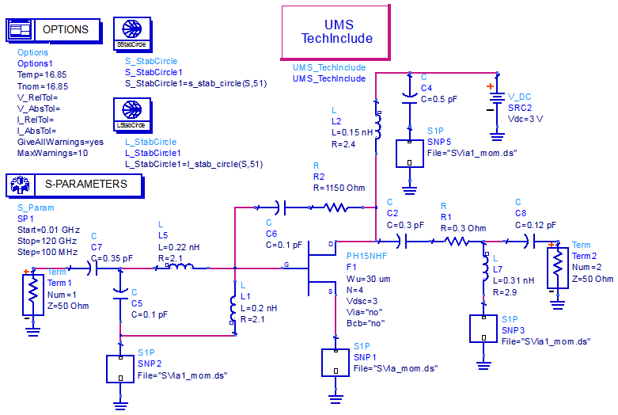
LNA Circuit Design

Slide 17
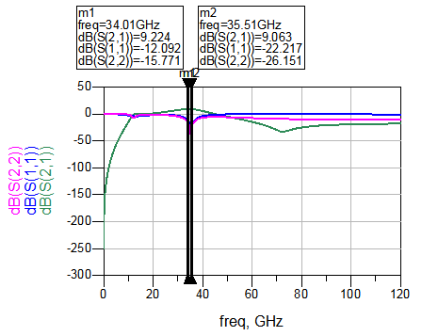
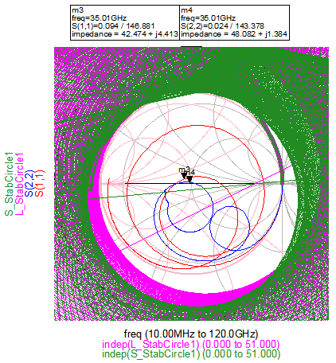
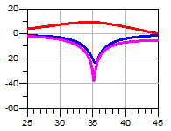
LNA SS-Stability, Return Losses & Gain
There is low pass match at the input and high pass match at the output. The goal is to tune the match components such a way that gain and return loss requirements are met across band. In our case the band of interest is 34.5 GHz to 35.5 GHz.
A band pass circuit is better for out-band stability
Lead Compensation and Source Degeneration establishes stability
Bias Decoupling is not used to improve compression characteristics
We will discuss LNA separately in other presentations

