Slide 1

Design & Training Services
Anurag Nigam
Phone: 0091 9158580922
0091 9623299070
e-mail: nigam_anurag2011@nattelmicro.com
Experience, Capabilities & Business Model

Slide 2

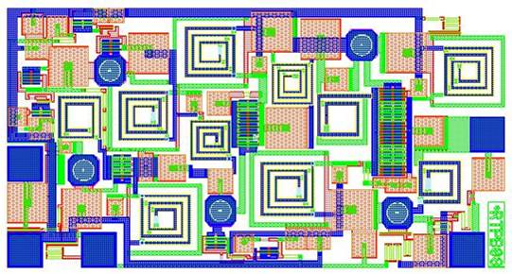
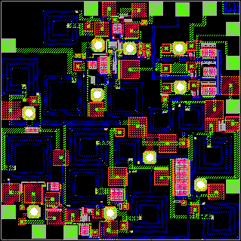
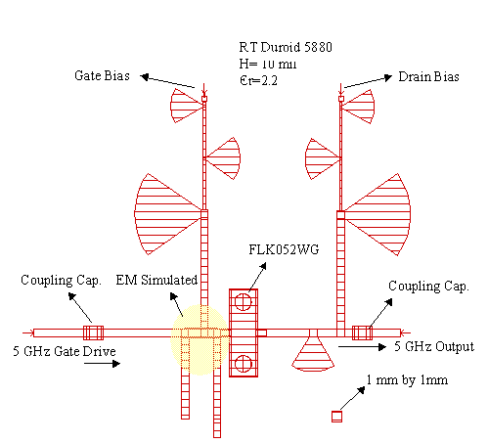
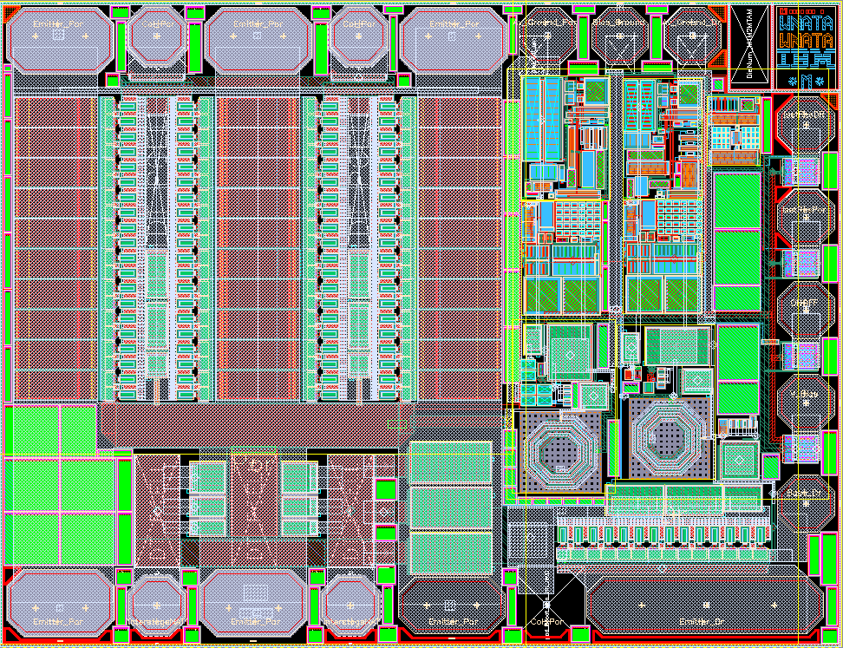
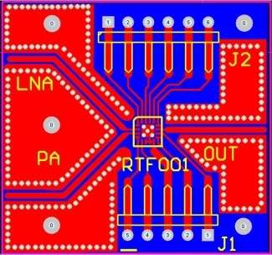



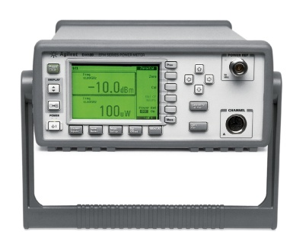
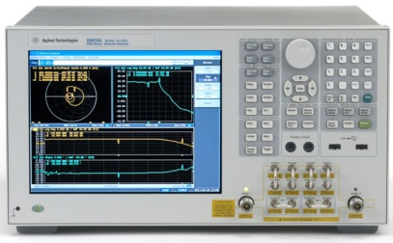


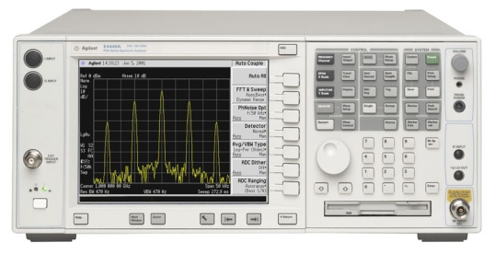
About Us
Technical Education
& Consultancy Services
NatTel Microsystems Private Limited
www.nattelmicro.com
Design Software
Test & Measurement
www.agilent.com

Slide 3
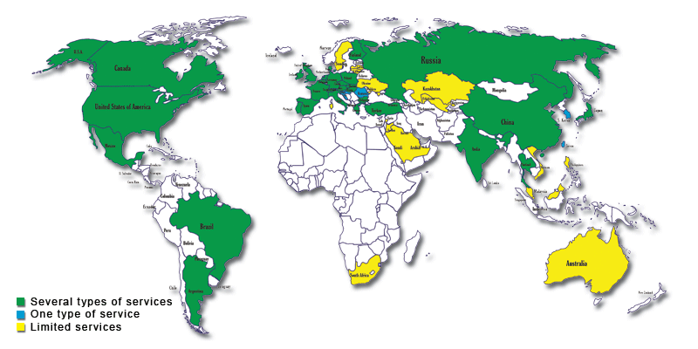
Your Interests!
Requires
Education
Technology
Training
Infrastructure for
Manufacturing
Goals
Favorable Destination for outsourcing
Technologically independent for internal markets
Robust Indigenous Defense Technologies

Slide 4




Highly Skilled Workforce
Through our concerted efforts we put you on fast track path to growth
We, Agilent & NatTel Micro, understand your Aspiration
We open avenues for Job Creation, Promote Foreign Investment, Self Sufficiency in Consumer & Defense Technologies
We bring to you cutting edge Technology, through trainings & consultancy in areas of Consumer & Defense Technology.
Economic Prosperity & Self Sufficiency

Slide 5
Interests & Outcomes
Students
Industry
Academic Institutions
Interests
Learning & Innovation
Recognition of Work
Future Prospects in
Industry
Financial Security
Competitive Workforce
Shorter Probation Time
Clean and Timely Execution
No Confusions
Innovation & Application
Profitability
Tangibility
Innovation & Recognition
Financial Gains in Long Run
Expected Outcomes
Better Jobs
Better Paying Jobs
Better Growth Prospects
Financial Security
Balance with social life
Company Value
Company Growth
Profits
Market Foothold
Publications
Projects as Success Stories
Student Strength
Industry Assistance

Slide 6
University & Industry Ecosystem
Institution as first choice of
students and industry
Course Definition And
Preparation
Lab. Planning, Procurement and
Setup
Designing & Conducting
Proper Courses
Paper Publication in International
Journals
Identifying Joint Projects
Faculty Awareness and
Experience
Executing Projects with Industry
Assistance
Interfacing with Industry for
Placement
Comprehensive Learning with
Practical Experience
Assistance & Concessions from
Industry
Placement of Students
Research Projects

Slide 7
Consultant’s Profile
Anurag Nigam
Phone: 0091 9158580922
0091 9623299070
e-mail: nigam_anurag2011@nattelmicro.com
Training & Design

Slide 8






Educational & Professional Background
Director, NatTel Microsystems Pvt. Ltd., Goa
4year & 3 Months
RFIC/MMIC Consultant, Agilent Technologies Inc., Asia Pacific Region
1 Year
RFIC Consultant to Persistent Systems Private Limited, Goa
6 months
Associate Technical Manager, Persistent Systems Pvt. Ltd., Goa
1 & 1/2 year
Senior Design Engineer and Project Manager, RF Arrays Systems Pvt. Ltd, Nagpur
1 year & 4months
RFIC Designer, IBM Boston Design Center, Lowell, MA
2 years & 8 months
Master of Technology
in Satellite Technology and Applications, Indian Institute of Science (IISc) Bangalore, India (2000)

Slide 9
Trainings
Trainings Conducted
One Day “Antenna Design” Training, Agilent, Singapore
One Day “MMIC Design” Training, SAMEER, Kolkata
Two Days “Power Amplifier Design” Workshop, Space Application Center, ISRO, Ahmadabad
Five Months Training, Birla Institute of Technology, Pilani-Goa Campus, Goa
Five days “SiGe BiCMOS Design” Training, R&D Telecom Malaysia
One Month “Millimeter Wave LNA & VCO Design” Workshop, R&D Telecom Malaysia
Two Month “Dual Band (Wi-Fi/ WiMAX) PLL Design for Direct Conversion Transceiver” Workshop, R&D Telecom Malaysia
Three Days “Advanced RF Design using Genesys” Training, MACRES, Malaysia
Thee Days “Advanced Communication System Design using Ptolemy” Training, UniMAP, Kuala Perlis, Malaysia
Five Days “Advanced RF Design using ADS” Training, Motorola, Penang, Malaysia
Three Days “Microwave Passive Design using ADS” Training, CoreEL Technologies, Bangalore
Three Days “Ka Band LNA & PA Design using ADS” Training, Space Application Center, ISRO, Ahmadabad
Five Days “ MMIC Design & simulations using ADS” Training, International University, HCMC, Vietnam
Two Days “ADS2011 Fundamental” Training, VIT, Mumbai; AIT, Delhi; RIT, Nagpur; AMU, Aligarh

Slide 10
Projects Accomplished
 | Projects | Company | Duration | Process
1 | Dual Band (Wi-Fi / WiMAX) multi modulus fractional N PLL | Telecom Malaysia R&D | 4 months | Silterra 0.13 um CMOS
2 | NADC/PDC SiGe Power Amplifier MMIC | IBM Microelectronics, Boston Design Center | 4 months | IBM SiGe 5 HP
3 | WCDMA SiGe Power Amplifier MMIC | IBM Microelectronics, Boston Design Center | 8 months | IBM SiGe 5 AM
4 | IS95 CDMA SiGe Power Amplifier MMIC | IBM Microelectronics, Boston Design Center | 3 months | IBM SiGe 5 AM C4
5 | SiGe MOSFET Predistorter Linearizer | IBM Microelectronics, Boston Design Center | 3 months | IBM SiGe 5 AM
6 | 5 GHz / 10 GHz Class E Power Amplifier MIC | Indian Institute of Science & LRDE, DRDO (Defense) India | 6 months | Fujitsu MESFET
7 | WLAN GaAs Power Amplifier/ Low Noise Amplifier/ TR Switch | RF Arrays Systems Pvt. Ltd., Triquint Semiconductors | 1 yr & 4 months | TQPED GaAs pHEMT Process
8 | 2.8 GHz SiGe VCO MMIC | Persistent Systems Pvt. Ltd. | 2 months | IBM SiGe 6 DM

Slide 11
Projects Accomplished
 | Projects | Company | Duration | Process
9 | Wi-Fi SiGe Mixer for Dual Conversion Transceiver | Persistent Systems Pvt. Ltd. | 2 months | IBM SiGe 6 DM
10 | 60 GHz SiGe Quadrature Mixer | Telecom Malaysia, R&D | 2 months | IHP SiGe 25H
11 | 60 GHz SiGe Low Noise Amplifier | Telecom Malaysia, R&D | 2 months | IHP SiGe 25H
12 | Zigbee Patch Antenna | Agilent | 1 months | Board
13 | 52 W MIC ISM Band Power Amplifier | Agilent | 1 months | FreeScale
14 | 24.12 GHz LNA & PA | Space Application Center | 1 months | UMS
15 | 5.8 GHz LNA, PA & Switch Design | International University, HCMC | 1 month | WIN pHEMT Process

Slide 12
Fabrication Experience
Silicon
AMI Semiconductor 0.5um
CMOS
Silterra 0.13um CMOS
IBM SiGe
BiCMOS
SiGe HBT
IBM SiGe BiCMOS 5HP 0.5um
IBM SiGe BiCMOS 5PA 0.5um
IBM SiGe BiCMOS 6DM 0.18um
IHP SiGe BiCMOS 25H
GaAs
TRIQUINT HBT
HBT
TRIQUINT TQTRX
MESFET
TRIQUINT TQPED
P-HEMT
UMS PHEMT
WIN PHEMT

Slide 13
Capabilities
RFIC, MMIC & Millimeter wave IC Designs
1 | Power Amplifiers- Linear & Saturated Power Amplifiers
2 | Low Noise Amplifiers- CMOS Differential and Single Ended Low Noise Amplifiers
3 | Transmit & Receive Switches
4 | Voltage Controlled Oscillators
5 | Fractional N PLLs
6 | Mixer- Gilbert Cell, Quadrature Balanced, Diode Balanced
7 | High Precision Voltage Reference for Flash Converters
Plastic & LTCC Package Design and Modeling for SIP/ MCM
Passive Components
1 | BALUNS
2 | Power Divides/ Combiners
3 | Hybrids & Couplers
4 | Patch Antenna Arrays & Phase Shifters
5 | Filters

Slide 14
Capabilities
Device Benchmarking (Probing) & Modeling
Simulation & Modeling Tools
1 | Agilent ADS, Genesys, EMPro, SystemVue
2 | AWR Microwave studio
3 | Cadence
4 | Ansoft HFSS
5 | Agilent IC Cap
Measurement & Testing
1 | Maury Load Pull, ATN Load Pull
2 | Noise Figure & Phase Noise Measurements
3 | Linearity Measurements (Connected Solution)
Assembly
1 | Die Attach, Package Attach
2 | Wedge & Ball Bonding
3 | Soldering

Slide 15
Our Expertise- Radio Front End
Radio Front End
Power
Amplifier
Functionality
Amplifies signal to be transmitted
Amplifies received signal with least noise addition
Switches between transmitted and received signal
Switch
Low Noise
Amplifier
Radio
Digital Baseband
Transceiver
Radio
Front End
Antenna

Slide 16
Our Expertise- Transceiver
+
I
Direct Conversion Transceiver
_
90º
Functionality
Up converts baseband to RF and Down converts RF to baseband
Selects channel of communication
+
Q
_
Channel
Selection
VCO/PLL
0º
+
I
_
Radio
90º
BALUN
+
Q
_
Digital Baseband
Transceiver
Radio
Front End
Antenna

Slide 17
Design Examples
Anurag Nigam
Phone: 0091 9158580922
0091 9623299070
e-mail: nigam_anurag2011@nattelmicro.com
MMIC, RFIC & MIC Designs

Slide 18
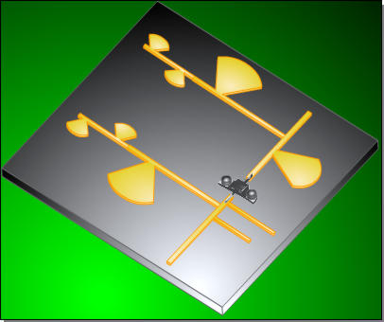
High Efficiency Class E Power Amplifier
Measurements
Frequency | 5 GHz
P input | 18 dBm
P output ( I Harm. ) P output ( II Harm. ) P output ( III Harm. ) | 27.5 dBm
 | -19.3 dBm
 | -30.3 dBm
Ids | 80 mA
P dc | 760 mW
Drain Efficiency | 73.99 %
Gain | 9.5 dB
P.A.E | 68.32 %

Slide 19
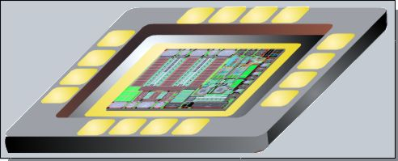
WCDMA 3GPP SiGe PA

Slide 20
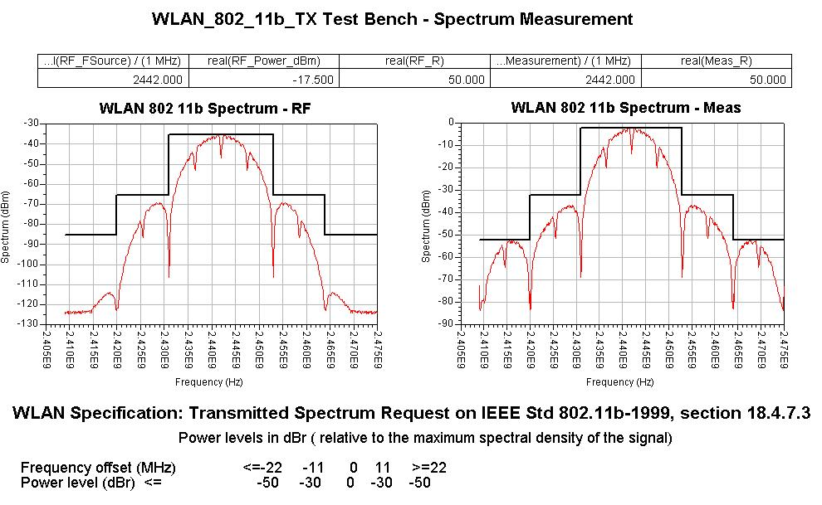
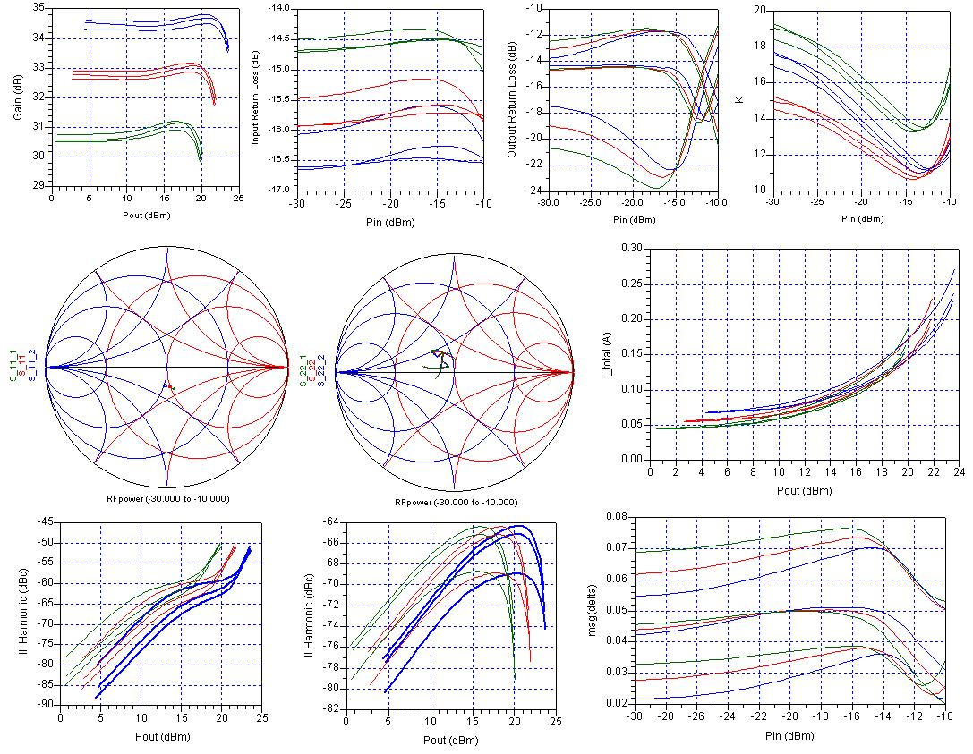
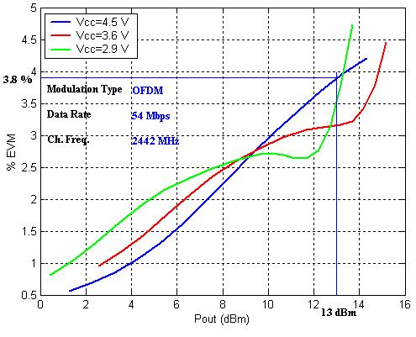
Wi-Fi 802.11 b/g Three Stage PA
2.9 V
3.6 V
4.5 V

Slide 21
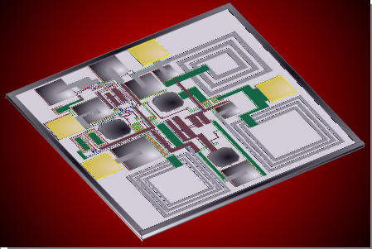
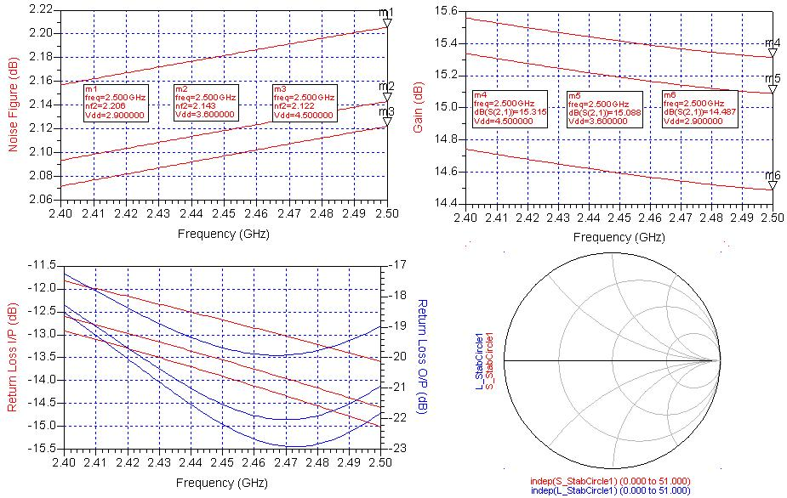
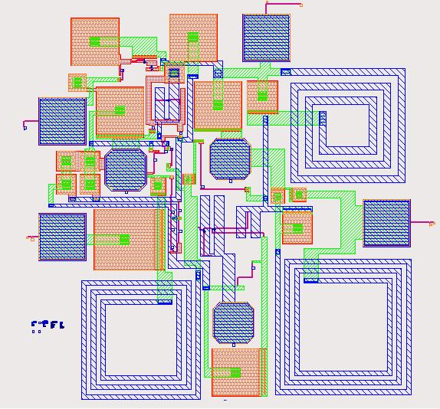
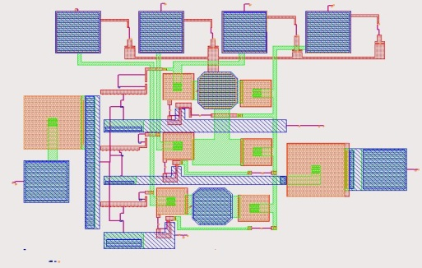
Wi-Fi 802.11 b/g Cascode LNA & TR Switch

Slide 22
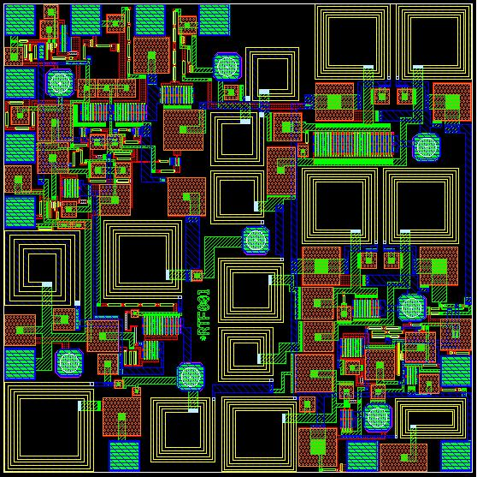

Wi-Fi 802.11 b/g Radio Front End
Full FEM
PA
SPTT Switch
LNA
Bias Networks
ESD
TR/BT Switch
1.5 mm
Evaluation Board for FEM
Low Noise Amplifier
1.5 mm

Slide 23
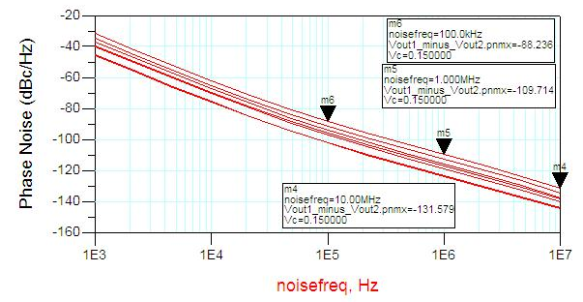
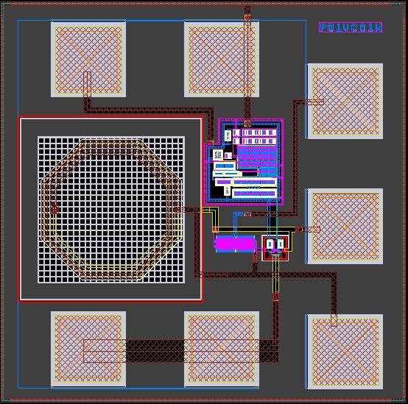
Wi-Fi / WiMax VCO
Electrical Parameters | Target Specs. | Simulated
Frequency of Operation | 2.55GHz-2.94GHz | 2.6GHz-2.9GHz
Supply Voltage (Vcc) | 2.9-4.5V | 2.9-4.5V
Power Dissipation (Core) | <3mW | 2.95mW
Power Dissipation (Total) | <18mW | 7.74mW
Phase Noise @ 100 KHz | -95dBc/Hz | -88dBc/Hz
Phase Noise @ 1 MHz | -110dBc/Hz | -109dBc/Hz
Phase Noise @ 10 MHz | -126dBc/Hz | -131dBc/Hz
Harmonic Distortion (II) | -22dBc | -25dBc
Harmonic Distortion (III) | -28dBc | -32dBc
Thermal Stability(-40/80 C) | 10KHz/C | 8KHz/C
Bias Circuit | Present | Present

Slide 24
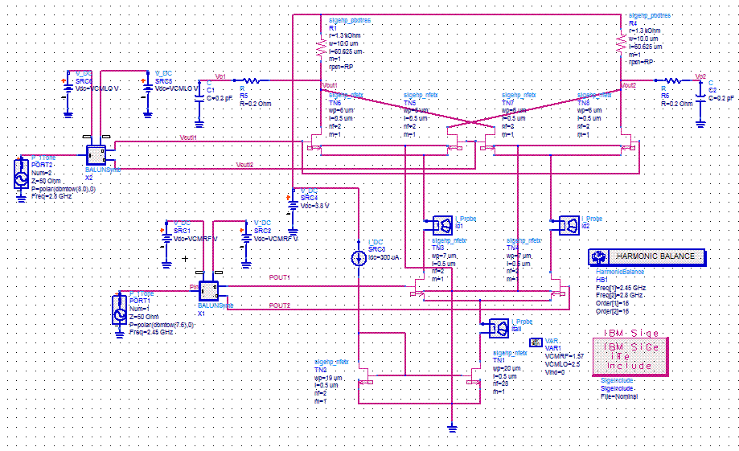
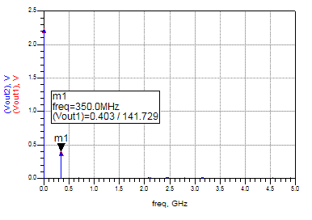
Mixer Design for Wi-Fi Transceiver

Slide 25
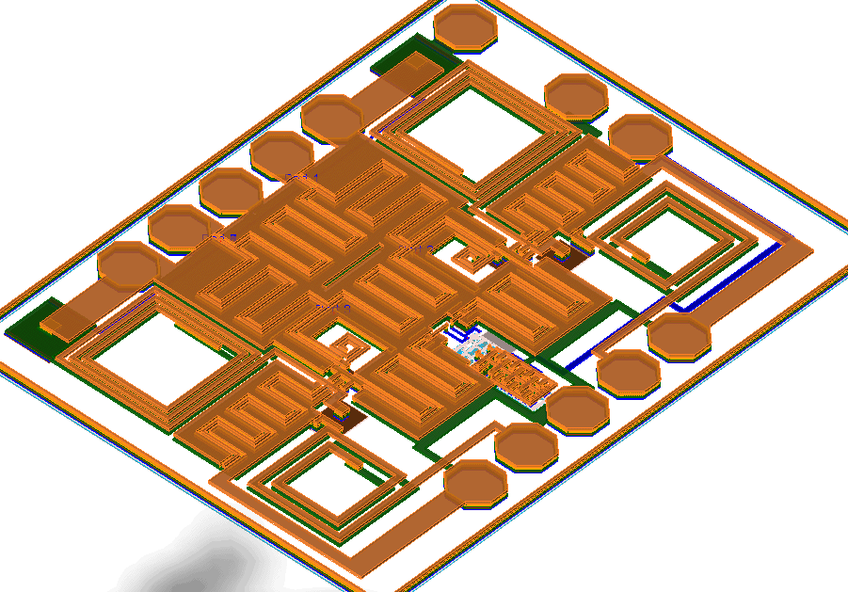
60 GHz Quadrature Mixer Design
VDC2
GSGSG
RF
VDC1
LO
Die Size 900 um x 700 um
Two DC Supplies- 1.8 V and 3.3 V
Quiescent Current of 6 mA from 1.8 V supply and 1.7 mA from 3.3 V supply
Across band conversion loss better than 1 dB
-1 dB Input Compression at -3.6 dBm RF input
LO is 57 GHz and 0 dBm
RF is 61.8 to 63.5 GHz
IF is 4.8 to 6.5 GHz
Noise Figure better than 12 dB
Temperature Compensated Bias Circuit (-40 to 85 Degree Celsius )
Phase Balance better than 3 degrees
Gain Balance better than 0.5 dB
IF+
IF-
GSGSG

Slide 26
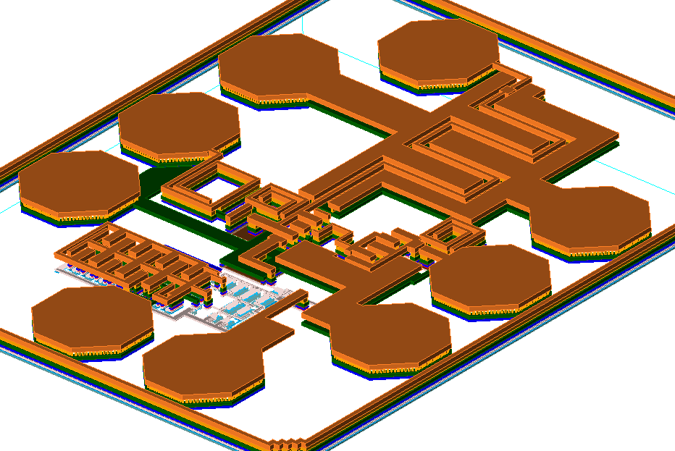
60 GHz LNA Design
Die Size 440 um x 430 um
DC Supplies- 3 - 3.6 V
Quiescent Current of 17 mA
Gain > 7.6 dB
Return Losses < -10 dB
Noise Figure 7.2 dB
Temperature Compensated Bias Circuit (-40 to 85 Degree Celsius )

Slide 27
Dual Band Multi-Modulus Fractional N PLL for Wi-Fi / WiMAX
2.3-2.7 GHz
3.3-3.9 GHz
Band Select
0º
90º
0º
90º
PFD
CP
Loop Filter
OCXO
CML to
CMOS
5/6-bit MMFD
Divide
By 2
CMOS to CML
5/6 select
6-bit Adder
3rd Order
ƩΔ Modulator
Load
5/6-bit Register
Clk
Fraction Count
Coarse Count

Slide 28
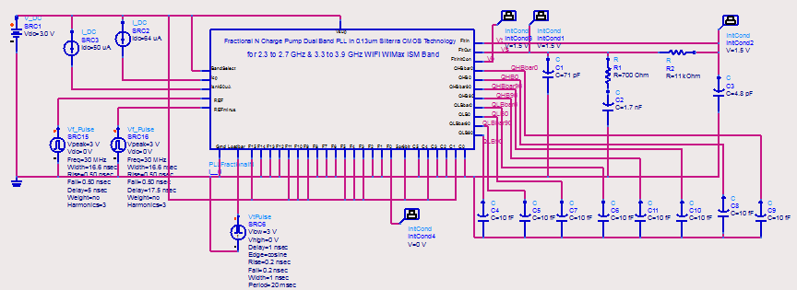
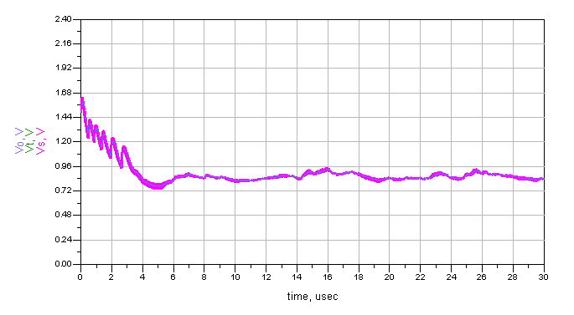
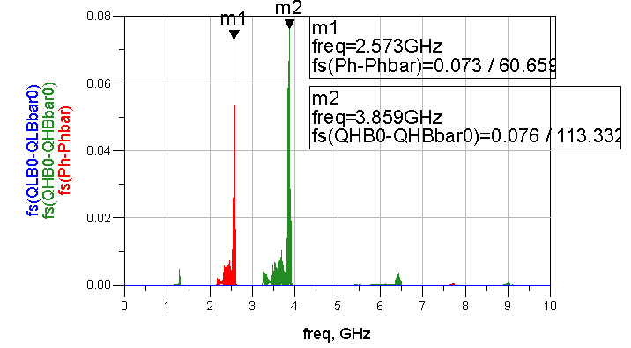
PLL Settling Characteristics
Effect of Sigma Delta Modulation

Slide 29
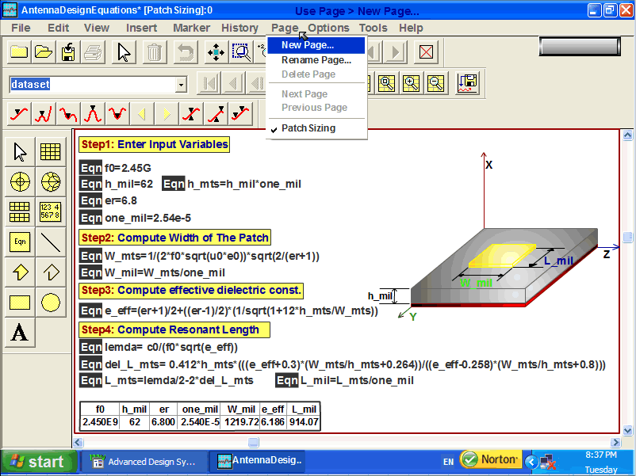
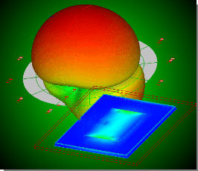
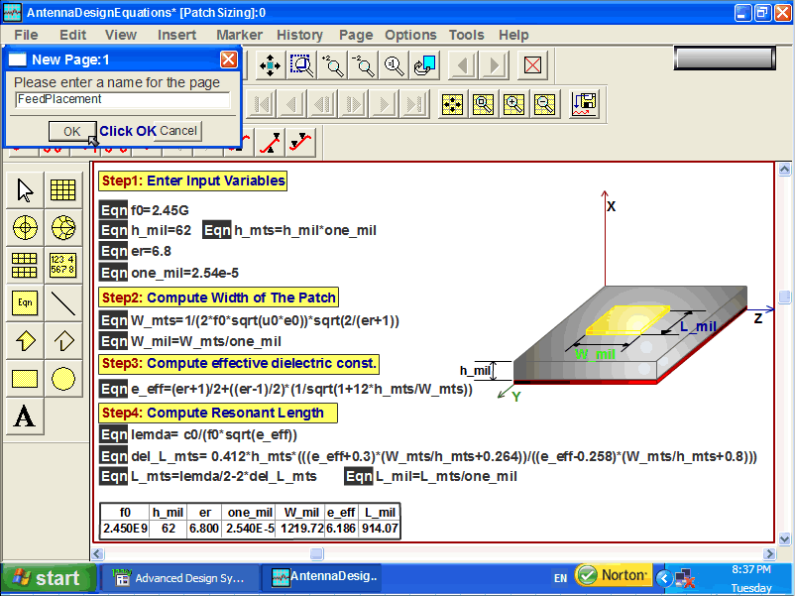
ZigBee Patch Antenna Design

Slide 30
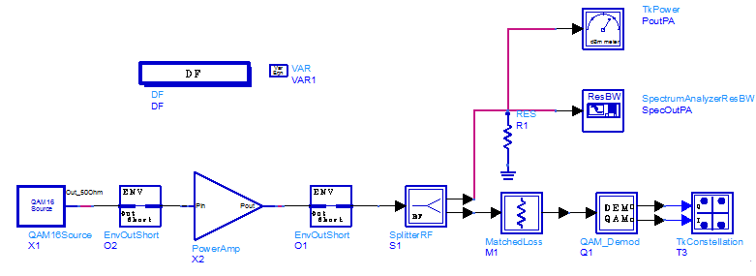
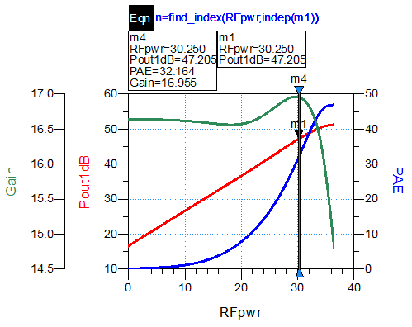
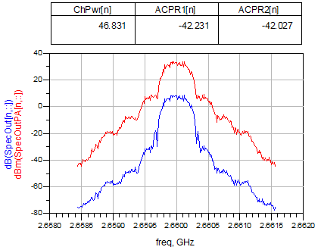
High Power Linear Amplifier Design
50 Watt linear output single stage PA using FreeScale Device

Slide 31
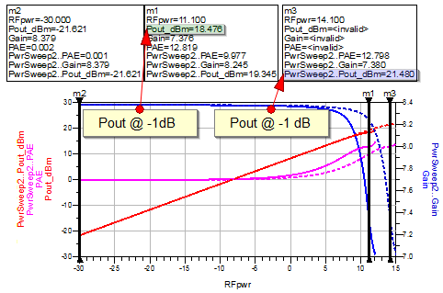
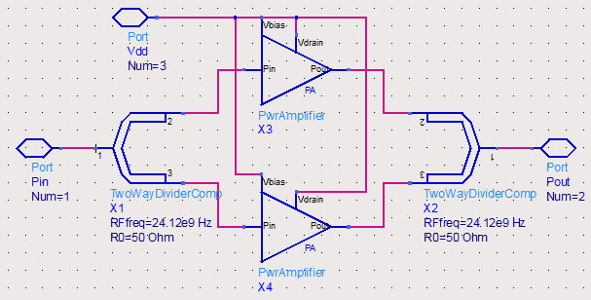
Balanced Ka Band Power Amplifier Design

Slide 32
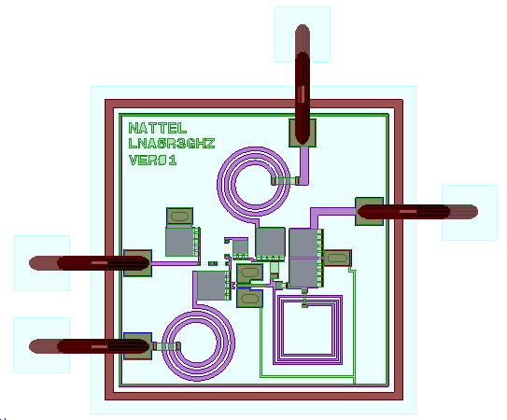
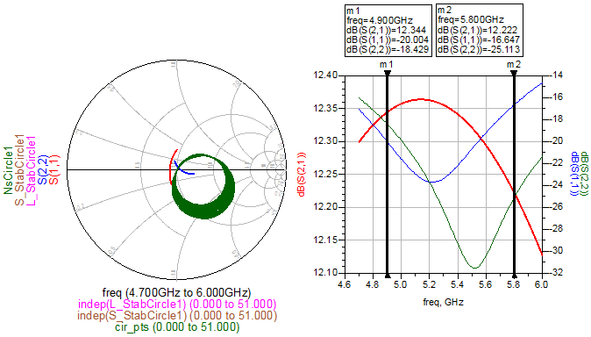
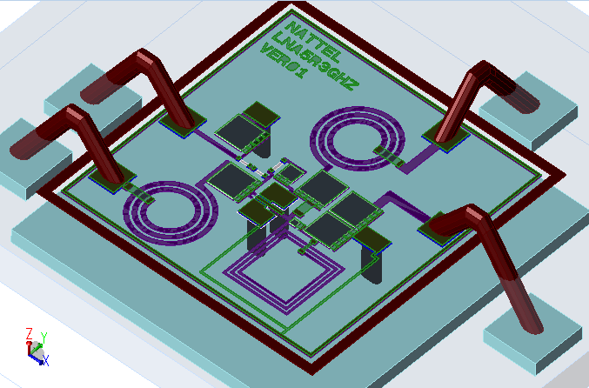
Wi-Fi 802.11 a LNA Design

Slide 33
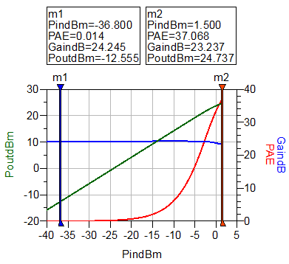
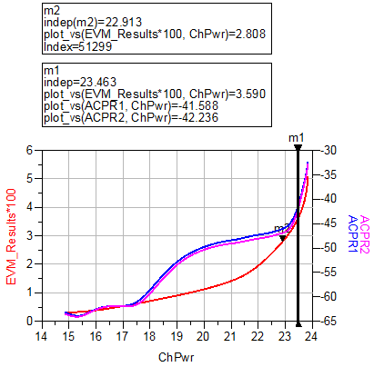
Wi-Fi 802.11 a PA Design

Slide 34
Design Activities
Anurag Nigam
Phone: 0091 9158580922
0091 9623299070
e-mail: nigam_anurag2011@nattelmicro.com
Design Flow, Steps & EDA Tools

Slide 35
Typical MMIC Design Flow
System
Simulations
Circuit
Specifications
Circuit
Design
Layout, EM
Analysis &
Refining
Post Layout Processing-
LVS & DRC
Yield Analysis
DOE
Concurrent Steps
Tiling & Tapeout
Evaluation Board Design
Assembly
Test Bench Setup
Testing
Respin

Slide 36
Design Flow
Start
Specification
Literature Survey
We will cover all steps in Advanced Module
Stop
Circuit Design Using Schematic Entry
Concept Design Document
Tape out
Tiling
Preliminary Design Document
Circuit Optimization
Sensitivity Analysis
Data Storage
Back Annotation Re-simulation
Critical Design Document
Design Centering
Yield Improvement
Parasitic Extraction
Post Layout Document
Layout Document
Electromagnetic Simulations
Layout

Slide 37
Action Item Check-List
Check List
This Check List will be followed in Advanced Module
Concept Design Review
Preliminary Design Review
Critical Design Review
Layout Review
Back Annotation & Simulation Review
Tiling Review
Document Verification
Manager Sign Off

Slide 38
Simulation Tool Constituents
We will detail these constituents in few Simulation Softwares
Method of Moment
Finite Element Method
X-Parameter Simulators
Finite Difference Time Domain Method
Electromagnetic Simulator
Simulation Software
Discrete Flow Simulator
(Digital)
Transient Simulator
Small Signal Simulator
(S-Parameter)
System Simulator
(SPARCA)
Harmonic Balance
Envelope

Slide 39
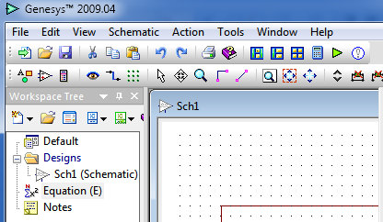
Agilent Genesys
Genesys from Agilent Technologies is very useful Simulator.
Genesys is known for System Simulator called Spectrasys.
Circuit and Electromagnetic Simulators are available for MMIC and MIC Designs.
Suitable for board simulations & layout.
Process Design Kits (PDK) libraries from Foundries are not readily available.
4 Days of Training is sufficient to get you started

Slide 40
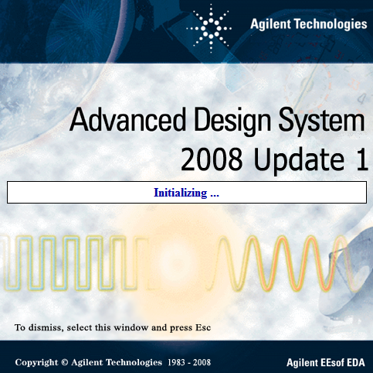
Agilent Advanced Design System
ADS is more versatile Simulator compared to any other simulator.
Its highlight feature is its Co-Simulation Capabilities.
EM/ Circuit/ DSP Co-Simulations are supported for system simulations.
Verilog & Matlab Co-simulations are supported.
Tape out for fabrication of CMOS is not supported.
8 days of training is sufficient to get you started

Slide 41

Cadence Design System
Cadence is very robust tool . It is widely used for CMOS designs, layout and tape outs.
Its unique feature is Auto-place and Route.
Cadence Suite has Envelope, Harmonic Balance and Electromagnetic Simulators.
Cadence also has dynamic link with Agilent Advanced Design System.
Cadence has parasitic extraction tool called DIVA and it also supports third party tools for extraction like Assura and Columbus RF
10 days of training is sufficient to get you started

Slide 42
Fabrication
Anurag Nigam
Phone: 0091 9158580922
0091 9623299070
e-mail: nigam_anurag2011@nattelmicro.com
Silicon, Silicon Germanium,
Silicon Carbide or Gallium Arsenide

Slide 43
Choice of Process
HBT
For High Power & High Frequency
Low Noise
Not Suited for Digital Logic or Analog Designs
ADS / AWR Supported but may need Cadence or IC Edit for Tapeouts
GaAs
pHEMT
MESFET
Not Suited for Low Noise or MMIC Design
ADS / AWR Supported but needs Cadence for Tapeouts
Silicon
CMOS
Low Frequency & Low Power
Silicon Germanium
Any Frequency, Medium Power, Low Noise
ADS / AWR Supported but needs Cadence for Tapeouts
Bi-CMOS
Suited for all kinds of designs

Slide 44
Development & Production Costs
Development Costs
Production Costs
Wafer / Die Handling
GaAs
Slightly Cheaper
Highest
Easy
Silicon
Higher
Lowest
Needs Care
Silicon Germanium
Highest
Low
Needs Care

Slide 45
Assembly &Test
Anurag Nigam
Phone: 0091 9158580922
0091 9623299070
e-mail: nigam_anurag2011@nattelmicro.com
Evaluation Boards, Die Attach, Bonding
& Connectors, Test Briefing

Slide 46
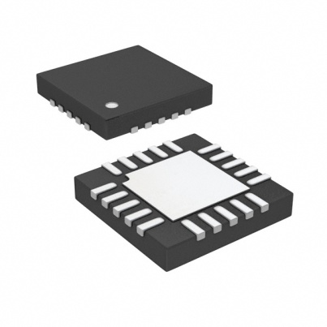
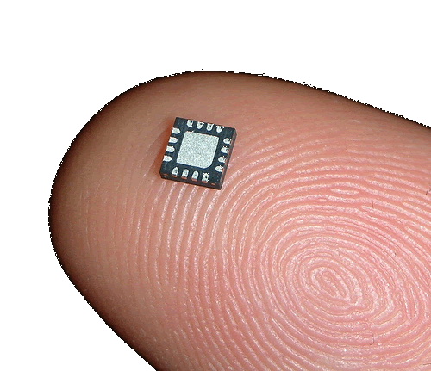
Multi-Chip Module Radio
Physical Dimensions
7mm x 7mm Air Cavity QFN Plastic Package
Die Size 1.1 mm x 1.1 mm
Electrical Characteristics
As per radio requirements for Short Range Narrow Band Radar
or
As per radio requirements for Broad Band long Haul connectivity for Wireless MAN.
or
As per radio requirements for WLAN (802.11a, b, g, n)

Slide 47
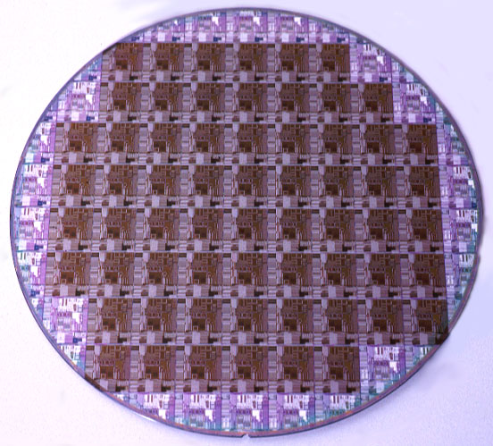
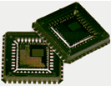
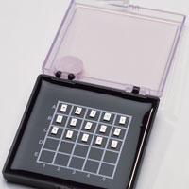
Wafer & Dicing
QFN
Die
Wafer
Gel Pack

Slide 48
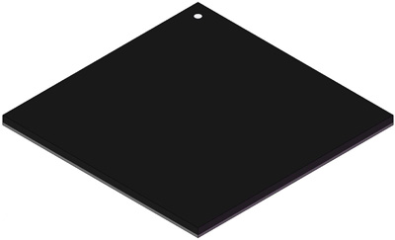
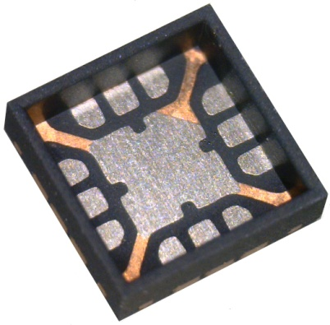

Air Cavity Package Requirements
Aluminum Oxide Lid
Metal 2 Air Bridge
S
G
D
G
S
Air Cavity QFN
pHEMT
We have to use Air Cavity QFN with Lid and not Plastic Top due to Air Bridge Structure
We can not apply pressure to bare die while epoxying except at edges due to Air Bridge Structures

Slide 49





Assembly- Die Attach & Bonding
Oven for
curing
Epoxy
Cut Section
of Die in QFN
Wire Bonds
QFN Attached
to Board
Wedge Bonder
Die Attach

Slide 50

Evaluation Boards
RFE Evaluation
Board
50 Ω
SMA
50 Ω
SMA
Number of QFN pads may vary from 16 to 12 and layout may change

Slide 51







Test Briefing- Power Measurements
PSG
PSA
Power Meter
Power Sensors
Directional Couplers
Waveguide
Tuner
Waveguide
Tuner
Attenuators

Slide 52





Test Briefing- Small Signal Measurements
Cal Kit
PNA
PSA
Series Noise Source
50Ω Cables
7mm to 3.5mm

Slide 53




You may need help!
We help you make right choices
We subordinate, coordinate & lead
Check List
Software tools
Measurement Setups
Process
Check List
Design Methodology
Train you workforce
Assembly Methodology
Transfer Technology
Debugging Strategy
We put it together for you
Coordinate with Fabs.
Carry out Designs
Carry out Assembly
Setup & Perform Tests

Slide 54
Business Model
Anurag Nigam
Phone: 0091 9158580922
0091 9623299070
e-mail: nigam_anurag2011@nattelmicro.com
For Academic Institutions & Industry

Slide 55
Business Model
Infrastructure
Centre of Excellence
MMIC & RFIC
Sign On Component
Technology
On-Site / Off Site Support
Monthly Payment
Payment

Slide 56
Design & Training Services
Experience, Capabilities & Business Model
Thanks

