Slide 1

Advanced Design System
Design and Modelling Tool for Electronic Systems

Slide 2






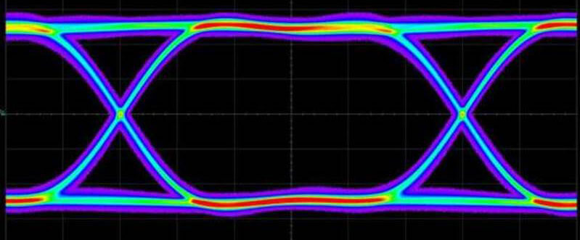
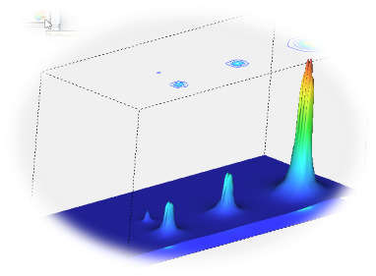


Brief History
1999
Released $α$and $β$ version successor to MDS
2003
Basic Simulators- S-parameter, DC, AC, Transient, HB, Envelope, Ptolemy, MOMENTUM
2005
2011
Connectivity to other products
2013
SI
IPDK
2015
Thermal
Dates based on Introduction to Author and not exact

Slide 3

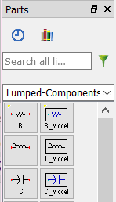
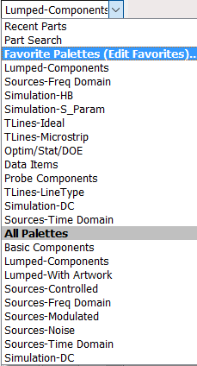

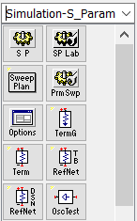
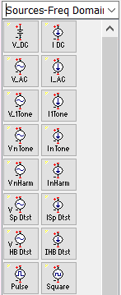
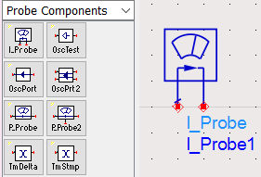
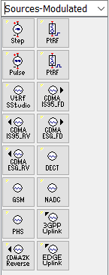


Overview-Schematic
2
1
Wire, Buses and Ground
Schematic based entry
Variable, Pin and Name Node
3
Part Selector to the left
4
5
Probe for Current Capture
Terminations & Excitation Sources
7
Name Node for Voltage Capture
6
Simulation Controllers
8
Equation Based Modelling

Slide 4
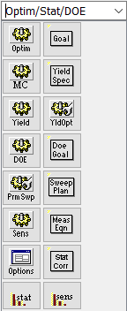
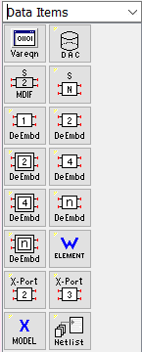
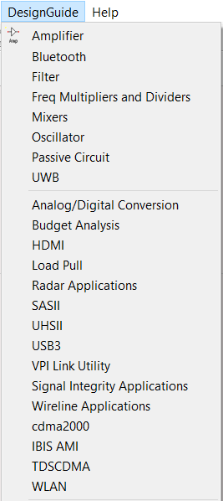
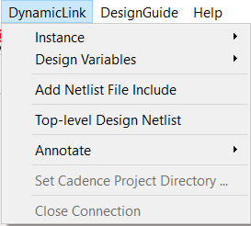
Overview-Schematic
9
Optimization and Design Of Experiments (DOE)
10
Data Adaptors/ Sockets
11
Design Guides
12
Dynamic Link to other software

Slide 5

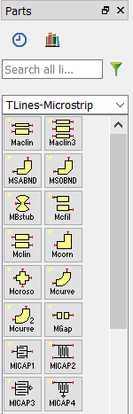


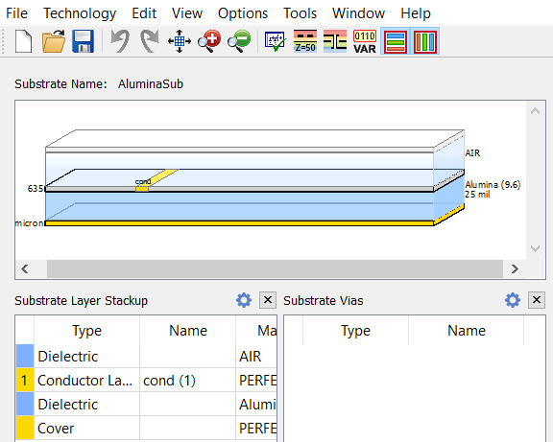
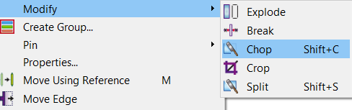
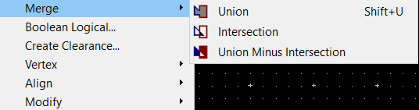
Overview-Layout
1
2
2D Layout Entry Tool for Planar Circuits
Interface to PDK, GPDK and IGPDK
4
Primitives
3
Part Selector to the left
6
Snap Options
5
Geometric Manipulations
8
Fully Customizable Substrate
7
Shape Manipulations
9
Logical Operations on Shapes

Slide 6
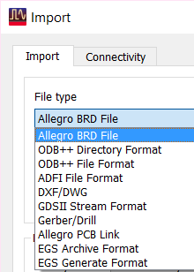
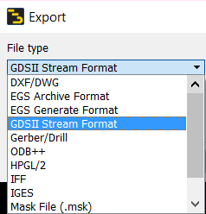

Overview-Layout
10
11
Import from and Export to major file formats
Schematic Awareness (connectivity)
12
Electrical Connectivity for detecting Opens and Shorts
13
3D Visualization

Slide 7
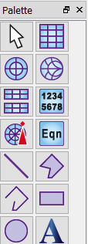


Overview-Data Display
1
2
Provides Display Template for Data
Interface to Default Dataset and many more
3
4
Part Selector to the left
Equations and Functions for Data Manipulation
5
Markers for reading Data
6
Instrument Server for writing data to a file

Slide 8






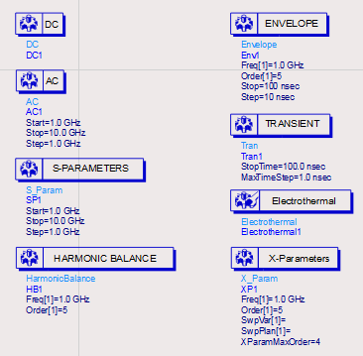


Overview-Simulators
7
1
Thermal Simulation of Power ICs
Bias condition for active
DC operating points
8
2
X-parameter modelling of Non-linear circuits
Stability of Small Signal Circuits
Frequency Response
9
3
MOMENTUM and FEM Simulators
Reflection and Transmission Characteristics of Matched stage
10
Ptolemy Simulations- Data Flow
4
Simulation Controllers
Frequency domain simulation of Non-Linear Circuits
5
Mixed domain simulation of circuits with modulated signals
6
Time domain simulation of circuits

Slide 9
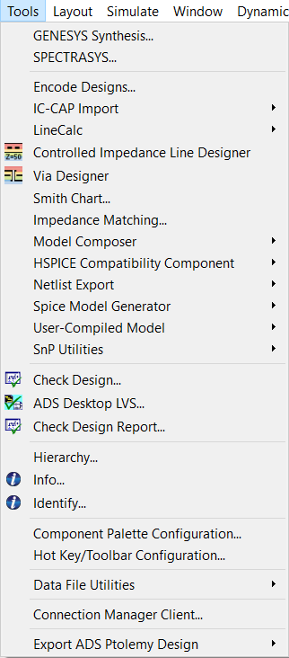
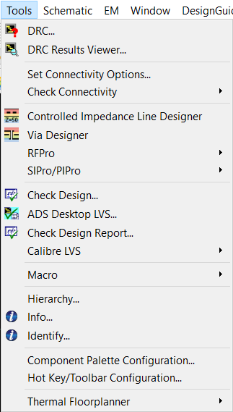
Overview-Post Layout
Other Tools…

Slide 10
Application Areas
Communication Systems
From System Simulation to Circuit design, modelling and simulation
System Simulation in Ptolemy (Digital Baseband), RF simulation for Transceivers and Radio Front-ends, Circuits like- ADC-DAC, IQ Modulators and Demodulators, FIR and IIR Filters, Mixers, Variable Gain Amplifiers, PLL Sub-circuits, Passives, Power Amplifiers, Low Noise Amplifiers, Microwave Filters, Antenna and sub-system
RADAR Systems and Sub-circuits
Analog Integrated Circuits
Single ended and differential gain stages, OpAmps and OTAs, Comparators, Schmitt Triger, Precision Voltage and Current References, Voltage Regulators, Protection Circuits, Switched Capacitor Circuits, Sigma Delta Modulators, Filters etc.
Digital Circuits
Logic Gates, Combinational and Sequential Circuits, Finite State Machines, Arithmetic Circuits, Microprocessor Circuits- Data Path and Control Path, Memory Controllers, SRAM and DRAM, Frequency Prescalar, MASH 1-1-1 Sigma Delta Modulator
Power Electronics Systems and Circuits
DC-DC Converters, Power Factor Correction Circuits, Power Detectors, Inverters, Motor Drives

Slide 11
Application Areas
Control Systems and Circuits
Motion Controllers- PID, Feedback and Feed Forward Circuits, Position/ Velocity/ Torque and Power Control Loops- Analysis Design and Modelling of Control Systems
Signals and Systems
CT and DT systems, DT approximation of CT systems, Sampling, Quantization, FIR and IIR Filters, Multi-rate circuits
Electromagnetics
Transmission Lines and Waveguides, H and E Tees, Magic Tee, Waveguide Mixers, Dielectric and Cavity Resonators, Passives- Power Dividers, Hybrids, BALUN, Directional Couplers, Circulators, Transformers, Microwave Filters, Antennas and Arrays, Microwave Lenses
Cellular Planning
Channel Modelling, Cellular Planning and Layout, Analysis of Frequency Re-use and Hand-offs

Slide 12
Third Party Technology Interface
PCB export to various file formats acceptable to manufacturers
Process Design Kits for various Semiconductor and LTCC Processes that support LVS, DRC and Tape-outs. PDKs also support thermal analysis
Third Party Libraries for SMDs and Packaged Components from various manufacturers. Modelithics supports these libraries for ADS
VHDL interface and HDL outputs for co-simulation and synthesis

Slide 13
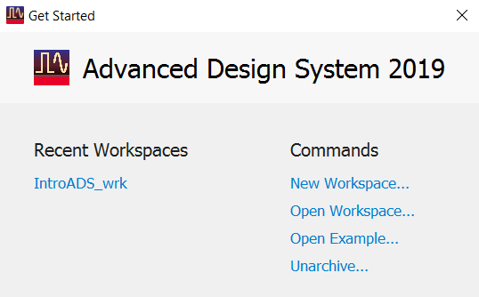
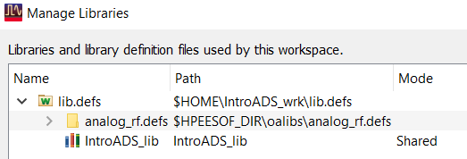
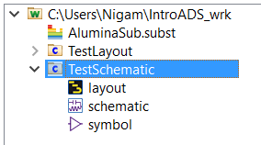
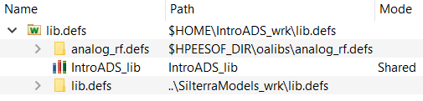
ADS Terminology
ADS project is called ‘Workspace’
All the resources and designs are contained in workspace folder named with _wrk extension
Design is known as Cell
Cell has three views
  Schematic
  Layout
  Symbol
Cell should have minimum one view
Every workspace has a local library
Cells, Notes, Data Display, Substrates are listed in Workspace tree
Workspace can refer to external library

Slide 14
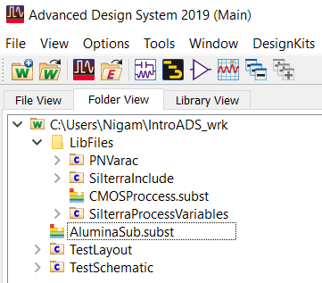
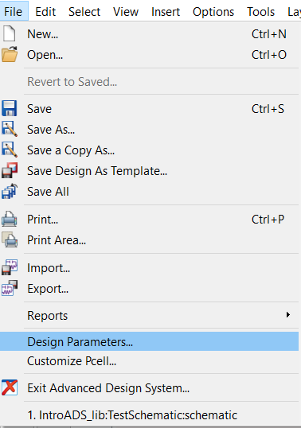
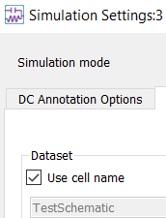
ADS Terminology
Designs, Data Displays and Substrates can be moved into folders in workspace tree
Sub-circuits with pins as termination can have symbol view. Schematic + symbol makes a component that can be used in bigger designs
EM Simulated Passives can be turned into look-alike components for Circuit-EM co-simulation
Cells can be parametrized using Design Parameters
Simulation results are stored in Dataset files.
Every design has dataset file with same name but can have more datasets.

Slide 15
Typical Design/ Simulation Flow
Name should start with an alphabet. Only alphabet, numbers and underscore are valid characters.
Attach a PDK library
Set layout resolution
START
Create a workspace
Default view can be schematic or layout
Use components from the palettes, wire, ground, excitation sources, DC supply and controller to make a design. Additionally, you may use pin terminations and make a component with a symbol.
Create a cell
Perform Simulation/ Tuning/ Optimization
Solve the issues
Are there errors, warnings, conversion issues
Visualize results in Data Display
yes
no
STOP

Slide 16
Example 1: Getting Started
We will learn to
Create a workspace
Create schematic
Perform Simulation
Visualize Data
Tune Components

Slide 17
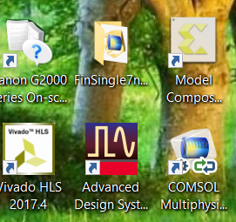
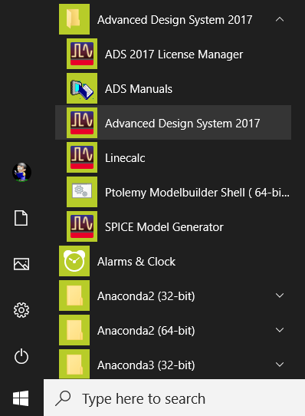
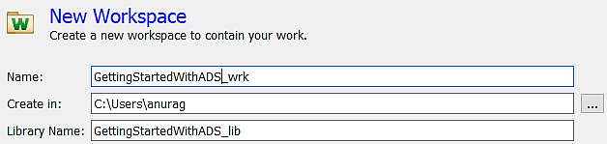
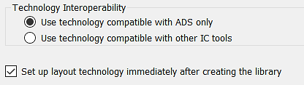
Creating a Workspace
1
2
Launch ADS
Create a New Workspace
3
4
Name the New Workspace
Setup resolution immediately
Use Library name same as workspace name

Slide 18

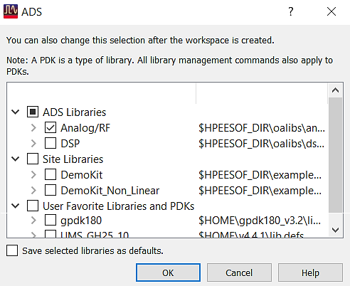
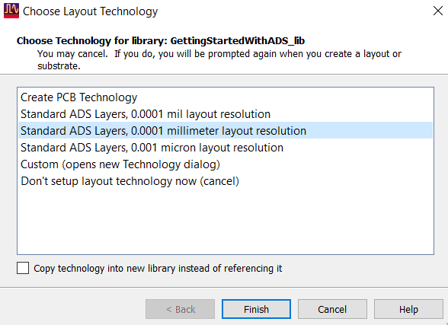
Creating a Workspace
5
Use Change Libraries… button to refer to a PDK or other workspace
6
Check from listed PDKs or Add a favourite PDK
7
Choose the layout resolution

Slide 19
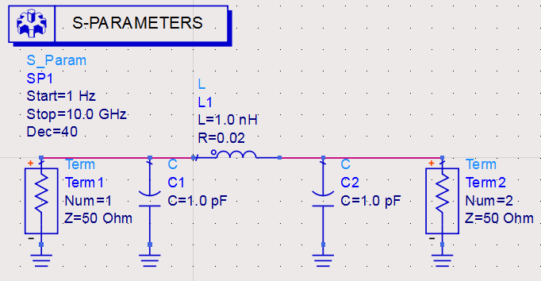

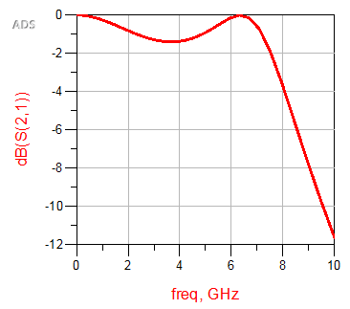
Create a Schematic
1
Create a New Cell with Schematic View
Simulate-able design has circuit with ground and supply, terminations and excitations and simulation controller
2
3
Create the design as shown in figure
Hit Simulate Button
4
Plot S21 in dB on Rectangular Plot

Slide 20
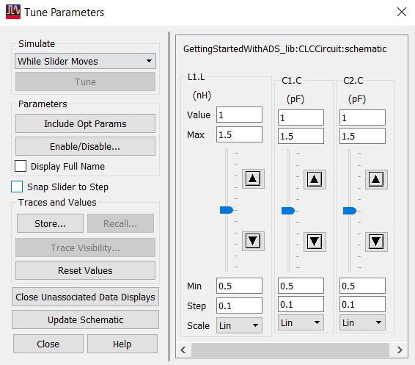
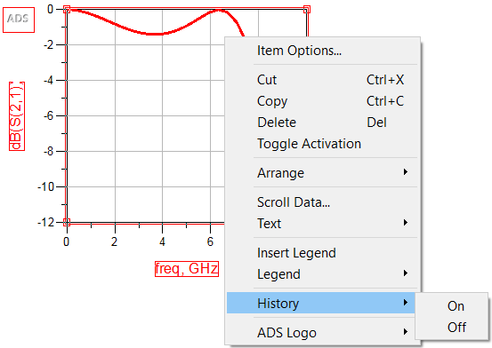
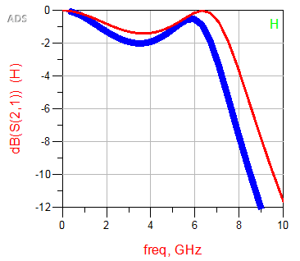
Tune and History
5
Use Tune to add tuners for inductors and capacitors
6
Enable History-On for the graph so that you can view the trend
7
History is just a visual aid, does not store component values
Store can be used to store tune state and Recall to restore a saved state
8
Use Update Schematic to update latest tuned values

Slide 21
Exercise 2: DC Simulations
In this exercise, we will learn
How to attach a third party PDK
How to use Models
How to perform DC Simulation
How to sweep variables
How to change Datasets

Slide 22



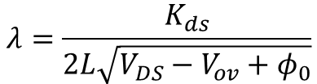

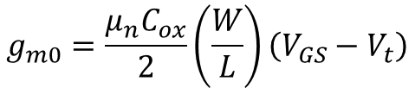


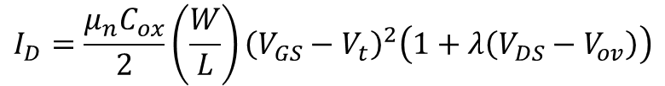


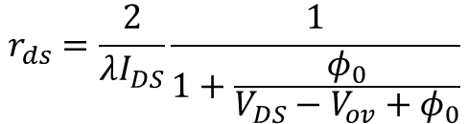

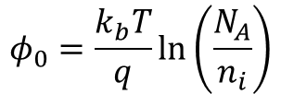




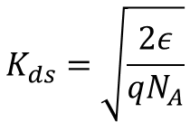

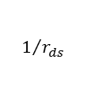

Overview of Problem
Goal: to study output and transfer characteristics of an NMOS device
Governing Equations
$$I_{D}=\frac{μ_{n}C_{ox}}{2}\left(\frac{W}{L}\right){\left(V_{GS}−V_{t}\right)}^{2}\left(1+λ\left(V_{DS}−V_{ov}\right)\right)$$
$$λ=\frac{K_{ds}}{2L\sqrt{V_{DS}−V_{ov}+φ_{0}}}$$
$$K_{ds}=\sqrt{\frac{2ε}{qN_{A}}}$$
$$φ_{0}=\frac{k_{b}T}{q}ln\left(\frac{N_{A}}{n_{i}}\right)$$
$$r_{ds}=\frac{2}{λI_{DS}}\frac{1}{1+\frac{φ_{0}}{V_{DS}−V_{ov}+φ_{0}}}$$
$$g_{m0}=\frac{μ_{n}C_{ox}}{2}\left(\frac{W}{L}\right)\left(V_{GS}−V_{t}\right)$$
$$I_{DS}$$
$$1/{r_{ds}}$$
$$Strong Inversion$$
$$Medium Inversion$$
$$I_{D}$$
$$I_{D}$$
Weak$Inversion$
$$Triode Region$$
$$Breakdown$$
$$Sub−threshold$$
$$Saturation Region$$
$$g_{m0}$$
$$V_{DS}−V_{ov}$$
$$V_{DS}$$
$$V_{GS}$$
Output Characteristics of MOSFET
$$V_{t}$$
Transfer Characteristics of MOSFET

Slide 23
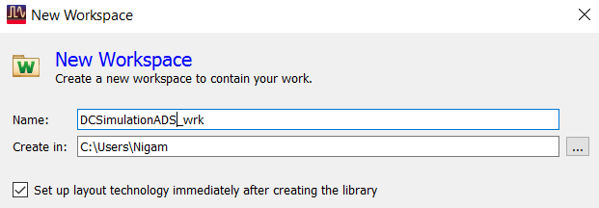
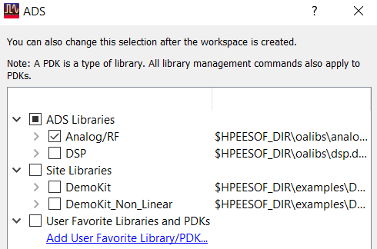
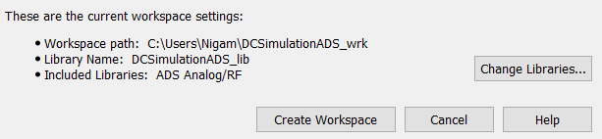


Setup Workspace and PDK
1
Create a New Workspace
3
Add reference to PDK
2
Add reference to PDK
4
Set the layout resolution

Slide 24


Organizing Workspace and Setup
5
6
Move Library Files to a Folder
Create a Simulate-able design as shown
Workspace Tree
Simulation- DC
Source- Frequency Domain
Devices-MOS
7
8
Declare used variables using Var
Use Current Probe to measure drain current
9
Place Silterra Include File from Workspace Tree using Drag and Drop
10
Perform Vds sweep in DC controller and Vgs sweep in Parameter Sweep referring to inner sweep in DC1 controller

Slide 25



DC Simulation
11
12
Hit simulate button
Plot Ids in Rectangular Graph
13
14
Swap Vgs and Vds in controllers
Change Dataset for next simulation

Slide 26



Plotting the Results
15
When simulation is complete, say no to change default Dataset. Plot Drain current from new Dataset
16
Place two markers on both the graphs on same trace

Slide 27



Post Processing using equations
17
Use equations to write equation for rds and gm
18
Tabulate the calculated values in a table

Slide 28
Exercise 3: AC Simulations
In this exercise, we will learn
How to design and simulate Analog Gain Stages
How to Perform AC Simulation
How to Plot Frequency Response
Determine Stability of Gain Stage

Slide 29
AC Simulation
Goal: to study frequency response of various gain stages and determine their stability
AC simulation is performed on active devices to determine their frequency response and predict their stability. Prior to AC simulation active devices have to biased by performing DC Analysis. Common Single Ended Amplifiers with Current Mirror Loads are shown in figure.
Common Source
Common Gate
Common Drain

Slide 30





Common Source Amplifier
1
Create Common Source Amplifier as shown in figure and perform DC Simulation
UGB
PM
BW
2
Set the AC Source with bias and perform AC Simulation

Slide 31
Exercise 4:Transient Simulations
In this exercise, we will learn
To design Logic Gates
To make component with symbol
To perform Transient Simulation
To determine dynamic characteristics of CMOS Inverter

Slide 32
Transient Simulation
Goal: to study dynamic characteristics of CMOS Inverter
Transient Simulation is time domain simulation that can be used to analyse linear as well as non-linear circuits.
Electron Mobility is 2.5 times the hole mobility. Hence to have same source and sink currents, PMOS should be 2 and ½ times NMOS
CMOS Inverter

Slide 33



CMOS Inverter
1
Create CMOS Inverter as shown in figure
2
Use pin instead of terminations, DC supply and ground
3
Save and close the design. Right Click on Cell name in workspace tree to make a new symbol for the design
4
Accept the default symbol design as is and modify symbol as you wish.
5
Sub-circuit with Pins and a symbol is a component that can be inserted in bigger design by dragging and dropping into another schematic from Workspace Window

Slide 34



Inverter Test Bench
6
Create a Test Bench to test the inverter as shown in figure
7
Perform Transient Simulation
8
Plot input and output waveforms as shown in figure
Rise Time
9
Use Markers, turn on Delta Mode by selecting two markers with m1 as reference.

Slide 35
Exercise 5: S-parameter Simulations
In this exercise, we will learn
To design an Elliptic Low Pass Filter using Insertion Loss Method
To perform S-parameter simulation
To determine Return Loss, Insertion Loss and Group Delay of the filter

Slide 36





















S-parameters
Goal: to design and simulate the response of an Elliptic Filter
S-Parameter refers to reflection and transmission coefficients in terms of voltage provided all the ports, except those under investigation, are terminated into characteristic impedance of the network i.e. they do not reflect any power incident on them.
$$Γ_{in}=\frac{V_{in}^{−}}{V_{in}^{+}}=S_{11}+\frac{S_{12}S_{21}Γ_{L}}{1−S_{22}Γ_{L}}$$
$$Γ_{S}$$
Two Port
Network
$$Γ_{L}$$
$$Z_{S}$$
$$Γ_{in}$$
$$Γ_{out}$$
$$Γ_{out}=\frac{V_{out}^{−}}{V_{out}^{+}}=S_{22}+\frac{S_{12}S_{21}Γ_{S}}{1−S_{11}Γ_{S}}$$
$$Z_{L}$$
$$S_{11}=\sqrt{\frac{b_{1}}{a_{1}}}$$
$$S_{nn}=\sqrt{\frac{b_{n}}{a_{n}}}$$
$$V^{−}$$
$$p_{2}$$
$$V^{+}$$
$$I^{−}$$
$$I^{+}$$
$$p_{1}$$
N-Port Network
$$S_{n1}=\sqrt{\frac{c_{n1}}{a_{1}}}$$
$$S_{1n}=\sqrt{\frac{c_{1n}}{a_{n}}}$$
$$p_{3}$$
$$p_{n}$$
$$p_{4}$$

Slide 37





















Elliptic Low Pass Filter
Elliptic Filters are equal ripple in pass band as well as stop band. This results in sharper rise in attenuation beyond corner frequency, ωc.
Amin
Pass band
$$ω_{c}$$
$$ω_{∞}$$
$$ω$$
$$P_{LR}$$
$${\left|S_{21}\right|}^{2}$$
Pass band
Amax
1
0
$$ω_{c}$$
$$ω_{∞}$$
$$ω$$
Power Loss Ratio and Transmission Characteristics of Elliptic Low Pass Filter
$$g_{2}′$$
$$g_{4}′$$
$$g_{0}$$
$$g_{2}$$
$$g_{4}$$
$$g_{1}$$
$$g_{3}$$
$$g_{n}$$
$$g_{2}′$$
$$g_{4}′$$
$$g_{1}$$
$$g_{3}$$
$$g_{n}$$
$$g_{n+1}$$
$$g_{0}$$
$$g_{2}$$
$$g_{4}$$
$$g_{n+1}$$
Ladder Structure for Elliptic Low Pass Filter
(Series Shunt-Resonant)
Ladder Structure for Elliptic Low Pass Filter
(Shunt Series-Resonant)
Figure is for odd N. For even N the terminations will not be same.

Slide 38





Elliptic Low Pass Filter Design
Elliptic Filters do not have exact match on both the ports. For a given Stop Band Attenuation, a certain mismatch has to be acceptable. Unlike Butterworth and Tchebyshev designs, Elliptic filters do not have stop band attenuation charts but rather a set of tables for different pass band attenuation.
$${ω_{∞}}/{ω_{c}}$$
$$g_{1}$$
$$g_{2}$$
$$g_{2}′$$
$$g_{3}$$
$$g_{4}$$
$$g_{4}′$$
$$g_{5}$$
N |  | Amin (dB)
3 | 1.4493 | 13.5698 | 0.7427 | 0.7096 | 0.5412 | 0.7427
 | 1.6949 | 18.8571 | 0.8333 | 0.8439 | 0.3252 | 0.8333
 | 2 | 24.0012 | 0.8949 | 0.9375 | 0.207 | 0.8949
 | 2.5 | 30.5161 | 0.9471 | 1.0173 | 0.1205 | 0.9471
4 | 1.2 | 12.0856 | 0.3714 | 0.5664 | 1.0929 | 1.1194 | 0.9244
 | 1.2425 | 14.1259 | 0.4282 | 0.6437 | 0.8902 | 1.1445 | 0.9289
 | 1.2977 | 16.5343 | 0.4877 | 0.7284 | 0.7155 | 1.1728 | 0.9322
 | 1.3962 | 20.3012 | 0.5675 | 0.8467 | 0.5261 | 1.2138 | 0.9345
 | 1.5 | 23.7378 | 0.6282 | 0.9401 | 0.4073 | 1.2471 | 0.9352
 | 1.709 | 29.5343 | 0.7094 | 1.0688 | 0.273 | 1.2943 | 0.9348
 | 2 | 36.0438 | 0.7755 | 1.1765 | 0.1796 | 1.3347 | 0.9352
5 | 1.05 | 13.8785 | 0.7081 | 0.7663 | 0.7357 | 1.1276 | 0.2014 | 4.3812 | 0.0499
 | 1.1 | 20.0291 | 0.813 | 0.9242 | 0.4934 | 1.2245 | 0.3719 | 2.135 | 0.2913
 | 1.1494 | 24.5451 | 0.8726 | 1.0084 | 0.3845 | 1.3097 | 0.4991 | 1.445 | 0.4302
 | 1.2 | 28.3031 | 0.9144 | 1.0652 | 0.3163 | 1.382 | 0.6013 | 1.0933 | 0.5297
 | 1.25 | 31.4911 | 0.9448 | 1.106 | 0.2694 | 1.4415 | 0.6829 | 0.8827 | 0.604
 | 1.2987 | 34.2484 | 0.9681 | 1.1366 | 0.2352 | 1.4904 | 0.7489 | 0.7426 | 0.6615
 | 1.4085 | 39.5947 | 1.0058 | 1.1862 | 0.1816 | 1.5771 | 0.8638 | 0.5436 | 0.7578
 | 1.6129 | 47.5698 | 1.0481 | 1.2416 | 0.1244 | 1.6843 | 1.0031 | 0.354 | 0.8692
 | 1.8182 | 54.0215 | 1.073 | 1.2741 | 0.0919 | 1.7522 | 1.0903 | 0.255 | 0.9367
 | 2 | 58.9117 | 1.0876 | 1.2932 | 0.0732 | 1.7939 | 1.1433 | 0.2004 | 0.9772
Amax=0.1 dB

Slide 39







Elliptic Low Pass Filter Design
$$g_{1}$$
$$g_{2}$$
$$g_{2}′$$
$$g_{3}$$
$$g_{4}$$
$$g_{4}′$$
$$g_{5}$$
$$g_{6}$$
$$g_{6}′$$
$$g_{7}$$
N |  | Amin (dB)
6 | 1.05 | 18.6757 | 0.4418 | 0.7165 | 0.9091 | 0.8314 | 0.3627 | 2.4468 | 0.8046 | 0.9986
 | 1.1 | 26.237 | 0.5763 | 0.888 | 0.6128 | 0.973 | 0.5906 | 1.3567 | 0.9431 | 1.0138
 | 1.158 | 32.4132 | 0.6549 | 1.0036 | 0.4597 | 1.0923 | 0.7731 | 0.9284 | 1.0406 | 1.0214
 | 1.2503 | 39.9773 | 0.7422 | 1.1189 | 0.3313 | 1.2276 | 0.9746 | 0.626 | 1.1413 | 1.0273
 | 1.3024 | 43.4113 | 0.7751 | 1.1631 | 0.287 | 1.2832 | 1.0565 | 0.5315 | 1.1809 | 1.0293
 | 1.3955 | 48.9251 | 0.8289 | 1.2243 | 0.2294 | 1.3634 | 1.1739 | 0.4148 | 1.2366 | 1.0316
 | 1.5962 | 58.4199 | 0.8821 | 1.3085 | 0.1565 | 1.4792 | 1.3421 | 0.2757 | 1.3148 | 1.0342
 | 1.7032 | 62.7525 | 0.9115 | 1.3383 | 0.1321 | 1.5216 | 1.4036 | 0.231 | 1.3429 | 1.035
 | 1.7927 | 66.019 | 0.9258 | 1.3583 | 0.1162 | 1.5505 | 1.4453 | 0.2022 | 1.3619 | 1.0355
 | 1.8915 | 69.3063 | 0.9316 | 1.3765 | 0.1019 | 1.5771 | 1.4837 | 0.1767 | 1.3794 | 1.0358
7 | 1.05 | 30.5062 | 0.9194 | 1.0766 | 0.3422 | 1.0962 | 0.4052 | 2.2085 | 0.8434 | 0.5034 | 2.2085 | 0.411
 | 1.1 | 39.3517 | 0.9882 | 1.1673 | 0.2437 | 1.2774 | 0.5972 | 1.3568 | 1.0403 | 0.6788 | 1.3568 | 0.5828
 | 1.1494 | 45.6916 | 1.0252 | 1.2157 | 0.194 | 1.5811 | 0.9939 | 0.5816 | 1.2382 | 0.5243 | 0.5816 | 0.4369
 | 1.25 | 55.4327 | 1.0683 | 1.2724 | 0.1382 | 1.7059 | 1.134 | 0.4093 | 1.4104 | 0.7127 | 0.4093 | 0.6164
 | 1.2987 | 59.2932 | 1.0818 | 1.2902 | 0.1211 | 1.7478 | 1.1805 | 0.3578 | 1.4738 | 0.7804 | 0.3578 | 0.6759
 | 1.4085 | 66.7795 | 1.1034 | 1.3189 | 0.094 | 1.8177 | 1.2583 | 0.277 | 1.5856 | 0.8983 | 0.277 | 0.7755
 | 1.5 | 72.1183 | 1.1159 | 1.3355 | 0.0786 | 1.7569 | 1.1517 | 0.3716 | 1.6383 | 1.125 | 0.3716 | 0.9559
 | 1.6129 | 77.9449 | 1.1272 | 1.3506 | 0.0647 | 1.8985 | 1.3485 | 0.1903 | 1.7235 | 1.0417 | 0.1903 | 0.8913
 | 1.6949 | 81.7567 | 1.1336 | 1.359 | 0.057 | 1.9206 | 1.3734 | 0.1675 | 1.7628 | 1.0823 | 0.1675 | 0.9231
 | 1.8182 | 86.9778 | 1.1411 | 1.369 | 0.0479 | 1.9472 | 1.4033 | 0.1408 | 1.8107 | 1.1316 | 0.1408 | 0.9616
$${ω_{∞}}/{ω_{c}}$$
Amax=0.1 dB

Slide 40











Low Pass Filter Design
Filter Specifications
$f_{c}=2.5 GHz$ and $f_{∞}=3 GHz$ desired attenuation in stop band is >30 dB
$${ω_{∞}}/{ω_{c}}=1.2$$
$${ω_{∞}}/{ω_{c}}$$
$$g_{1}$$
$$g_{2}$$
$$g_{2}′$$
$$g_{3}$$
$$g_{4}$$
$$g_{4}′$$
$$g_{5}$$
N |  | Amin (dB)
5 | 1.2 | 28.3031 | 0.9144 | 1.0652 | 0.3163 | 1.382 | 0.6013 | 1.0933 | 0.5297
1
$$C_{n}=\frac{g_{n}}{ω_{c}R_{0}}$$
Compute Inductors and Capacitors using given equations
$$L_{n}=\frac{g_{n}R_{0}}{ω_{c}}$$
2
Define Design Parameters as R0 and fc
3
Create sub-network with its symbol

Slide 41



Response of Elliptic Low Pass Filter
4
Create a test bench as shown in figure, to test the filter response
5
Enable Group Delay in simulation controller under Parameter Tab
6
Perform Simulation and Plot the Response as shown

Slide 42
Exercise 6: EM Simulations
In this exercise, we will learn to
Specify custom substrate
Layout an inductor and a capacitor on chip
Model inductor and capacitor

Slide 43




Introduction to Substrates
ADS provides (1) MOMENTUM, a Method of Moment based 2.5 D simulator
(2) FEM, Finite Element Method 3 D simulator
Layout is a 2 D entry tool, hence z-axis information is specified as Metal Stack with sandwich dielectric. Substrate Height, Metal thickness and electrical properties have to be specified. Two metal layers are connected through conductor via. We specify 5+1 Metal Stack as shown in figure.
Material
Cu,$σ=5.8e7 S/m$
Silicon Dioxide,$ε_{r}=3.9, tanδ=0.0001$
Silicon Nitride, $ε_{r}=8.5, tanδ=0.0001$
Silicon, $ε_{r}=11.9, σ=6.67 S/m$

Slide 44

Metal Stack
1
UTM, Cu, 7µm
ViaT, Silicon Dioxide, 4µm
TopMetal, Cu, 2µm
Via4, Silicon Dioxide, 2µm
M4, Cu, 1µm
Via3, Silicon Nitride, 0.05µm
M3, Cu, 1µm
Via2, Silicon Dioxide, 1µm
M2, Cu, 1µm
Via1, Silicon Dioxide, 1µm
M1, Cu, 1µm
Via0, Silicon Dioxide, 1µm
M0, Cu, 0.67µm
Silicon Dioxide, 1µm
Silicon, 100µm
Cond, Cu, 1.34 mil
Right click on workspace tree and create new substrate
Let the template be anything
2
Create new drawing layers using Technology> Layer Definitions

Slide 45





Substrate in ADS
Layer Colour and Pattern
Role
3
Add material from Database

Slide 46

Substrate in ADS
4
Create the metal stack with thicknesses of various layers as shown in figure

Slide 47


Inductor Design
Goal: to design a 2.5 nH inductor at 3.3 GHz
Inductors are spiral traces with ground as far as layout size permits. Despite this designer has to have ground continuity between two ports. For predictability termination of electric lines of flux should be fixed i.e. inductor can be surrounded with ground at sufficiently large distance.
5
Layout a spiral inductor on UTM layer using Transmission Line Microstrip palette. Instead of air bridge or underpass use stacked inductor on UTM to spiral in and Top Metal to spiral out.
6
Use following dimensions
L1=L2=152 µm
Trace width is 10 µm and gap is 10 µm

Slide 48


EM Simulation Setup
7
At the two ends of the inductor place two ports followed by two ports for local grounds. All signal ports should be connected first before ground reference ports
8
Setup EM Simulation
9
Set port 3 as ground reference for port 1 and port 4 as ground reference for port 2 using Port Editor
10
11
12
Set simulation frequency as 3.3 GHz single point
Enable Transmission Line Mesh and Edge Mesh in Option> Mesh
Hit Simulate Button

Slide 49


Inductor Simulation Results
13
Plot S11 on Smith Chart. Write the following equations to compute inductance and series resistance
14
Tabulate Inductance and Series Resistance.
15
Run the simulation from 0 Hz to 18 GHz

Slide 50



Capacitor Design
16
Layout the MIM (Metal-Insulator-Metal) capacitor as shown in figure. M4 is the top plate of MIM and M3 is the bottom plate. M4 has inclusion rule on M3 of 1 um.
We wish to design 2 pf capacitor at 3.3 GHz. Dimensions of Top Plate of capacitor is 36 um x 36 um

Slide 51
Exercise 7: EM-Circuit Co-simulations
In this exercise, we will learn to
Create a look-alike model of Inductor
Create a VCO-core and simulate its start-up characteristics

Slide 52

Generating a Look-alike symbol
Goal: to design a VCO operating in commercial defence band (3.1 GHz to 3.5 GHz). We wish to use the designed inductor in LC circuit
1
If you have made sure that EM model is generated at the time of EM simulation, you can drag and drop the inductor from Workspace Tree

Slide 53

Voltage Controlled Oscillator
2
Create a VCO with Start-up Circuit

Slide 54

Simulation Response of VCO
3
Simulate for Vc=0 V, 0.4 V and 0.7 V

Slide 55
Exercise 8: Harmonic Balance
In this exercise, we will learn to
Design a Class E High Efficiency Amplifier
Perform Harmonic Balance Simulation
Plot Harmonics
Compute Power, Gain, Power Added Efficiency

Slide 56

Introduction to Class E Power Amplifier
Goal: to design and simulate Class E Power Amplifier and understand trade-offs
Applications
High Efficiency DC-DC Converters
High Efficiency constant envelope power amplifiers
Operation
100% Drain Efficiency by removing losses in load network
Voltage across the device and current through the device in quadrature
Switch-on of the device is smooth i.e. no power stored in load network
Class E Topology
Load Network consists of shunt capacitor and series tuned LCR circuit
Assuming Series LC are ideal, the only power dissipation is in the load
Radio Frequency Choke is the source of Direct Current
Switch Capacitor combination traps all current harmonics
Series LC traps all voltage harmonics

Slide 57




Class E Waveforms
1
Compute Class E Waveforms, design and important parameters

Slide 58

ADS Schematic for Class E Simulation
2
Setup Class E amplifier as shown in figure. Set Harmonic Balance Controller as shown. Simulate and plot Class E waveforms. Tabulate Drain Efficiency and Output Power

Slide 59


Simulated Waveforms of Class E PA

Slide 60
Exercise 9: Ptolemy Simulations
In this exercise, we will learn to
Design QPSK Source
Plot various constellations
Study the effect of VCO Phase Noise on Demodulated Signal

Slide 61






QPSK Source
Goal: to design QPSK source in Ptolemy and study the effect of phase noise on demodulation
1
Create New Schematic with following Design Parameters

Slide 62


QPSK Source Design
2
Compute inputs from Design Parameters in a variable
3
Set the data source and splitter as shown

Slide 63

QPSK Source Design
4
Process the I and Q channels as shown in figure and input filtered IQ channels into QPSK Modulator

Slide 64

QPSK Test Bench

Slide 65




Demodulation with VCO Phase Noise

Slide 66
Exercise 10: Envelope-Ptolemy Co-Simulations
In this exercise, we will learn to
Input modulated signal into PA model
Plot output spectrum
Compute ACPR

Slide 67












Power Amplifier Non-linearity
Goal: To model a Non-linear Power Amplifier in Harmonic Balance and determine ACPR for QPSK Modulated Signal Input
1
Create New Schematic with Amplifier Model from System- Amps & Mixers Palette
We are using TOI and SOI to model amplifier non-linearity. TOI is 8 to 10 dB above 1 dB compression point and SOI is usually 14 dB above that. Amplifier is 1 dB compressed at 14.3 dBm input
$$SOI$$
$${IP}_{2}$$
$${IP}_{3}$$
$$14dB$$
$$TOI$$
$$Gain$$
$$10dB$$
$$P_{−1dB}$$
$$P_{out}$$
$$P_{in}$$

Slide 68

Single Tone HB Response
2
Sweep RF power to simulate 0.5 dB and 1 dB compression points

Slide 69


PA Component for Envelope-Ptolemy Co-simulation
3
Create a PA Model with Envelope Controller as shown in figure. Tstop and Tstep are design parameters. You can give Tstep default value as 1 us and Tstop default value as 100 us.

Slide 70

DF simulation bench
4
Copy the test bench from previous Ptolemy simulation and modify as in figure. The changes are marked in the figure

Slide 71

Ptolemy-Envelope Co-simulation Results
5
Plot output spectrum for two values of input power just to study spectral re-growth (-20 dBm and 14 dBm)
Pin=14 dBm
Pin=-20 dBm

Slide 72
Smith Chart and Matching
Matching Techniques

Slide 73










S-Parameters
Scattering parameters are indirectly established through power measurements. Scattering Parameters or S-parameters in short are reflection and transmission coefficients under a special condition that all ports other than those under investigation are not the source of power into the network. This is true when all other ports are matched in characteristic impedance of the network. In case all the other ports are matched for maximum power out i.e. to port conjugate impedance, S-parameters are known as Generalized S-Parameters.
$$Γ_{S}$$
Two Port
Network
$$Γ_{L}$$
$$Γ_{in}=\frac{V_{in}^{−}}{V_{in}^{+}}=S_{11}+\frac{S_{12}S_{21}Γ_{L}}{1−S_{22}Γ_{L}}$$
$$Z_{S}$$
$$Γ_{in}$$
$$Γ_{out}$$
$$Z_{L}$$
$$Γ_{out}=\frac{V_{out}^{−}}{V_{out}^{+}}=S_{22}+\frac{S_{12}S_{21}Γ_{S}}{1−S_{11}Γ_{S}}$$
$$\left|Γ_{in}\right|=20 \log_{10}\left(\frac{V_{in}^{−}}{V_{in}^{+}}\right)$$
Where $V_{in}^{+}$ represents peak amplitude of incident wave and $V_{in}^{−}$ represents peak amplitude of reflected wave at input port. Similarly
$$\left|Γ_{out}\right|=20 \log_{10}\left(\frac{V_{out}^{−}}{V_{out}^{+}}\right)$$

Slide 74














N-port Network
Let there be two ports under consideration 1 and n. All other ports are terminated in characteristic impedance of the network. Let $a_{x}$ be the power of incident wave at port x, $b_{x}$ be the power of reflected wave at port x and $c_{nx}$ be the power out at port n due to power incident at port x. Thus S-parameters are defined as
$$V^{−}$$
$$p_{2}$$
$$V^{+}$$
$$I^{−}$$
$$I^{+}$$
$$p_{1}$$
N-Port Network
$$p_{3}$$
$$p_{n}$$
$$p_{4}$$
$$S_{11}=\sqrt{\frac{b_{1}}{a_{1}}}$$
$$S_{nn}=\sqrt{\frac{b_{n}}{a_{n}}}$$
$$S_{n1}=\sqrt{\frac{c_{n1}}{a_{1}}}$$
$$S_{1n}=\sqrt{\frac{c_{1n}}{a_{n}}}$$

Slide 75











Characteristic Impedance
1
2
$$Z_{1}=Z_{2}=Z_{0}$$
1
2
$$Z_{1}$$
2 Port Network
$$Z_{2}$$
$$Z_{0}$$
$$Z_{0}$$
$$Z_{0}$$
1’
2’
1’
2’
$$Z_{1}^{∗}$$
$$Z_{2}^{∗}$$
$$Z_{0}^{∗}$$
$$Z_{0}^{∗}$$
Max. Power Transfer Plane
Max. Power Transfer Plane
Max. Power Transfer Plane
Max. Power Transfer Plane
Characteristic Impedance is a special case of Driving Point Impedance. In 2-port network with two terminations as $Z_{1}$ and $Z_{2}$ such that impedance looking into the network at port 1 is complex conjugate $Z_{1}^{∗}$ and impedance looking into the network at port 2 is complex conjugate $Z_{2}^{∗}$. This assures maximum power transfer at both the ports. $Z_{1}$ and $Z_{2}$ are called Driving Point Impedances. In case $Z_{1}=Z_{2}=Z_{0}$, $Z_{0}$ is Characteristic Impedance.

Slide 76











Free Space Wave
In lossless charge free medium, electromagnetic waves travel supporting each other as predicted by Maxwell’s Curl Equations
$$∇×\vec{H}=\frac{∂\vec{D}}{∂t}$$
$$∇×\vec{E}=−\frac{∂\vec{B}}{∂t}$$
The solution is
$$E_{x}=E_{x}^{+}e^{−αz}Cos\left(ωt−βz\right)+E_{x}^{−}e^{αz}Cos\left(ωt+βz\right)$$
$$\frac{∂^{2}E_{x}}{∂z^{2}}+γz=0$$
$$\frac{∂^{2}H_{y}}{∂z^{2}}+γz=0$$
$$H_{y}=\frac{E_{x}^{+}}{{ωμ}/γ}e^{−αz}Cos\left(ωt−βz\right)−\frac{E_{x}^{−}}{{ωμ}/γ}e^{αz}Cos\left(ωt+βz\right)$$
Loss Tangent
Propagation Constant
Phase Velocity
$$tanδ=\frac{σ+ωε"}{ωε′}$$
$$γ=ω\sqrt{με′}{\left(1−jtanδ\right)}^{1/2}$$
$$v_{p}=\frac{∂z}{∂t}=\frac{ω}{β}=\frac{1}{\sqrt{με^{′}}}=\frac{c}{\sqrt{μ_{r}ε_{r}}}$$
$$γ=−jα_{z}+β_{z}$$
Attenuation Constant
Wavelength
$$α=ω\sqrt{με^{′}}\left(0.5tanδ−0.0625\tan^{3}δ+0.0273\tan^{5}δ \right)$$
$$λ=\frac{2π}{β}=\frac{1}{f\sqrt{με^{′}}}=\frac{v_{p}}{f}$$
Phase Constant
$$β=ω\sqrt{με^{′}}\left(1+0.125\tan^{2}δ−0.0391\tan^{4}δ+0.0205\tan^{6}δ \right)$$
Characteristic Impedance
$$Z_{0}=\frac{ωμ}{γ}=\sqrt{\frac{μ}{ε^{′}}}$$

Slide 77





















Guided Wave (TEM)
$$\frac{L∆z}{2}$$
$$\frac{R∆z}{2}$$
$$\frac{∂i\left(z,t\right)}{∂z}=−\left(G+jωC\right)v\left(z,t\right)$$
$$\frac{∂v\left(z,t\right)}{∂z}=−\left(R+jωL\right)i\left(z,t\right)$$
$$G∆z$$
$$C∆z$$
$$\frac{L∆z}{2}$$
$$\frac{R∆z}{2}$$
(a)
$$γ^{2}=−\left(R+jωL\right)\left(G+jωC\right)$$
$$i\left(z,t\right)$$
$$L∆z$$
$$R∆z$$
$$i\left(z+∆z,t\right)$$
$$γ=−jα_{z}+β_{z}$$
$$v\left(z,t\right)$$
$$v\left(z+∆z,t\right)$$
$$G∆z$$
$$C∆z$$
(b)
$$\frac{∂^{2}v\left(z,t\right)}{∂z^{2}}−\left(R+jωL\right)\left(G+jωC\right)v\left(z,t\right)=0$$
$$\frac{∂^{2}i\left(z,t\right)}{∂z^{2}}−\left(R+jωL\right)\left(G+jωC\right)i\left(z,t\right)=0$$
$$v\left(z,t\right)=V^{+}e^{−jγz}+V^{−}e^{jγz}$$
$$i\left(z,t\right)=\frac{A^{+}}{Z_{0}}e^{−αz}Cos\left(ωt−βz\right)−\frac{A^{−}}{Z_{0}}e^{αz}Cos\left(ωt+βz\right)$$
$$v\left(z,t\right)=A^{+}e^{−αz}Cos\left(ωt−βz\right)+A^{−}e^{αz}Cos\left(ωt+βz\right)$$

Slide 78






Propagation Constant (TEM Guided Wave)
$$α+jβ=jω\sqrt{LC}\sqrt{1−\frac{RG}{ω^{2}LC}}\sqrt{1+j\frac{ω\left(RC+LG\right)}{RG−ω^{2}LC}}$$
Attenuation Constant
$$α=0.5ω\sqrt{LC}\sqrt{1−\frac{RG}{ω^{2}LC}}\left(\frac{ω\left(RC+LG\right)}{ω^{2}LC−RG}\right)−0.0625ω\sqrt{LC}\sqrt{1−\frac{RG}{ω^{2}LC}}{\left(\frac{ω\left(RC+LG\right)}{ω^{2}LC−RG}\right)}^{3}…$$
Phase Constant
$$β=ω\sqrt{LC}\sqrt{1−\frac{RG}{ω^{2}LC}}+0.125ω\sqrt{LC}\sqrt{1−\frac{RG}{ω^{2}LC}}{\left(\frac{ω\left(RC+LG\right)}{ω^{2}LC−RG}\right)}^{2}−0.0391ω\sqrt{LC}\sqrt{1−\frac{RG}{ω^{2}LC}}{\left(\frac{ω\left(RC+LG\right)}{ω^{2}LC−RG}\right)}^{4}…$$
Corner Frequency
Phase Velocity
Wavelength
$$ω_{c}^{2}LC=RG$$
$$v_{p}=\frac{ω}{β}=\frac{1}{\sqrt{LC}}$$
$$λ=\frac{2π}{β}=\frac{1}{f\sqrt{LC}}=\frac{v_{p}}{f}$$
$$f_{C}=\frac{1}{2π}\sqrt{\frac{RG}{LC}}$$

Slide 79




Characteristic Impedance (TEM Guided Wave)
$$Z_{0}=\frac{\left(R+jωL\right)}{jγ}=\sqrt{\frac{R+jωL}{G+jωC}}$$
$$Z_{0}=R_{0}+jX_{0}$$
$$R_{0}=\sqrt{\frac{RG+ω^{2}LC}{G^{2}+ω^{2}C^{2}}}+0.125\sqrt{\frac{RG+ω^{2}LC}{G^{2}+ω^{2}C^{2}}}{\left(\frac{ω\left(RC−LG\right)\left(G^{2}+ω^{2}C^{2}\right)}{\left(RG+ω^{2}LC\right)}\right)}^{2}−0.0391\sqrt{\frac{RG+ω^{2}LC}{G^{2}+ω^{2}C^{2}}}{\left(\frac{ω\left(RC−LG\right)\left(G^{2}+ω^{2}C^{2}\right)}{\left(RG+ω^{2}LC\right)}\right)}^{4}$$
$$X_{0}=−0.5\sqrt{\frac{RG+ω^{2}LC}{G^{2}+ω^{2}C^{2}}}\left(\frac{ω\left(RC−LG\right)\left(G^{2}+ω^{2}C^{2}\right)}{\left(RG+ω^{2}LC\right)}\right)+0.0625\sqrt{\frac{RG+ω^{2}LC}{G^{2}+ω^{2}C^{2}}}{\left(\frac{ω\left(RC−LG\right)\left(G^{2}+ω^{2}C^{2}\right)}{\left(RG+ω^{2}LC\right)}\right)}^{3}$$

Slide 80






















Travelling Wave Vs. Discontinuity
$$Z_{1}=36.53−j0.77$$
$$Z_{2}=54.80−j1.42$$
$$Z_{1}$$
$$Z_{2}$$
Standing wave pattern
Travelling wave
$$T$$
$$Γ$$
$$z=0$$
V
$$T=1.2001−j0.0022$$
Source
$$Γ=0.2001−j0.0022$$
Interface
Z
At the interface z=0 gives
$$V^{+}e^{jγ_{1}z}+ΓV^{+}e^{−jγ_{1}z}=TV^{+}e^{{jγ}_{2}z}$$
$$V^{+}+ΓV^{+}=TV^{+}$$
$$\frac{V^{+}}{Z_{01}}e^{jγ_{1}z}−Γ\frac{V^{+}}{Z_{01}}e^{−jγ_{1}z}=T\frac{V^{+}}{Z_{02}}e^{jγ_{2}z}$$
$$\frac{V^{+}}{Z_{01}}−Γ\frac{V^{+}}{Z_{01}}=T\frac{V^{+}}{Z_{02}}$$
Normalized Impedance
Normalized Impedance
$$V_{max}=\left(1+\left|Γ\right|\right)V^{+}$$
$$\frac{1+Γ}{1−Γ}=\frac{Z_{02}}{Z_{01}}$$
$$Γ=\frac{Z_{02}−Z_{01}}{Z_{02}+Z_{01}}$$
$$V_{min}=\left(1−\left|Γ\right|\right)V^{+}$$
$$VSWR=\frac{1+\left|Γ\right|}{1−\left|Γ\right|}$$
$\left|Γ\right|=0$,$VSWR=1$
$$T=\frac{{2Z}_{02}}{Z_{02}+Z_{01}}$$
$$1+Γ=T$$
$\left|Γ\right|=1$ and $VSWR=∞$

Slide 81












Line Terminated in any Impedance
Impedance at any point before z=0 for lossless line is given by
$$Z_{in}=Z_{01}\frac{e^{−jβ_{1}z}+Γe^{jβ_{1}z}}{e^{−jβ_{1}z}−Γe^{jβ_{1}z}}$$
$$Z_{1}$$
$$T$$
$$Z_{2}$$
$$Γ$$
Let $l=−z$ be the length from the load
$$z=0$$
$$Z_{in}=Z_{01}\frac{e^{jβ_{1}l}+Γe^{−jβ_{1}l}}{e^{jβ_{1}l}−Γe^{−jβ_{1}l}}$$
Standing Wave Periodicity
$$Γ_{in}=\frac{\frac{Z_{in}}{Z_{01}}−1}{\frac{Z_{in}}{Z_{01}}+1}=\frac{2Γe^{−jβ_{1}l}}{2e^{jβ_{1}l}}=Γe^{−j2β_{1}l}$$
For $l=l+λ/2$
$$Γ_{in+λ/2}=Γe^{−j2β_{1}\left(l+λ/2\right)}$$
$$Γ_{in+λ/2}=Γe^{−j2β_{1}\left(l\right)}.e^{−j2π}=Γ_{in}$$

Slide 82















Introduction to Smith Chart
Centre of the Smith Chart represents $Z_{load}=Z_{0}$ where $Z_{0}$ is characteristic impedance of the system or the line. At the center, $\left|Γ\right|=0$ and $VSWR=1$
The edge of the Smith represents $\left|Γ\right|=1$ and $VSWR=∞$. Two points on this circle are $Γ=−1=1∠180˚$ for $Z_{02}=0$ and $Γ=1=1∠0˚$ for $Z_{02}=∞$
$$T=1+Γ$$
$$\left|Γ\right|$$
$$Z_{02}=0$$
$$Z_{02}=∞$$
$$1$$
$$Z_{02}=Z_{01}$$
$\frac{Z_{02}}{Z_{01}}=\frac{1+Γ}{1−Γ}$ where reflection is due to load $Z_{02}$
$$Γ=\frac{Z_{02}−Z_{01}}{Z_{02}+Z_{01}}$$
$$\frac{Z_{02}}{Z_{01}}=r_{L}+jx_{L}=\frac{1+Γ_{r}+jΓ_{i}}{1−Γ_{r}−jΓ_{i}}$$
$$\left(0,0\right)$$
$$\left(0.5,0\right)$$
$$\left(1,0\right)$$
$${\left(Γ_{r}−\frac{r_{L}}{1+r_{L}}\right)}^{2}+{\left(Γ_{i}\right)}^{2}={\left(\frac{1}{1+r_{L}}\right)}^{2}$$

Slide 83



Reactance Circles
$${\left(Γ_{r}−1\right)}^{2}+{\left(Γ_{i}−\frac{1}{x_{L}}\right)}^{2}={\left(\frac{1}{x_{L}}\right)}^{2}$$
These circles are centered on vertical line at $Γ_{r}=1$ and $Γ_{i}=\frac{1}{x_{L}}$. Radius of circles is $\frac{1}{x_{L}}$. Hence all the circles pass through 1,0. In case $x_{L}={ωL}/{r_{0}}$, all the circle centers are on positive $Γ_{i}$. In case $x_{L}=1/{ωCr_{0}}$, all the circles are on negative $Γ_{i}$. A series C=0 represents a circle at 1,0 with radius as 0. A series L=∞ represents a circle at 1,0 with radius as 0. Both cases are open circuit. Figure shows the reactance circles.

Slide 84

Impedance Chart
A series transmission line with same characteristic impedance as the center of the Smith Chart moves the impedance on concentric constant VSWR circles. A series Transmission Line of Higher Impedance than the center will move the impedance towards Open and of Lower Impedance than the center will move the impedance towards Short.
Increasing Series L
Series R
Series R
Decreasing Series C
Constant VSWR

Slide 85











Quarter Wavelength Line
$$\frac{Z_{in}}{Z_{01}}=\frac{1+Γe^{−jπ}}{1−Γe^{−jπ}}=\frac{1−\frac{Z_{02}−Z_{01}}{Z_{02}+Z_{01}}}{1+\frac{Z_{02}−Z_{01}}{Z_{02}+Z_{01}}}=\frac{1}{{Z_{02}}/{Z_{01}}}$$
Normalized Impedance is inverted by Quarter Wavelength Line
$$Z_{01}=\sqrt{Z_{in}Z_{02}}$$
$Z_{in}$ can be matched to $Z_{02}$ by quarter wavelength long line between the two
Shunt Elements can be matched using Admittance Chart.
Decreasing Shunt L
$$Z_{in}=Z_{01}\frac{e^{jβ_{1}l}−e^{−jβ_{1}l}}{e^{jβ_{1}l}+e^{−jβ_{1}l}}$$
For Short Circuited Stub
$$Γ=−1$$
$$Z_{in}=Z_{01}\frac{jSin(β_{1}l) }{Cos(β_{1}l)}=jZ_{01}Tan(β_{1}l)$$
Shunt G
Shunt G
$$L=\frac{Z_{01}}{ω}Tan\left(\frac{2πl}{λ}\right)$$
For Short Circuited Stub
$$Γ=1$$
Increasing Shunt C
$$Z_{in}=Z_{01}\frac{Cos(β_{1}l)}{jSin(β_{1}l)}=−jZ_{01}Cot(β_{1}l)$$
$$C=\frac{1}{ωZ_{01}}Tan\left(\frac{2πl}{λ}\right)$$

Slide 86
Exercise 11: Impedance Matching
In this exercise, we will learn to
Match arbitrary impedance to 50 Ω
Broadband Match
We will use Transmission Lines and Lumped Components to do the matching

Slide 87


Quarter Wave Transformer
Goal: design Quarter Wave Transformer to match 3 Ω to 50 Ω
3Ω
6Ω
12Ω
25Ω
50Ω
We will match 3Ω to 6Ω to 12Ω to 25Ω to 50Ω using quarter wavelength lines between two impedances. Design Frequency is 9.5 GHz.
1
Create New Schematic with Quarter Wave Transformer
2
Perform S-Parameter Simulations
3
Plot S-Parameters

Slide 88


Line Calc for Transmission Line Design
Goal: design Microstrip Line of desired impedance using Line Calc
4
Let us use FR4 substrate with 10 mil height. First section is 4.2Ω.
5
Repeat the procedure for 8.5Ω, 17.3Ω, and 35.35Ω

Slide 89


Quarter Wave Transformer using µ-strip line
Characteristic Impedance | µ-strip Width in mil | µ-strip Length in mil
4.2Ω | 401 | 148.5
8.5Ω | 185.2 | 151.5
17.3Ω | 80.4 | 156.8
35.35Ω | 30.77 | 165.25
6
Create Quarter Wave Transformer using µ-strip lines and simulate
Ideal
µ strip

Slide 90




Auto Layout Generation
7
Create a new schematic and copy paste the transformer as shown
9
Define substrate, add ground plane, add ports (port 1 is 3Ω and port 2 is 50Ω) and perform EM simulation
8
Auto generate layout

Slide 91





EM Simulation of Q-Wave Transformer
EM
circuit
circuit
EM

Slide 92







Low Pass Match
Goal: Match 4+j8 to 50Ω using single pole matching at 9.5 GHz
8 GHz
8.5 GHz
The Issue…
10 GHz
13 GHz

Slide 93




High Pass Match
8 GHz
8.5 GHz
The Issue…
13 GHz
10 GHz

Slide 94



Two Pole Band Pass Match
Same match can be designed using Low Pass- High Pass poles
Series L
The Issue…
Shunt C
Shunt L
Precise non-standard component values
Series C

Slide 95
Ferro A6S All Silver Green Tape
LTCC Process Description and ADS setup

Slide 96
Green Tape
FERRO
Ferro Green Tapes are low cost patented Calcium Borosilicate tapes available in two thicknesses – 10 mil (254 µm) and 5 mil (127 µm). For our applications we will use 5 mil tapes. Non-standard thicknesses are 60 µm and 100 µm. These dimensions are pre-Co-firing.
8
7
6
5
4
3
2
0.0105
0.0085
0.0075
0.0065
0.0055
0.0045
0.0035
0.0025
0.0015
0.0005
0.000
Shrinkage upon Co-firing
XY | 15.3%±0.2%
Z (un-laminated to fired) | 24%±0.2%
Loss Tangent
Dielectric Constant
Metallization is Self-Adhering Metallization (SAMS). Metallization is of following types
All Silver Based
All Gold Based
Mixed Metal System
1 10 20 30 40 50 60 70 80 90 100
Frequency (GHz)
We will use ASB with normalized fired metal thickness of 6 to 9 µm (post firing)

Slide 97

Typical LTCC Stack
Pin
Window Frame / Heat Sink
Surface Thick film Resistor
Pad
Blind Via
Post Fired Processing
Buried Stacked Via
$${Green Tape}^{TM}$$
Cavity
Staggered Via
Buried Thick film Resistor
Thermal Via
Buried Interdigited Capacitor

Slide 98




LTCC Processing Steps
Step 1: Unreeling the tape
Comes with polyester backing, to be retained till lamination, no pre-conditioning required (may distort the tape)
Step 2: Blanking
Ferro LTCC Tapes can be blanked by hot knife, die cutting or lasering. Blanking refers to cutting tapes to standard, preferably square, shape and size. Green tape is lead free and non toxic making disposal of scrapes easy.
Step 3: Frame and Register
Registration holes are punched into tapes during blanking or subsequently. Tapes can be mounted on to frames using rubber adhesives. Cross plying of alternate layers is not required.
Step 4: Punch Vias and Cavities
Registration holes are punched into tapes during blanking or subsequently. Tapes can be mounted on to frames using rubber adhesives. Cross plying of alternate layers is not required.
Step 5: Conductor Printing
Metal compounds with matching shrinkage are used to screen print conductors
Step 6: Registration and Lamination
Registration is the process of stacking green tape layers using metal cast. Lamination is treating under pressure the layers so that they stick together
Step 7: Co-firing
To avoid buckling, uniform metal loading on exposed layers, stress relaxation using holes and cut-outs, flipping during firing

Slide 99




Post Co-firing Processing
Post Co-firing a two-paste process can be used to create landing features for window frames, pins and heat sinks. Temperature coefficient of Expansion of metal alloy has to be matched to that of fired ceramic. Dicing can be done mechanically or using laser.
ASB Materials and Metallization Properties
Fired Physical Properties
TCE (25-300 ̊ ) | <8 ppm/ ̊ C
Fired Density | 2.43 g/${cm}^{3}$
Flexural Strength | >160 M Pa
Thermal Conductivity | 2W/ mK
With Thermal Vias | >50W/ mK
Fired Electrical Properties
Dielectric Constant (1 to 100 GHz) | 5.9±0.2
Loss Tangent (1 to 100 GHz) | <0.002
Insertion Loss (10 GHz) | <0.18 dB/inch
Bulk Resistivity | >${10}^{12}$Ω/cm

Slide 100

All Silver Base Material (Metal)
Material Type | Material | Firing
Inner Conductor | CN 33-398 | Co-fireable
Resistor Termination | CN 33-391 | Co-fireable
Via Fill | CN 33-343 | Co-fireable
Surface Conductors
Standard | CN 33-391
Pure Silver | 3309 | Post-Fireable
Solder able | 3350 | Post-Fireable
Resistor | FX 87 Series | Co-fireable
CN 33-343
Silver Via Fill Paste
Typical Properties
Solid Content | 88.5-91.5%
Fineness of Grind | 24/22 µm
Coverage | 60 ${cm}^{2}$
Print Conditions
Brass or Stainless-Steel Stencil (1 mil to 3 mil)
Dry Conditions
15 min to 1 hr. at room temp or 10 min at 70 ̊C
Co-Firing flow
2 ̊C/min from room temperature to 450 ̊C, 2 hr. at 450 ̊C, 8 ̊C/min to 850 ̊C, 10 min at 850 ̊C
Resistivity | ≤2 mΩ/sq.
CN 33-391
Termination of resistances, Solder able Surface Metal
Thinning is not recommended. With shelf life, evaporation of solvent can be complemented by Ferroflo Thinner 0804
Typical Properties
Solid Content | 70%
Print Thickness | 9-12 µm (pre) 6-9 µm (post)
Resistivity | ≤1 mΩ/sq.
Solderability | >95%
Printing, Drying & Firing are as discussed with CN 33-343
Storage & Shelf Life
Should be stored in cool & Dry conditions away from sun light. Self life of more than 6 months is possible

Slide 101
Exercise 12: Passive Designs
In this exercise, we will learn to
design and simulate planar transmission lines
model transmission lines using pi equivalent
design, simulate and model inductors and capacitor
design, simulate and model commonly used passives

Slide 102



Layers and material in LTCC Process
Goal: to design Transmission Lines in LTCC Process
1
Create a workspace with millimetre as layout unit. Create 8 Layer LTCC Process Stack

Slide 103

Substrate Definition for A6S ASB
We will use Vias for Thermal Vias as well though Thermal conductivity of Silver Filled Vias is 174 W/ mK while that of thermal Vias is 50 W/mK

Slide 104

CPWG in LTCC Process
For the design we are assuming line on M7 and ground on M5.

Slide 105



CPWG Line Layout
2
Layout CPWG Line as shown in figure and perform EM Simulation

Slide 106



High Frequency Stacked Inductor

Slide 107

10 mil green tape
The only change in substrate is that the fired height of each layer is 186 µm.
Save the LTCC substrate as 10 mil substrate and change heights of all layers to 186 µm. Change the substrate for the inductor in EM setup and perform EM simulations.

Slide 108



Dual MIM Capacitors in FERRO A6S
5 mil Green Tape

Slide 109




Dual MIM with Interdigit edges

Slide 110


Dual MIM Capacitor plain edges
Resonant Frequency is slightly lower
Capacitance is slightly lower
What remains to be studied is reliability

Slide 111







Power Dividers
Goal: to design and simulate a 2 way Wilkinson Divider
1
Use Line Calc to determine dimensions of Quarter Wave 70.7Ω and 50Ω CPWG at 9.5 GHz on M7 with M5 as ground.
70.7 Ω CPWG on M7 with M5 as ground
$$W=58 μm, G=60 μm, L=4.36 mm$$
50 Ω CPWG on M7 with M5 as ground
$W=162 μm, G=60 μm, L=4.25 mm$
$λ/4$,$Z_{a}=\sqrt{2}Z_{0}$
$$Z_{0}$$
$$Z_{0}$$
$λ/4$,$Z_{a}=\sqrt{2}Z_{0}$

Slide 112


Simplified Layout for Faster Simulation
2
Computation Load and Time are two major factors in development that have to be minimized. This requires design to be simplified based on symmetry and small features. Small features like numerous vias should be combined into one. Use your intuition to reduce the number of vias.

Slide 113





90֯ Hybrid
50 Ω CPWG on M7 with M5 as ground
$W=162 μm, G=60 μm, L=4.25 mm$
35.35 Ω CPWG on M7 with M5 as ground
$W=360 μm, G=60 μm, L=4.08 mm$

Slide 114
Exercise 13: Filter Design Guide
In this exercise, we will learn to
Design a filter using filter design guide
Layout the filter and EM simulate its response

Slide 115



Design Guide
Goal: to explore Filter Design Guide and put it to use to design an Elliptic Filter
Design Guides are packages that automate or assist the design of various sub-systems
1
Launch the Filter Design Guide
2
Place BPF component from Filter DG- All on to schematic

Slide 116

Filter Design Assistant
3
Specify the desired filter characteristics. Check Realizations View All
4
Hit Design. Cycle through various realizations and select one among the designs

Slide 117

Simulation Assistant
5
In Simulation Assistant tab, select the simulation frequency and hit simulate. You can hit Create Template to create a schematic for simulations later.

Slide 118

Yield Assistant
6
A gaussian statistical variation on each component with standard deviation of 5% can be specified. Component value can be enabled for yield optimization.
constraints on filter specifications can be set for qualification of filter
7
Hit optimize to perform the yield optimization. You can optionally create a template to perform yield optimization manually at later point

Slide 119


Filter Realization
8
At this point you have a filter for implementation. Notice that there are 7 anti-resonant circuits that have to be accurately designed. You can proceed to do so manually or perform Lumped to Distributed Transformation.
At this point, you can save a copy of the filter design for the manual approach. This might close the Filter Assistant but you can launch it later from the template you created.

Slide 120

Lumped to Transmission Lines to Microstrip
9
Some resonant circuits offer themselves for single step transformation to Microstrip, while others may need Lumped to TL to TL (Kuroda) and then to
Microstrip Transformation.
10
Layout is critical due to distributed ground and parasitic and will be presented by the presenter at the end of the exercise

Slide 121
Exercise 14: LTCC Package Design
Package Design and Simulation

Slide 122


SMA Jack and Number of Layers
1 mm
1
Create the Metal Stack as shown in Figure in ADS

Slide 123






Steps for LTCC Package Design
2
Layout the Package as shown in Figure. Note that Thermal Vias are large (0.4 mm radius) while other vias are small (0.05 mm radius)
3
Vgp1
Vgp3
Vgp2
Vddp
Separately simulate the SMA to Microstrip Transitions before including them on to Module. These transitions are critical
$$G=0.35 to 0.4 mm$$
PA out
FEM out
$$W=0.8 to 0.85 mm$$
$$L=3.81 mm$$
All layers except M0 removed from under the Transition
LNA out
Vddn
4
Vsp
Vsn
Vgl1
Vgl2
CPWG Lines are
5
Wire Bonding Pads are 0.5 mm x 0.5 mm
$$G=0.18 mm$$
$$W=0.154 mm$$

Slide 124


Design Simplification for EM Simulation
3D EM preview of LTCC Module
Simplified Layout for EM Simulation
6
Combine round Vias into rectangular Vias
Convert round Thermal Vias to rectangular Vias

Slide 125

Multi-Technology Demo
7
Follow Multi-Technology Flow with the Instructor in ADS using FEM Solver
OR
The difference in the flow is that the chip would be the part of the Multi-Technology Flow. There is a disconnect at this step in design. The flow is good for validation after the design has been finished. A continuous design flow simulates LTCC Package separately and MMIC separately
7
Export the design to EMPro with the click of a button in EM simulation settings
This would open EMpro with the 3D LTCC. At this point it is advisable to make all the models editable and copy them to workspace tree. You can merge all connected metal structures and dielectric structures. You can name every Line as per the functionality they have.

Slide 126

3D Package with Cavity in EMpro

Slide 127

Bond Wires
8
You can add bondwire definitions under definition tab in workspace tree
9
You can add bond wires to connect Pads on the chip to the pads on the package

Slide 128


Material Definition and Assignment
10
You can add a material from database or define material properties for those not available in database.
11
You can assign a material to an object by drag and drop.

Slide 129





Ports
12
You can use Waveguide Ports for those on the edges but for internal ports you have to have port definition
13
You can add a port with No Definition and later define its placement and characteristics

Slide 130


Port Assignment
Port 1
Port 2

Slide 131


FEM Simulations
14
Once you are done with Ports, you are ready for specifying the Bounding Box and Absorbing Boundaries. You can check the default settings
15
Set the frequency for simulation as single point (9.5 GHz). Launch the simulation and wait for the results
16
Plot the reflection and transmission coefficients for RF Lines
PA Input Line

Slide 132


Results- LNA Output Line
LNA Output Line

Slide 133



Results- FEM Antenna Line
FEM Antenna Line
From these simulations
You can assume LNA Noise Figure to degrade by 0.12 dB plus 0.1 dB of connector loss plus speculated IRF loss of 1 dB
Power at the antenna would be lower by same numbers
Discussion on Ground Inductance
Ports capture the ground inductance effects as they are referenced to local grounds. This means that you can safely connect the EM simulated lines to the design without worrying about ground inductance. The reference of the ports can be global ground as the effects of ground inductances are captured in S Parameters

Slide 134


Across Band Simulation & EM Model
Package should be simulated up to 5th Harmonic which is approximately 50 GHz.
17
Once simulation is complete you can export the EM Model to ADS as shown

Slide 135



Importing EM Model into ADS
18
Copy the package to ADS working directory.
19
Use Manage Libraries from ADS Main Window to add the library with EM Model for Ceramic Package
20
You can copy the model to project library and make a more easy to use symbol.

Slide 136
GaN Process
UMS Process

Slide 137



UMS GaN Process

Slide 138







Key Rules

Slide 139









Layout Rules

Slide 140








Layout Rules

Slide 141



Layout Rules

Slide 142
Low Noise Amplifier
Operation and Specifications

Slide 143


Role of Low Noise Amplifier
Amplifies signal with least possible contribution to Noise. In classic receiver noise analysis, thermal noise is considered as the only source of noise. Thus for a receiver
$$e=\sqrt{k_{b}.∆f.T.{\left(\frac{S}{N}\right)}_{det}.NF.Z_{0}}$$
Where, NF is cascaded Noise Factor of the receive chain
Noise Factor of the receive chain is given by Friis Formula
$NF=L_{IRF}+{NF}_{LNA}+\frac{{NF}_{1}−1}{G_{1}}+\frac{{NF}_{2}−1}{{G_{1}G}_{2}}$ $+\frac{{NF}_{3}−1}{{G_{1}G}_{2}G_{3}}$…
Leading up to detector
All the losses between Antenna and LNA input are directly added to Noise Factor
Noise Factor of LNA contributes directly to the receiver Noise Factor. Rest of the Gain Blocks have their Noise Factor minus 1 divided by total gain prior to that Gain Block. Thus we can see that Noise Factor of LNA, and Loss of Image Reject Filter must be minimized.

Slide 144




LNA Electrical Characteristics
Gain
Power Gain is the ratio of output power to input power and can be expressed in dB as
Power gain includes mismatch losses at input as well as output. LNA is not only matched for Maximum Gain but also for Noise Figure (Factor). Hence Available and Transducer Gains can be investigated.
Higher the Gain of LNA, lower the effect of Noise of succeeding Gain Stages on over all receiver Noise Figure.
$$G_{dB}=10.\log_{10}\left(\frac{P_{out}}{P_{in}}\right)$$
Return Losses
Ratio of incident and reflected powers expressed in dB is called Return Loss. In case of simultaneous conjugate match at input and output, Reflection Coefficients are same as $S_{11}$ and $S_{22}$
Noise Factor (Figure)
Ratio of Gain offered by a stage to Noise and that to Signal is known as Noise Factor. When expressed in dB, the quantity is known as Noise Figure. Ideally, Noise Factor should be 1 or Noise Figure should be 0dB.
$$NF=\frac{{N_{o}}/{N_{i}}}{{S_{o}}/{S_{i}}}=\frac{{\left(S/N\right)}_{i}}{{\left(S/N\right)}_{o}}$$
$${NF}_{dB}=10.\log_{10}\left(NF\right)$$
Half IF components fall in band and cause increase of Noise Figure due to second order mixing. SOI (Second Order Intercept and Image Rejection becomes important. In low IF and direct conversion both TOI and SOI become important.

Slide 145
LNA Electrical Characteristics
Input Second Order Intercept (SOI)
Input Power, at which the IM2 components have same magnitude as the signal magnitude provided a linear gain, is called Input SOI. In dB, IM2 Gain is twice that of Linear Gain. Thus SOI is greater than TOI.
Input Third Order Intercept (TOI)
Input Power, at which the IM3 components have same magnitude as the signal magnitude provided a linear gain, is called Input TOI. In dB, IM3 Gain is times that of Linear Gain.
Spurious Free Dynamic Range (SFDR)
Least detectable signal amidst noise is called Sensitivity. Sensitivity is a function of LNA Noise Figure, Gain, System Bandwidth and Temperature. The highest input for LNA is considered as Input TOI. Range between sensitivity and TOI is referred to as SFDR.
Stability
Stability at small signal is established using Source and Load Stability Circles. Stability can be expressed as Spurs in dBc. Stability can also be established using K (K>1 for in-band as well as out-band and for entire SFDR)

Slide 146
Noise Sources in Active Devices
Electrical Noise in active devices is of the form of random current and voltage fluctuations. The source of these noises is mainly the discrete nature of charge or random motion of carriers or scattering from defect sites and alloy impurities. Extraneous pickup of noise will be discussed later.
Most of the devices have PN junctions that are forward or reverse biased. In reverse biased diode, the leakage current is very small. Noise becomes significant in case of forward biased diode due to accompanying current.
Thermal Noise
Burst Noise
Noise
Flicker Noise
Shot Noise

Slide 147
Shot Noise
Minor fluctuations in the number of carriers crossing the junction causes shot noise. The current is composed of bursts of charge crossing the junction with random time intervals.
Na
Nd
White Noise
x
f
Carrier Distribution across forward biased PN Junction
Shot Noise Power Spectral Density
The minimum time for transition, $τ$, through the junction sets the upper limit on the frequency, 1/$τ$, up to which such a noise is present.
Reverse Biased Junctions have very small leakage current and hence do not contribute to Shot Noise

Slide 148
Thermal Noise
Unlike the Shot Noise, Thermal Noise is present in active and passive devices due to random motion of carriers in physical resistances. This random motion of carriers is directly proportional to the temperature. Shot Noise is independent of temperature.
Like Shot Noise, Thermal Noise Spectral Power Density is independent of frequency. Current or voltage fluctuations have Gaussian Probability Density Function about their mean values.
Thermal Noise Spectral Density can be specified as mean square current or voltage per unit bandwidth or root mean square current or voltage per unit bandwidth root. It can also be specified as equivalent thermal resistance.
Thermal Noise extends to much higher frequencies than Shot Noise which is limited by smallest transition time through the junction. Thus at high frequencies one can expect only thermal noise as white noise.
Small Signal Thermal Noise Model of a resistor

Slide 149
Flicker Noise
Source of Flicker Noise is carrier traps due to crystal defects in bulk or at polycrystalline interface with the semiconductor. These traps capture & release carriers with randomly varying time intervals. Most of the time intervals are large causing most of the energy to be concentrated around low frequencies. Flicker noise is process dependent and can vary from wafer lot to wafer lot as well as device to device on same wafer. PCM (Process Control Monitor) can provide insight into on wafer variations.
where is process dependent parameter
a can vary between 0.5 to 2
b can be 1 or higher
For low noise avoid bulk resistors and use metal film resistors.
Larger the defect area more are the trap sites and nice averaging leads to lower Flicker Noise.
In Pseudomorphic materials it is a function of critical thickness. In quantum well devices like pHEMT it is dependent on material lattice constants.
log scale
log scale
f
Flicker Noise Spectral Density

Slide 150
Burst Noise
Source of Burst Noise is the alloy (heavy metal) contamination. Usually gold doped devices show high level of burst noise. Heavy metal ions are capture sites and time constants are large. This causes pulses of current at much lower frequencies in audio range (few KHz). The period and width of pulses is random resulting in following spectral content-
where is process dependent parameter
c can vary between 0.5 to 2
Noise Current Amplitude
t
Burst Noise Amplitude Pulses
f
Burst Noise Spectral Density

Slide 151
LNA Specifications in context of Receiver
LNA Specifications | Receiver Performance
LNA Gain | SFDR, Sensitivity
LNA Bandwidth and Roll-off | Image and ½ IF rejection, Sensitivity
LNA Noise Figure | Sensitivity, SFDR
Insertion Loss of Input Match | Sensitivity
LNA Linearity (SOI, TOI, Pin-1dB, AM-AM, AM-PM) | Selectivity, Inter-channel interference, SFDR
LNA Reverse Isolation | Self Demodulation of Carrier leading to DC Wandering in Direct Conversion Transceivers
LNA Ruggedness | Receiver Ruggedness
Target LNA Specifications
Characteristics | Specifications
Frequency Band | 8.5 to 11 GHz
Gain | 18 to 20 dB
I/O Return Loss | < -10 dB
Noise Figure | < 2.1 dB
Quiescent Current | < 65 mA (Vdd=15 V, 975 mW)
Pin @ -1 dB | -5 dBm
Input TOI | 10 dBm
Input SOI | 20 dBm
Assuming 24 dB isolation of Switch and peak output of PA to be 42 dBm. LNA should survive peak input power of 18 dBm. LNA will be switched off when PA is on

Slide 152
Exercise 15: LNA design in UMS GH25 Process
In this exercise we will learn to design and layout a two stage LNA in UMS GH25 Process

Slide 153

Two Stage LNA
1
Use GH25LNF Model for the device. Bias is established by current density and size. Size the device and fix current density for desired quiescent current. Transistor gate bias is to merely provide AC ground and its value has to be adjusted to establish the current density using the GH25NHF device model with same device size.

Slide 154


Single and Two Stage Design
2
Use the device with the following size and current density. Use Source Degeneration and RC feedback to stabilize the device.
3
Use only capacitors and microstrip lines to simultaneously match input and output for best Return Loss and Noise Figure
4
Follow the same procedure to design the second stage The primary goal from second stage is the Gain and not the Noise Figure with least quiescent current. Cascade both the stages. Remove large series capacitors in case they are not required.

Slide 155

Small Signal Response of LNA

Slide 156



First Stage Stability Circles
Matched Stage is absolutely Stable
$$\left|S_{11}\right|<1$$
Load and Source Stability Circles completely enclose the Smit Chart or are completely outside the Smith Chart
$$\left|S_{22}\right|<1$$

Slide 157

Second Stage Stability Circles
Matched Stage is absolutely Stable
$$\left|S_{11}\right|<1$$
Load and Source Stability Circles completely enclose the Smit Chart or are completely outside the Smith Chart
$$\left|S_{22}\right|<1$$

Slide 158

Two Stage Stability

Slide 159






Implementing Input Match
Circuit
EM

Slide 160



Implementing Input Match
Circuit
EM

Slide 161



Implementing Input Match
Circuit
EM

Slide 162


Implementing Input Match

Slide 163

EM Simulated Input Match
Circuit
EM

Slide 164


Testing with Input Match

Slide 165





Inter-stage Simplification
In the design process each stage was matched to 50 Ohm and the stages were simply cascaded
Load Match
50Ω
Source Match
$$Z_{L}=R_{L}+jX_{L}$$
$$Z_{L}^{′}=R_{L}−jX_{L}$$
$$Z_{s}=R_{s}+jX_{s}$$
$$Z_{s}^{′}=R_{s}−jX_{s}$$

Slide 166


Inter-stage Simplification
From Previous Slide

Slide 167


Inter-stage Simplification
From Previous Slide

Slide 168


Inter-stage Simplification
From Previous Slide

Slide 169


Performance with simplified Inter-stage

Slide 170





Source Degeneration on Stage 1
Circuit
EM

Slide 171


Performance with Source Degeneration

Slide 172



Inter-stage Implementation
Circuit
EM

Slide 173



Inter-stage Implementation
Circuit
EM

Slide 174



Inter-stage Implementation
Circuit
EM

Slide 175



Inter-Stage Implementation
Circuit
EM

Slide 176



Inter-stage Implementation
Circuit
EM

Slide 177



Inter-stage Implementation
Circuit
EM

Slide 178

LNA with Inter-stage EM Model

Slide 179

Response with Inter-stage EM Model

Slide 180



Source Degeneration of Second Stage

Slide 181


Performance with Source Degeneration

Slide 182



Load Match Implementation
Circuit
EM

Slide 183



Load Match Implementation
Circuit
EM

Slide 184



Load Match Implementation
Circuit
EM

Slide 185



Load Match Implementation
Circuit
EM

Slide 186



Load Match Implementation
Circuit
EM

Slide 187


LNA with all Matching

Slide 188


LTCC Module

Slide 189


LNA Performance with LTCC Package
Conclusion
We will loose 0.4 to 0.6 dB in Noise Figure due to mismatch on package pins and losses in bond wires. Gain Flatness will also be affected.
3Ω mismatch in 50Ω system roughly corresponds to 1 dB loss in gain.

Slide 190


LNA Layout (DRC clean)
Scope for Size Reduction

Slide 191
Power Amplifier Fundamentals
Design considerations for Communication System

Slide 192
Role of Power Amplifier in Communication System
Ideally, Power Amplifier amplifies the output of a Transceiver to Power Level that would be enough for signal to get through the medium to a receiver where it can be faithfully demodulated. Faithfully Demodulated refers to satisfying a certain Bit-Error-Rate (BER) upon demodulation.
Tolerable non-Ideal characteristics of a PA depend upon its application. These non-ideal characteristics have to be optimized by a designer.
VCO
Power Amplifier (PA) amplifies signal power to compensate for signal degradation in channel so as to maintain signal integrity and minimum S/N Ratio required at the Receiver
Antenna
BPF
LNA
Baseband
Mixer
Receiver
Path Loss
Attenuation
Fading
Noise
Transmitter
Antenna
VCO
BPF
PA
Baseband
Mixer

Slide 193
PA in FDD Vs TDD System
Radio Front End (RFE) shares antenna between Transmitter and Receiver.
In Time Division Duplex (TDD) Transmit & Receive takes place in Different Time Slots
PA
LNA
In Frequency Division Duplex (FDD) Transmit & Receive takes place in Different Frequency Bands
PA
LNA
PA is operated in pulsed mode in TDD Systems while in FDD Systems it is operated continuously

Slide 194


PA Topologies at a glance
Power Amplifier
Switching Amplifier
Non-Switching Amplifier
Mixed Mode Amplifier
Class C
Class D
Class F
Class A
Class AB
Class E
Class B
 | Class-A | Class-AB | Class-B Push-pull | Class-C
Conduction Angle | 360⁰ | >180⁰ <360⁰ | 360⁰ | <180⁰
Device Utilization Factor | 0.125 | 0.125 | 0.125 | 0.0981 @ 120⁰
Ideal Maximum Efficiency | 25% | <78% | 78.4% | 89.6% @ 120⁰
Application | Audio | Data & Voice Communication | Audio | Data & Voice Communication
Class-A
$$I_{C} or I_{D}$$
Class-AB
Class-B
Class-C
$$V_{CE} or V_{DS}$$

Slide 195
PA Specifications and Constraints
Constraints
Size
Temperature Range
Supply Voltage Range
Component Count
Power Gain
Available Gain
Transducer Gain
Gain
Return Loss
Quiescent Current
Drain Efficiency
Power Added Eff.
Conversion Eff.
Efficiency
PA Specifications
Adjacent Channel Power Ratio
Error Vector Magnitude
Third Order Intercept
Linearity
MTTF, MTBF
Yield
Stability
Ruggedness
Turn on time/Receive Band Noise

Slide 196











Gain
Let us assume ideal circulators at the input and output of PA to distinguish between incident, transmitted and reflected power at Input and Output of PA.
$$P_{in}$$
$$P_{in}^{′}$$
$$P_{out}^{′}$$
$$P_{out}$$
PA
$$P_{r}$$
$$P_{r}^{′}$$
$$P_{in}=P_{in}^{′}+P_{r}$$
$$P_{out}^{′}=P_{out}+P_{r}^{′}$$
Power Gain
Power Gain absorbs both output and input mismatch losses. Power Gain is given by
$$G_{P}={P_{out}}/{P_{in}}$$
Available Gain
Available Gain does not absorb any mismatch losses and is true measure of gain of a PA.
$$G_{A}={P_{out}^{′}}/{P_{in}^{′}}$$
Transducer Gain
Transduce Gain absorbs mismatch at the output of PA and not at the input of PA.
$$G_{T}={P_{out}}/{P_{in}^{′}}$$

Slide 197
















S-Parameters and Return Losses
Forward Gain $\left(G_{F}\right)$
Special Case
$$Γ_{S}$$
$$Γ_{in}$$
$$Γ_{out}$$
$$Γ_{L}$$
$$G_{F}=\frac{{\left|S_{21}\right|}^{2}\left(1−{\left|Γ_{L}\right|}^{2}\right)}{\left(1−{\left|Γ_{in}\right|}^{2}\right)\left(1−S_{22}Γ_{L}\right)}$$
$$Γ_{L}=Γ_{S}=Γ_{in}=Γ_{out}=0$$
$$G_{F}={\left|S_{21}\right|}^{2}$$
Reverse Gain $\left(G_{R}\right)$
$$G_{R}={\left|S_{12}\right|}^{2}$$
$$G_{R}=\frac{{\left|S_{12}\right|}^{2}\left(1−{\left|Γ_{S}\right|}^{2}\right)}{\left(1−{\left|Γ_{out}\right|}^{2}\right)\left(1−S_{11}Γ_{S}\right)}$$
Return Loss
Special Case
$$\left|Γ_{in}\right|={\left(\frac{V_{in}^{−}}{V_{in}^{+}}\right)}^{2}={\left(S_{11}+\frac{S_{12}S_{21}Γ_{L}}{1−S_{22}Γ_{L}}\right)}^{2}$$
$$Γ_{L}=Γ_{S}=0$$
$$\left|Γ_{in}\right|={\left|S_{11}\right|}^{2}$$
$$\left|Γ_{out}\right|={\left(\frac{V_{out}^{−}}{V_{out}^{+}}\right)}^{2}={\left(S_{22}+\frac{S_{12}S_{21}Γ_{S}}{1−S_{11}Γ_{S}}\right)}^{2}$$
$$\left|Γ_{out}\right|={\left|S_{22}\right|}^{2}$$

Slide 198







Efficiency
$$P_{DC}$$
Power Amplifier delivers high power to antenna (may be a switch or a circulator in between). PA drains maximum DC power and hence is critical component from viewpoint of efficiency. Power drawn from DC Supply not delivered to output is dissipated as heat. Hence high efficiency is also desirable for cooler operation of handset. Efficiency can be defined in three ways
$$P_{in}$$
$$PA$$
$$P_{out}$$
Drain/Collector Efficiency
Power Added Efficiency
Conversion Efficiency
$$η_{drain/collector}=\frac{P_{out}}{P_{DC}}$$
$$η_{PAE}=\frac{P_{out}}{{P_{in}+P}_{DC}}$$
$$η_{Conversion}=\frac{P_{out−P_{in}}}{P_{DC}}$$

Slide 199

Single Tone Characteristics of PA
Saturated Region
Output Power (dBm)
Linear Region
Gain
PAE (%)
Gain (dB)
Nonlinear Region
Output Power
PAE
Power Input (dBm)
Non-Linear Region
Linear Region
$$P_{out}=G_{1}P_{in}+G_{2}P_{in}^{2}+G_{3}P_{in}^{3}+G_{4}P_{in}^{4}+G_{5}P_{in}^{5}+…$$
$$P_{out}=GP_{in}$$
Linear
Non-Linear
Here Pin is input power and can be single tone, multi-tone or Fourier expansion of any periodic waveform

Slide 200

Two Tone
Let us assume two tones with frequencies $f_{1}$ and $f_{2}$such that $f_{2}>f_{1}$and $f_{2}−f_{1}$=∆𝑓 tends to zero.
$P_{1}=A_{1}cos\left(2πf_{1}t+φ_{1}\right)$
$P_{2}=A_{2}cos\left(2πf_{2}t+φ_{2}\right)$
Input $P_{in}=P_{1}+P_{2}$ is applied to PA operation in non-linear region
Linear Component of Output Power
Principle of Superposition can be applied to each tone giving Linear Components of output power as Gain times the two tones.
$$P_{out1}={G_{1}A}_{1}cos\left(2πf_{1}t+φ_{1}\right)+{G_{1}A}_{2}cos\left(2πf_{2}t+φ_{2}\right)$$

Slide 201










Second Order Mixing
OSOI
$${2f}_{1}$$
$${2f}_{2}$$
$${IM}_{2}$$
Output Power (dBm)
$$f_{1}$$
$$f_{2}$$
$$G_{1}$$
$$f_{2}−f_{1}$$
$$f_{1}+f_{2}$$
$${2G}_{1}$$
Second Order Mix Spectral Components
Power Input (dBm)
ISOI
Second Order Mix Components vs. Input Power
$$P_{out2}=G_{2}\left(\begin{aligned}&1+\frac{A_{1}^{2}}{2}cos\left(2π\left(2f_{1}\right)t+2φ_{1}\right) \\ &+\frac{A_{2}^{2}}{2}cos\left(2π\left(2f_{2}\right)t+2φ_{2}\right) \\ &+A_{1}A_{2}cos\left(2π\left(f_{1}+f_{2}\right)t+φ_{1}+φ_{2}\right) \\ &+A_{1}A_{2}cos\left(2π\left(f_{2}−f_{1}\right)t+φ_{2}−φ_{1}\right)\end{aligned}\right)$$
In non-linear region second order mix components are offered twice the gain compared to gain offered to tones in linear region i.e. they grow faster with increased input power compared to two tones.

Slide 202













Third Order Mixing
OSOI
$${2f}_{1}−f_{2}$$
$${2f}_{2}−f_{1}$$
$${3f}_{1}$$
$${3f}_{2}$$
OTOI
$${IM}_{2}$$
$${IM}_{3}$$
$${2G}_{1}$$
$$f_{1}$$
$$f_{2}$$
$${2f}_{1}+f_{2}$$
$${2f}_{2}+f_{1}$$
Output Power (dBm)
$$G_{1}$$
$${3G}_{1}$$
Third Order Mix Spectral Components
ITOI
Power Input (dBm)
ISOI
Third Order Mix Components vs. Input Power
Figure shows that Odd-Order Mixing results in spectral components adjacent to the main channel. PA Non-linearity thus results in Spectral Regrowth

Slide 203

Adjacent Channel Power Ratio (ACPR)
In case of Band Limited Signal around a tone, odd order mixing results in adjacent channel interference
Main Channel
Note that adjacent channel power expressed in dB below Main Channel Power (dBc) is referred to as Adjacent Channel Power Ratio (ACPR).
Adjacent Channel
Adjacent Channel
Adjacent Channel Power Ratio
$$freq$$
Adjacent Bands due to Odd Order Mixing for Modulated (Band-Limited) Input

Slide 204
AM-AM Conversion
Mix Components that are generated through mixing of tone with itself and its harmonics may result in components at same frequency as the tone. In case they are in sync with phase of the tone, these in-modulation components result in Amplitude Modulation. This phenomenon is referred to as AM to AM Conversion.
Pure Tone
In-Modulation Comp.
Phasor Representation of Tone
Amplitude
Time
In-Modulation Comp.
Pure Tone
AM-AM Distorted Tone
AM-AM Distorted Tone

Slide 205
AM-PM Conversion
Another scenario is when In-modulation component in previous demonstration appear with phase offset in respect to Tone. In such situation the resultant Phasor Representation shows Phase Modulation along with AM-AM Conversion. This is referred to as AM-PM Conversion.
In-Modulation Comp.
Phasor Representation of Tone
AM-PM Conversion
In-Modulation Comp.
Pure Tone
AM to PM Conversion

Slide 206




Error Vector Magnitude
Compressed Constellation
Original Constellation
Symbols Not Affected by Compression
Effect of I & Q Imbalance
Symbols Worst Affected by Compression
Effect of PA Compression
Acceptable BER
BER
%EVM
Acceptable %EVM
Demodulated Constellation
Original Constellation
Output Power (dBm)
$$\frac{\left|\vec{B}\right|}{\left|\vec{A}\right|}×100=\%EVM$$
BER & %EVM vs. Output Power
$$\vec{A}$$
$$20log\left[\frac{\left|\vec{B}\right|}{\left|\vec{A}\right|}\right]=EVM$$
$$\vec{B}$$
Error Vector Magnitude
Average EVM over all symbols expressed in dB is called Average Relative Constellation Error (RCE)

Slide 207
Exercise 16: Power Amplifier Design
PA Design in UMS GaN Process

Slide 208


Typical Power Densities in UMS Processes
UMS GaN GH25
4 Watt / mm of Gate Width
Typical Supply Voltage 12 V< $V_{dd}$<30 V
Typical Gate Bias -3.2 V
$f_{t}$= 30 GHz
Issues
Gain has soft compression
Inductors have high Q but Bandwidth is difficult to achieve
UMS GaAs PPH25
0.7 Watt / mm of Gate Width
Typical Supply Voltage 6 V< $V_{dd}$<12 V
Typical Gate Bias -0.7 V
$f_{t}$= 45 GHz
Issues
Large Size
Complicated Power Combining

Slide 209

Power Amplifier Specifications
Specifications | min | typ | max
$$V_{dd}$$ | 25 V | 28 V | 30 V
$$I_{cq}$$ | 0.8 A | 1 A | 1.2 A
Gain | 23 dB | 25 dB | 27 dB
$$P_{out}$$ | 41 dBm | 42 dBm | 42.5 dBm
Return Loss | -15 dB | -12 dB | -9 dB
Compression | -3 dB | -4 dB | -5 dB
PAE | 33% | 35% | 38%

Slide 210


Balanced Power Stage Design
1
Put together the balanced power stage for PA as shown.

Slide 211


ADS Bench for Tuning
2
Create the PA Test Bench as shown in figure

Slide 212

HB Simulation Results from Power Stage
8.5 GHz to 10.5 GHz
3
Use Tune to achieve the desired specifications. Alternatively you can use optimization to fine tune the performance.

Slide 213


Driver Stage
4
Follow the procedure, discussed previously for Power Stage, to implement Driver Stage and Pre-driver stage.

Slide 214

ADS Bench for Tuning Driver Stage

Slide 215

HB Simulation Results from Driver Stage
8.5 GHz to 10.5 GHz

Slide 216

Complete Three Stage

Slide 217

Circuit Simulation Results
Variation across frequency should not be source of concern. Experience shows that this variation is not noticeable in EM Co-Simulation.

Slide 218



Load Match Implementation
Package Line Equivalent

Slide 219



Load Match Implementation

Slide 220



Load Implementation

Slide 221


Complete Power Stage for EM Co-Sim.
EM Co-Sim.
Circuit

Slide 222


Complete Class E Driver Stage
EM Co-Sim.
Circuit

Slide 223


Complete Pre-Driver
EM Co-Sim.
Circuit

Slide 224

EM-Circuit Co-simulation of PA

Slide 225

Across Frequency Performance

Slide 226

Across Power Performance
Stats
Small Signal Gain 32 dB
2 dB compressed at 10.5 Watt
5 dB compresses at 15 Watt
Worse case return loss -7 dB
PAE at -2dB Compression is 34.3 %
PAE at -5dB Compression is 35.6%

Slide 227

PA Layout as EM Co-simulated

Slide 228
Phase Shifter Fundamentals
Low Pass/ High Pass and Band Pass Networks

Slide 229






Topology Overview
$$∆t_{1}$$
$$∆t_{3}$$
$$∆t_{2n−1}$$
$$∆t_{2}$$
$$∆t_{4}$$
$$∆t_{2n}$$
Difference in delay in two paths through an element gives the desired phase shift.
Both elements have same characteristics across frequency but one has positive delay while the other one has negative delay resulting in twice the delay contributed by switching one element. The variation across frequency is cancelled resulting in broadband nature of delay.
Each delay element has attenuation that has to be compensated by a gain stage following the phase shifter.
Phase Error on each element can be absolute or relative in percentage. The over all phase error is RMS value of individual contributions.

Slide 230



High Pass/ Low Pass Networks
High Pass T
For less number of Inductors
Low Pass π
HP
$$φ$$
$$ω_{0}$$
$$−φ$$
LP
Many combinations are possible to realize a Bandwidth as high as 70% with rms PE < 5%

Slide 231
Exercise 17: Digital Phase Shifter Design
Digital Phase Shifter in GaN Process

Slide 232


Single Pole Double Throw Switch

Slide 233

Response of SPDT Switch

Slide 234




Delay Elements
Realizing HP/LP Delay elements is easy using network theory rather than formulas

Slide 235


180⁰ Delay using HP & LP
$±2^{°}$ PE

Slide 236


90⁰ Delay using HP & LP

Slide 237


45⁰ Delay using HP & LP

Slide 238


22.5⁰ Delay using HP & BP

Slide 239


11.25⁰ Delay using HP & BP

Slide 240


5.625⁰ Delay using HP & BP

Slide 241


6-Bit Phase Shifter

Slide 242


Simulating 6-bit Phase Shifter

Slide 243
Questions & Answers
Please let us know how we can work further!

